Slide 1











HUMAN-CENTRED DESIGN
IN GLOBAL MENTAL HEALTH
TATIANA TAYLOR SALISBURY PhD
Reader in Global Mental Health, Health Service and Population Research Department
Co-director, WHO Collaborating Center for Research and Training in Mental Health
Deputy Director, Centre for Global Mental Health
tatiana.salisbury@kcl.ac.uk
@SalisburyMH
www.designinmh.com

Slide 2
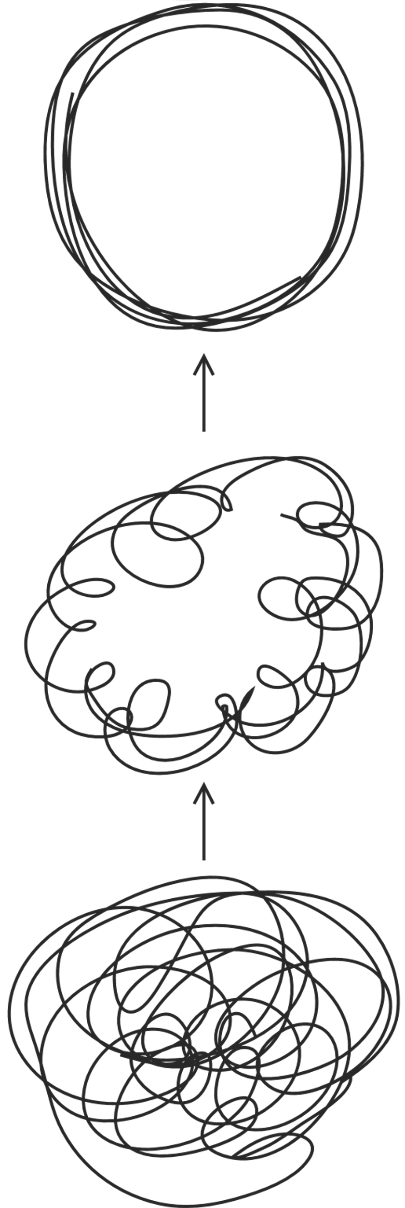


Existing evidence
The Problem
Expert
opinion
Solution
Guidelines & recommendations
Theories & frameworks

Slide 3

The problem (and the solution) depends on your perspective

Slide 4












Existing evidence
Expert opinion
The Problem
Solution
Guidelines & recommendations
Theories & frameworks

Slide 5
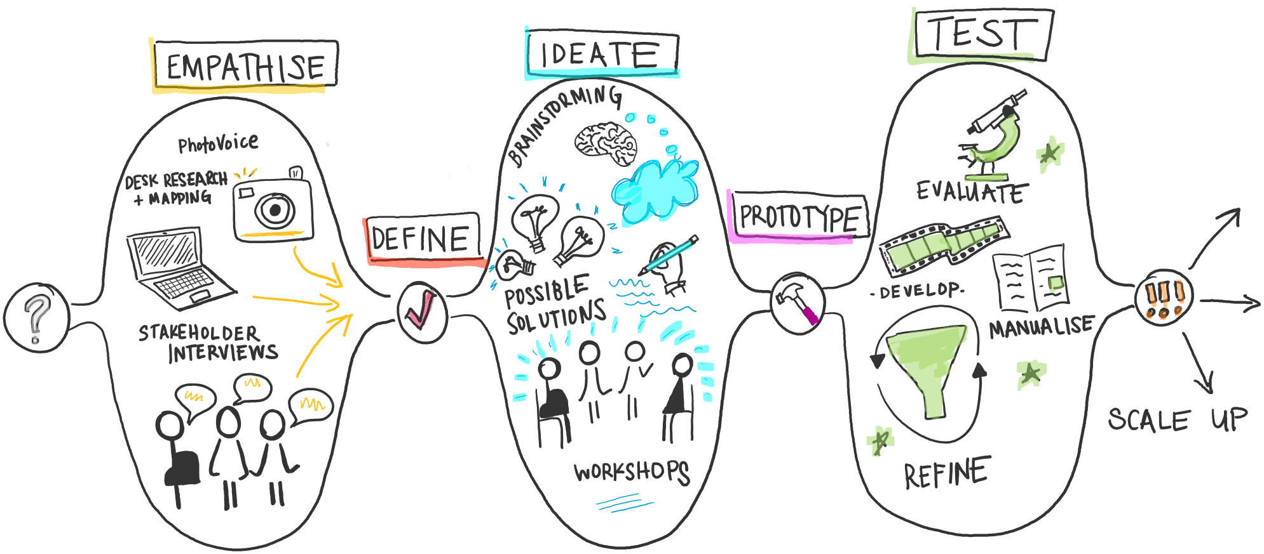
HUMAN-CENTRED DESIGN APPROACH

Slide 6



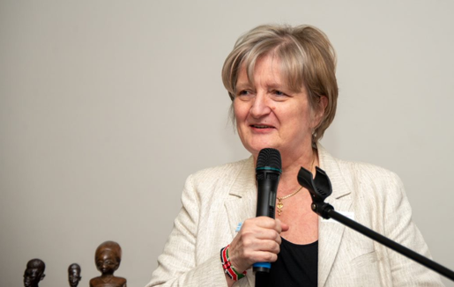


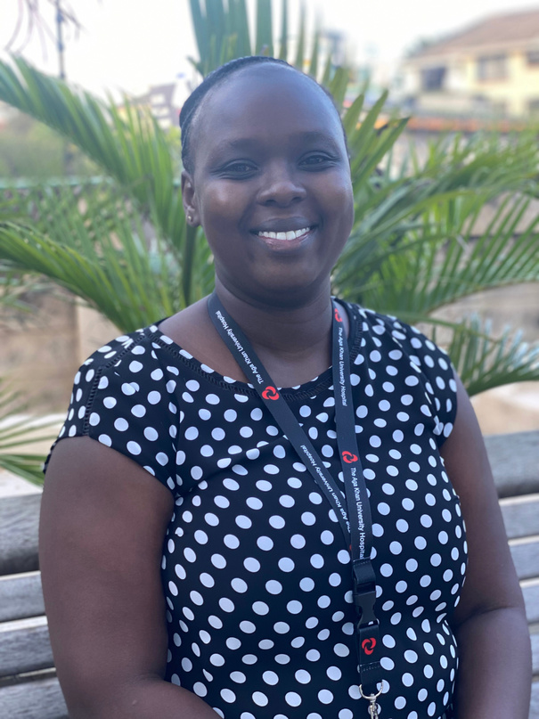



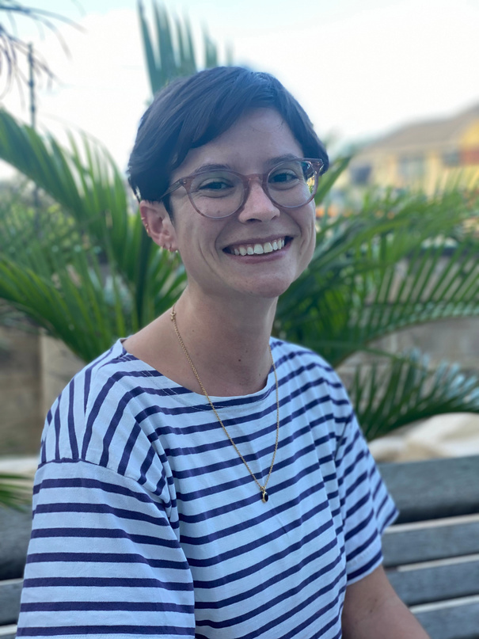
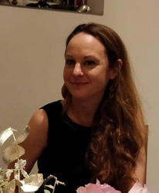
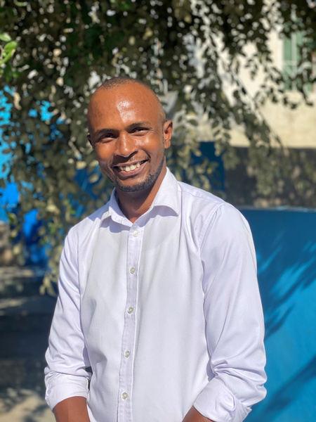


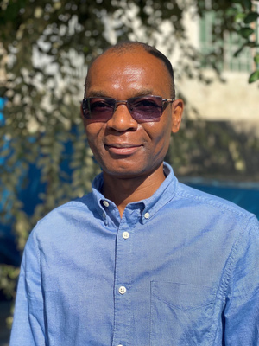


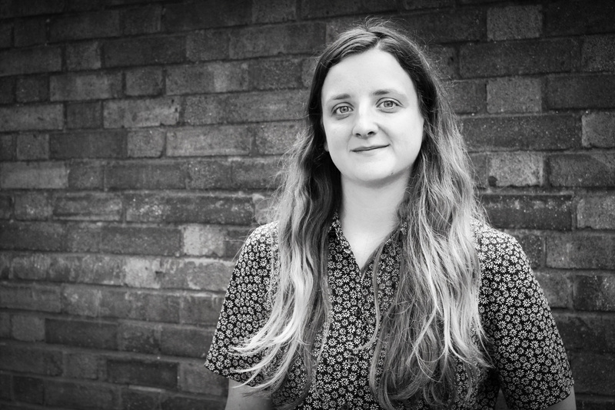





INSPIRE aims partner with girls, their families and communities to develop and test interventions to prevent adolescent perinatal mental health conditions in Mozambique and Kenya

Slide 7











56
adolescents girls &young women
We have partnered with 163 stakeholders since October 2021
55
partners & family members
20
service
providers
32
community leaders

Slide 8











IDENTIFIED PRIORITIES
Understanding of pregnancy & contraception
Dealing with stigma
Getting good antenatal care
Having a say about what happens to me and my baby
Having good relationships with family & friends
Going back to school/ Finding a job
Having enough money to pay for essentials
Knowing how to care for my baby

Slide 9
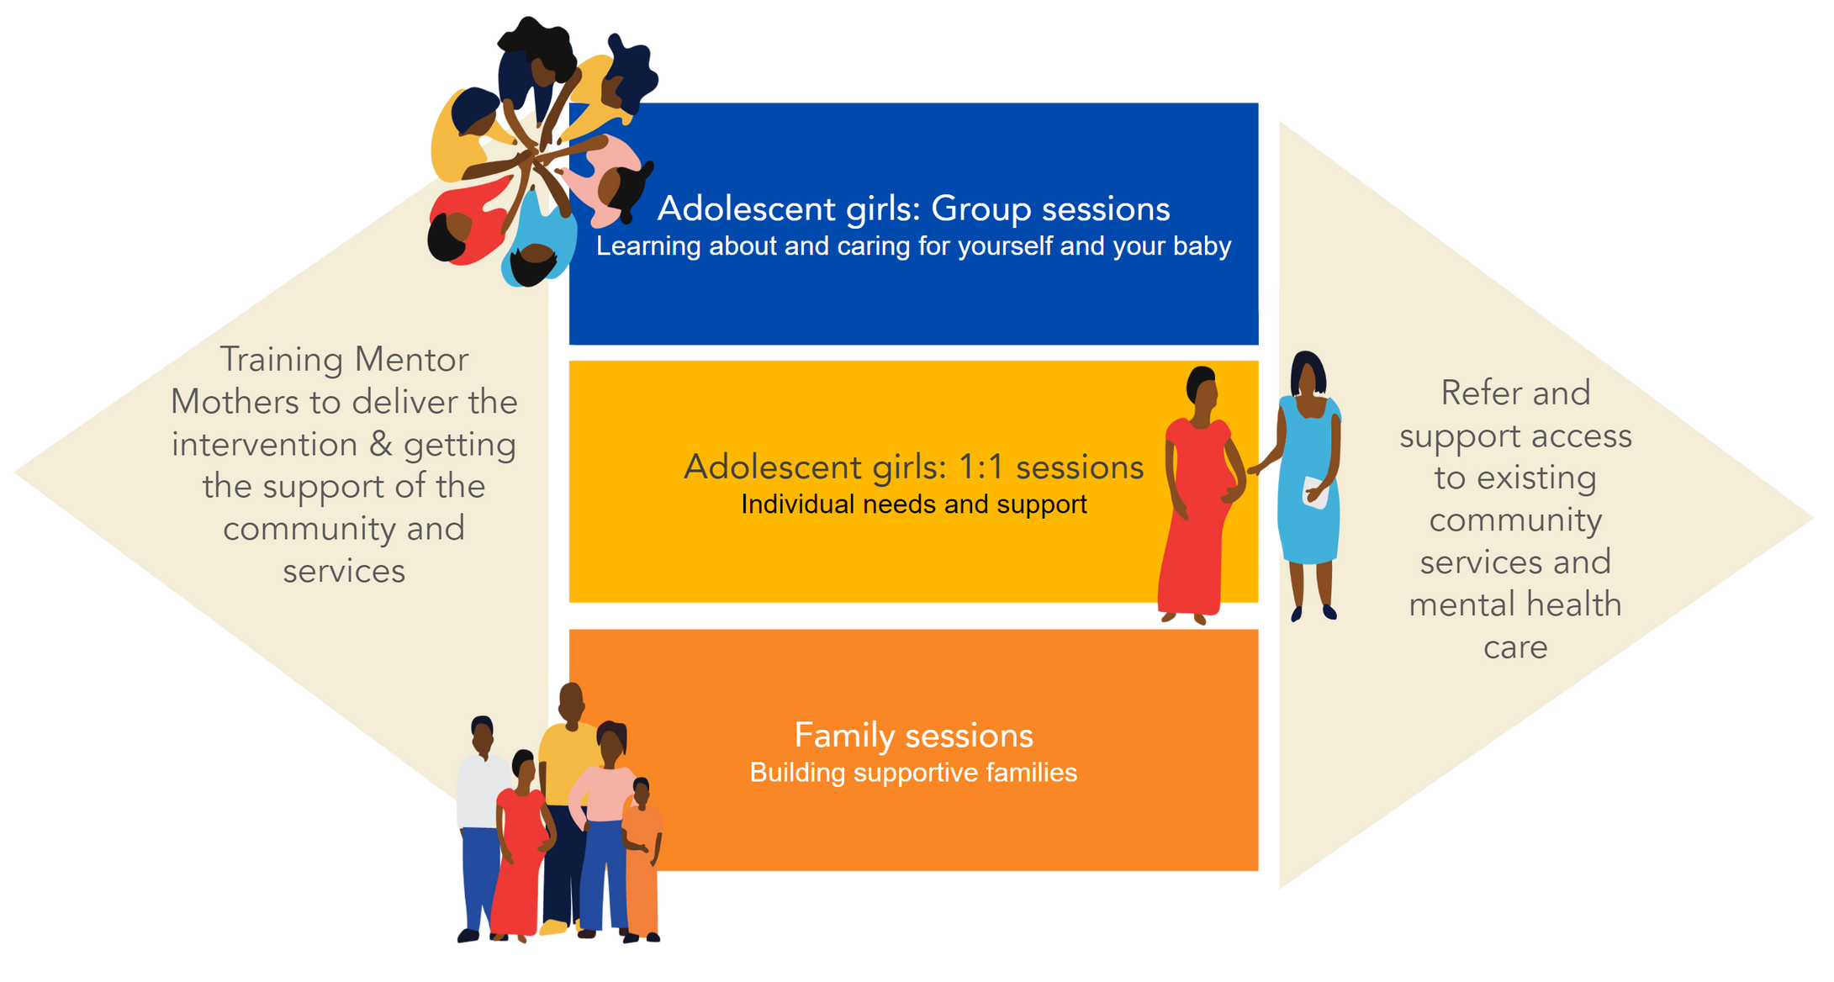
THE THRIVING MAMAS PROGRAMME

Slide 10
