Slide 1
Mental health in global development policy: Victories and unfinished business
Prof Crick Lund
Festschrift conference for Prof Sir Graham Thornicroft
Local and Global Mental Health: So Near and So Far
London, 12 March 2024

Slide 2
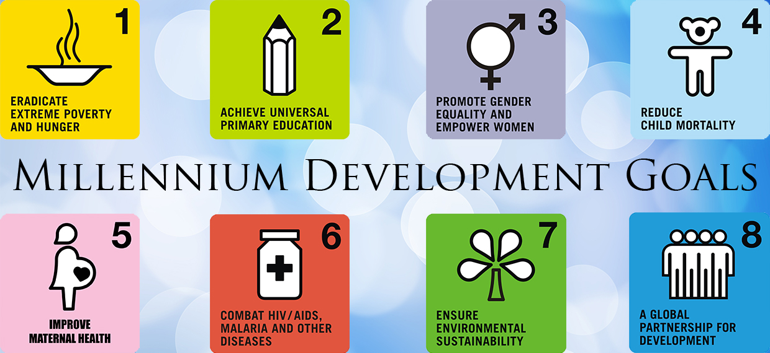
Mental health (not) in the Millennium Development Goals
Environmental…
Governmental
Intergovernmental…
…but no mental health!

Slide 3
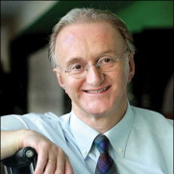
#FundamentalSDG A campaign to include mental health in the Sustainable Development Goals

Slide 4
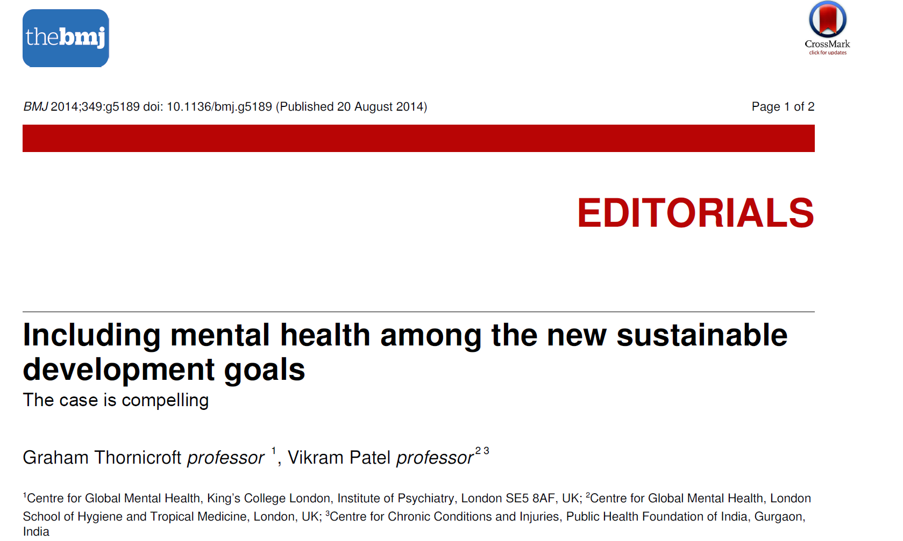
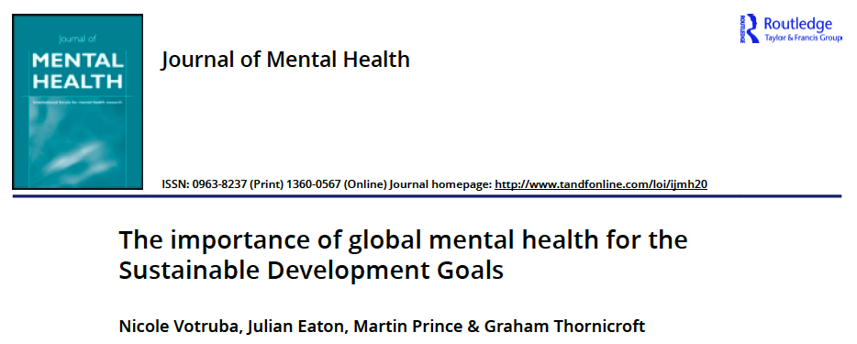

Slide 5
#FundamentalSDG was supported by:
>70 organisations
>400 individuals
SDG Lead (Amina J Mohammed)
Notes:
Achievements
In this short time we managed to get support of international organisations, NGOs, companies, and individuals
World Psychiatric Association (WPA), World Medical Association (WMA)

Slide 7
…and 11 UN Member states
Barbados
Notes:
And several countries expressed their support

Slide 10
Notes:
… then lead on to what happened to Mental Health?
Unsure about the policy process..

Slide 11
Mental Health
is included!

Slide 12
Declaration: Preamble
§ 7
To promote physical and mental health and well-being, and to extend life expectancy for all, we must achieve universal health coverage and access to quality health care.
§ 26
We are committed to the prevention and treatment of NCDs, including behavioural, developmental and neurological disorders, which constitute a major challenge for sustainable development

Slide 13
Target 3.4 - By 2030, reduce by one third premature mortality from non-communicable diseases through prevention and treatment and promote mental health and well-being
Target 3.5 - Strengthen the prevention and treatment of substance abuse, including narcotic drug abuse and harmful use of alcohol
Target 3.8 - Achieve universal health coverage, including financial risk protection, access to quality essential health-care services and access to safe, effective, quality and affordable essential medicines and vaccines for all
Notes:
The joint efforts of the Globla mental health community including the work of FMSDG

Slide 14
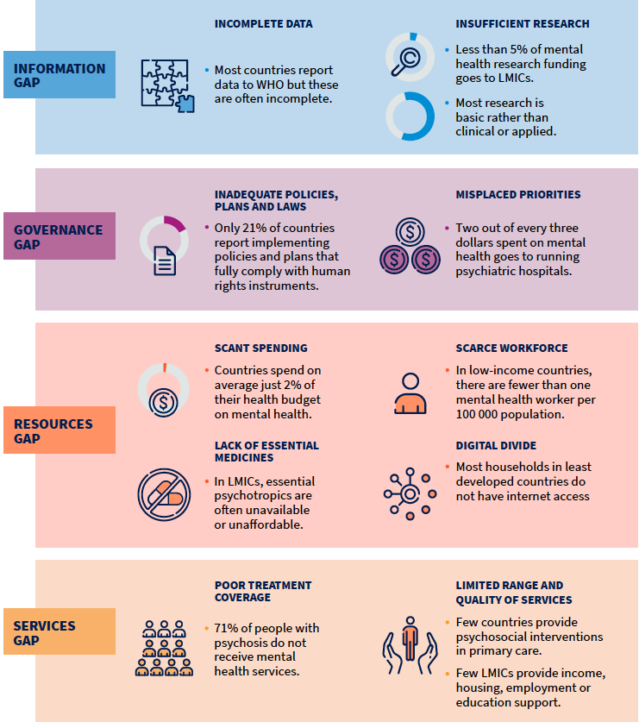
Unfinished business (1)
Woefully inadequate investments in mental health:
2% of national health budgets for mental health
<5% of mental health research funding goes to LMIC
21% of countries implement policies
71% treatment gap for psychosis
International development assistance poorly aligned with mental health needs
WHO (2022) World Mental Health Report.
Iemmi (2021) Global collective action in mental health financing. Social Science and Medicine.

Slide 15
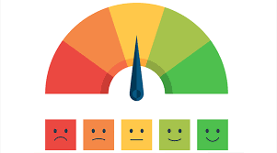
Unfinished business (2)
Finding the right indicators:
Current SDG indicators include suicide mortality rate, coverage of treatment for substance use conditions
What about coverage for severe mental health conditions?

Slide 16
Growing evidence on improvements in coverage in low resource settings

Slide 17
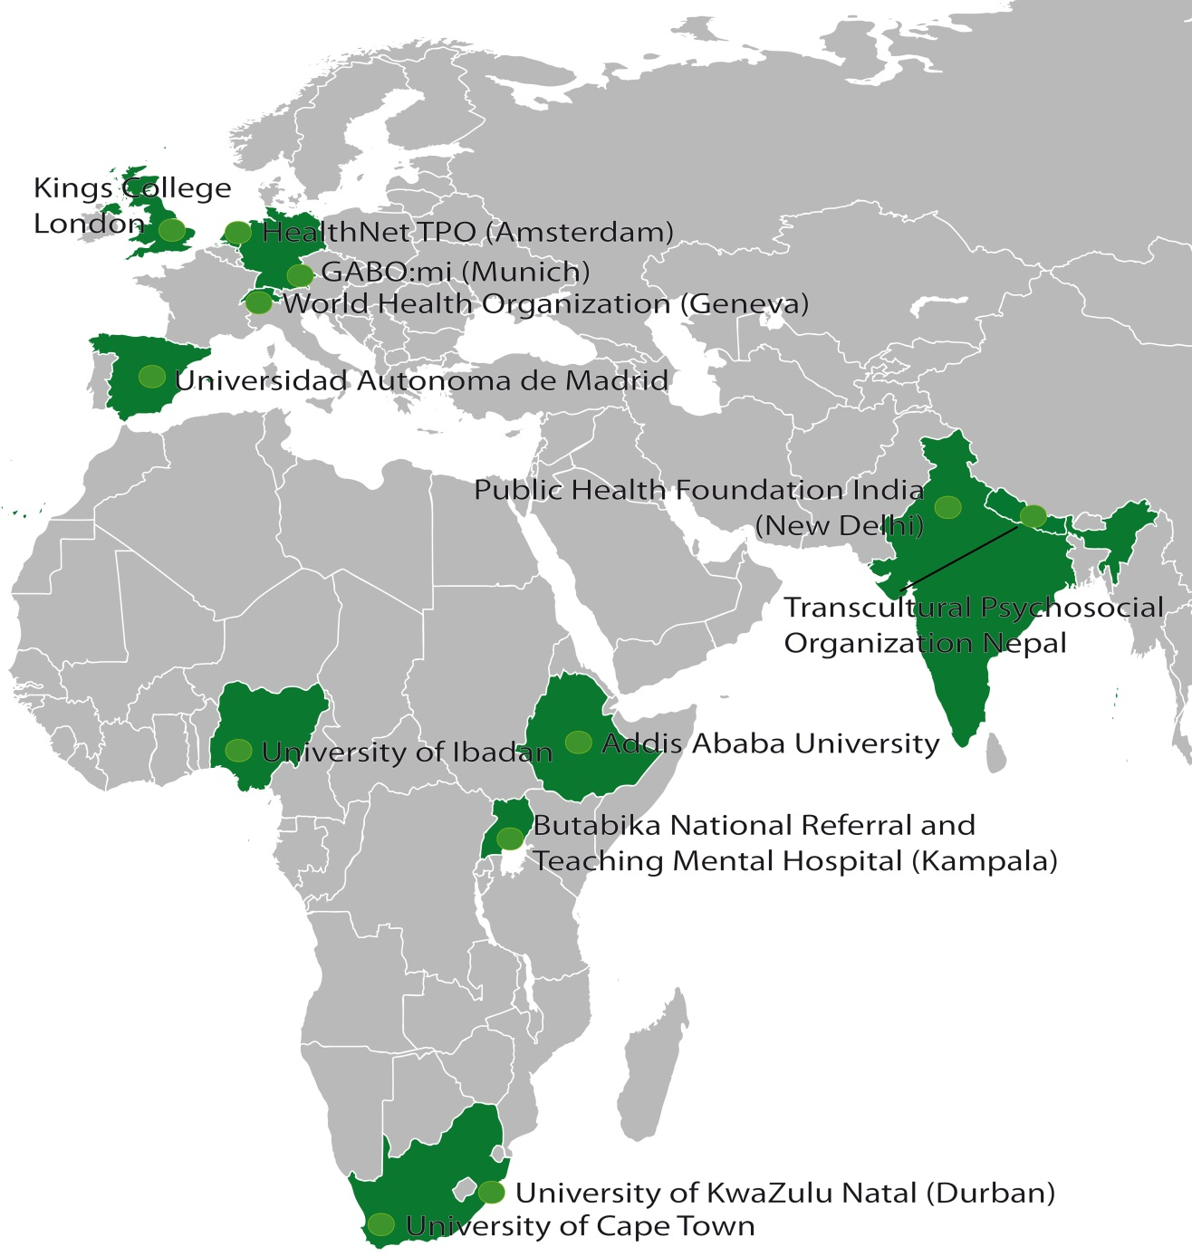
EMERALD partners and sites
2012-2017

Slide 18
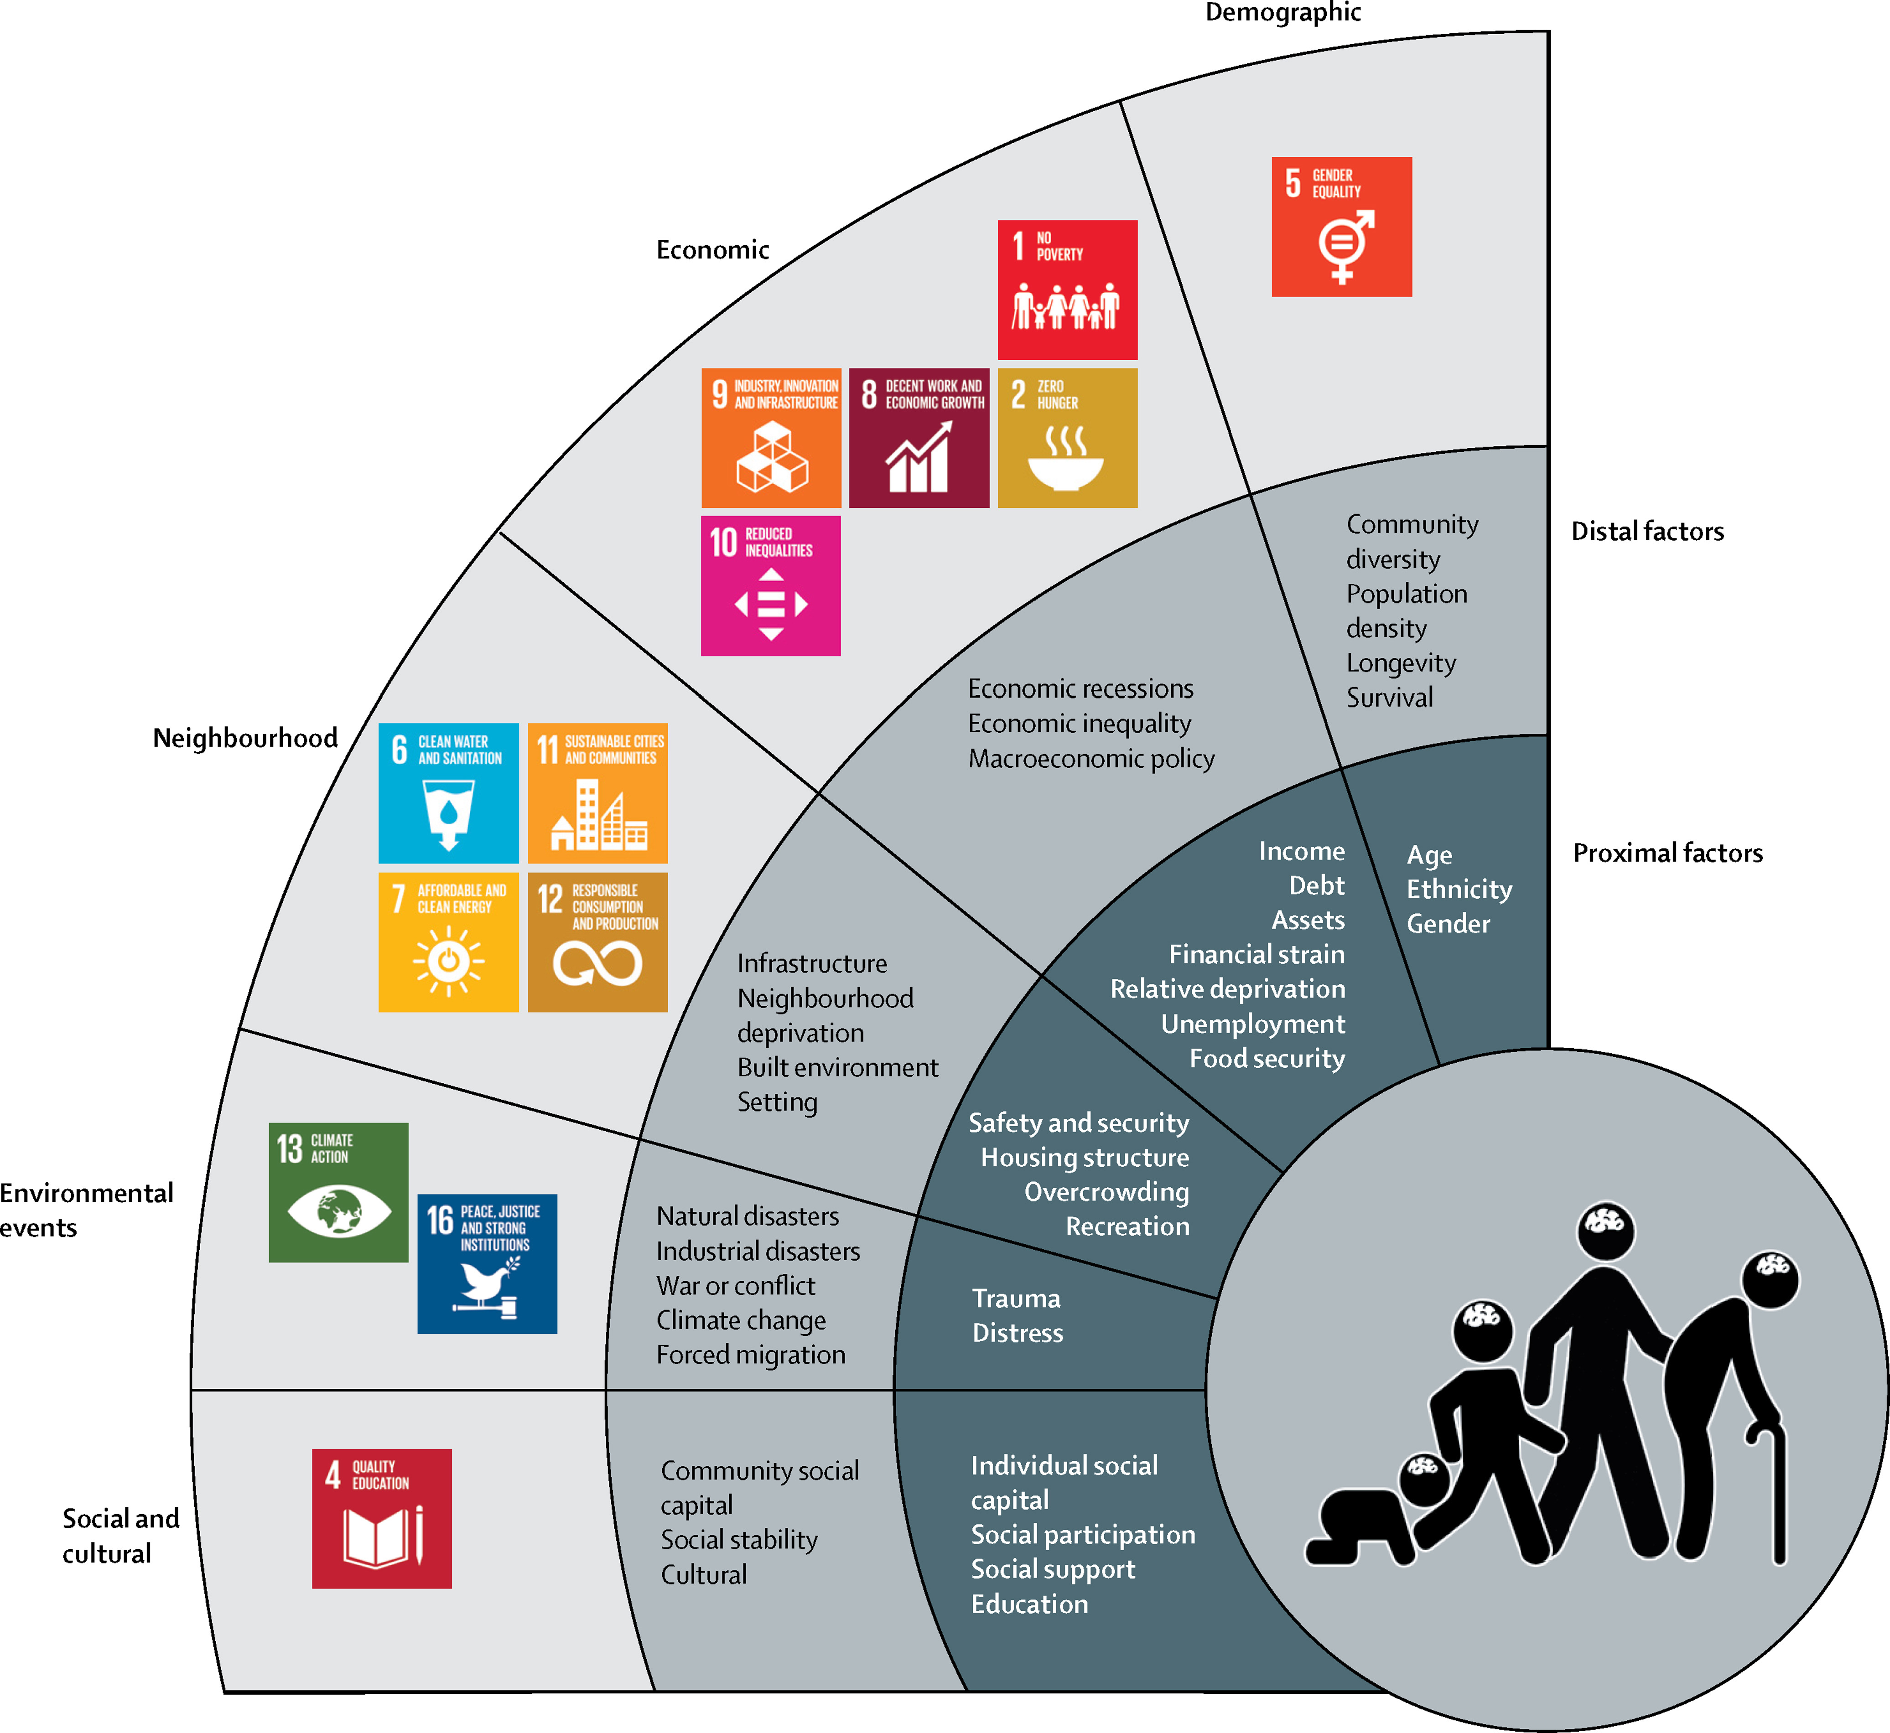
Unfinished business (3): Social determinants of mental health and the SDGs
Lund et al (2018) Social determinants of mental disorders and the sustainable development goals: a systematic review of reviews. Lancet Psychiatry. 5: 357-369.

Slide 19
…even more relevant in the COVID era
71-100 million people driven into extreme poverty
Widening income inequality
Food insecurity
Gender based violence
World Bank (2020) Global Outlook. Pandemic, Recession: the global economy in crisis. Washington DC: World Bank, June 2020.

Slide 20
Growing consensus on priorities for interventions to address social determinants
Academy of Medical Sciences and Inter-Academy partnership meeting on social determinants of GMH (Oct/Nov 2019) identified intervention priorities by domain:
Demographic
Economic
Neighbourhood
Environmental events
Social/cultural
Rose-Clarke et al (2020). Rethinking research on the social determinants of global mental health. Lancet Psychiatry. 7: 659-662. https://doi.org/10.1016/S2215-0366(20)30134-6.

Slide 21
Research gaps and intervention priorities:
AMS workshop, 2019
Social Determinants Domain | Research gaps | Intervention priorities
Demographic | Longitudinal data to identify causality | Reduce gender-based violence
Economic | Economic drivers of mental health | Social protection eg cash transfers
Neighbourhood | Mechanisms by which neighbourhood characteristics influence mental health | Urban renewal
Environmental events | Role of resilience in adverse events and disaster risk reduction | Disaster response
Social/cultural | Causal pathways from socio-cultural determinants to mental health | Social capital/trust Education
Rose-Clarke et al (2020). Rethinking research on the social determinants of global mental health. Lancet Psychiatry. 7: 659-662. https://doi.org/10.1016/S2215-0366(20)30134-6.

Slide 22
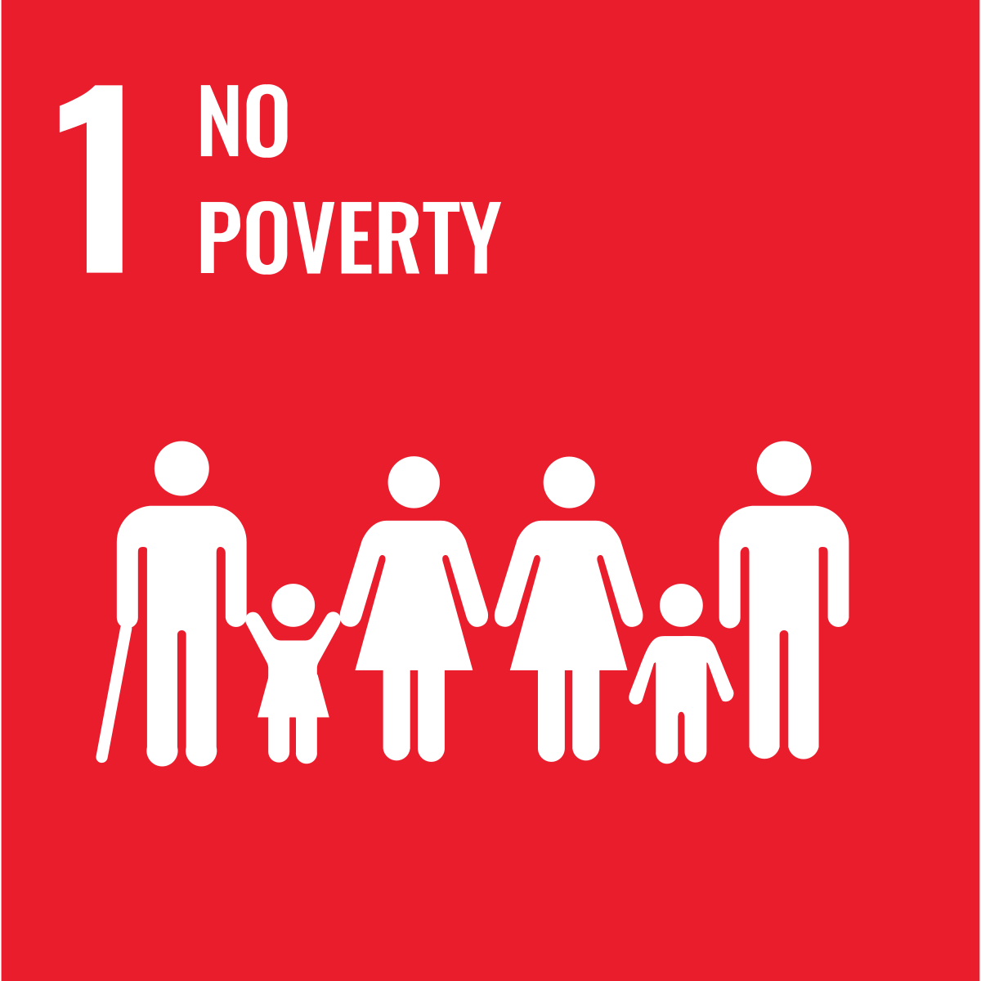
Growing evidence for interventions that address social determinants¹
1. Oswald et al (in press) Public mental health interventions targeting the UN Sustainable Development Goals. Psychol Med.
economic domain – 24 reviews
Determinants:
Income
Debt / Assets
Financial strain
Unemployment
Relative deprivation
Interventions:
Increasing employment
Improving employment conditions
Poverty alleviation (e.g., cash transfers)
Key Findings:
Cash transfers in LMICs
Cash transfers were found to offer the greatest potential benefits for mental health in LMICs, but some conditionalities may increase stress.
Future research should look at implementing CTs in HICs and pay close attention to the impact of cash amounts and conditionalities on outcomes
Increasing employment & employment conditions
In HICs, improved work schedules for healthcare workers, the Workplace Triple P Program for working parents, and Job Clubs for unemployed individuals offer mental health benefits, although may not generalise, given diverse national policies, labour markets, and welfare systems.
UN SDGs:
Key Gaps:
CTs in HICs
Income inequality
Employment precarity
Role of gender
Notes:
Examples of economic determinants of mental health: income, debt, assets, financial strain, unemployment, relative deprivation.
Relevant Sustainable Development Goals include SDG 1 (no poverty by 2030) and SDG 10 (reduced inequalities by 2030).
The interventions we identified which mapped onto these determinants were around:
Increasing employment
Improving employment conditions
And poverty alleviation (for example cash transfer interventions)
Most reviews were rated as high quality in this domain.
Key findings, from the reviews which were moderate or high quality:
CASH TRANSFERS IN LMICS:
Cash transfers were found to offer the greatest potential benefits for mental health in LMICs, but some conditionalities may increase stress.
Future research should look at implementing CTs in HICs and pay close attention to the impact of cash amounts and conditionalities on outcomes
INCREASING EMPLOYMENT & EMPLOYMENT CONDITIONS:
In HICs, improved work schedules for healthcare workers, the Workplace Triple P Program for working parents, and Job Clubs for unemployed individuals offer mental health benefits, although may not generalise, given diverse national policies, labour markets, and welfare systems.
Key gaps identified through our work:
We failed to identify any reviews which looked at CTs in HICs, which is an important gap given widening economic inequalities in HICs.
We didn’t find any reviews looking at interventions or programs to reduce income inequality, or address employment precarity (which is increasingly common and can be as stressful as unemployment).
Most of the studies identified in this domain failed to consider the role of gender, which appears to be important.

Slide 23
Unfinished business (4). Improved ‘Whole of society’ development indicators for mental health in Countdown GMH 2030
Framework components
A
Determinants of mental health
B
C
Factors shaping the strength of the mental health system (supply)
Factors shaping the demand
for mental health care
Framework sub-components
A.1: Society / family situation
A.2: Economic conditions
A.3: Educational situation
A.4: Physical health situation
A.5: Conflict / displacement
A.6: Environmental conditions
A.7: Severity of the COVID-19 pandemic
B.1: Attitudes to mental health
B.2: Burden of mental health conditions
B.3: Financial accessibility of mental health care
C.1: Mental health service levels
C.2: Mental health human resource levels
C.3: Mental health service quality
C.4: Integration of mental health into other services and programmes
C.5: Sustainable financing for and efficient spend on mental health
C.6: Laws, policies and leadership in mental health
C.7: Promotion of good mental health and prevention of poor mental health
C.8: Monitoring and evaluation for mental health
C.9: Research in mental health
https://unitedgmh.org/knowledge-hub/countdown2030/

Slide 24
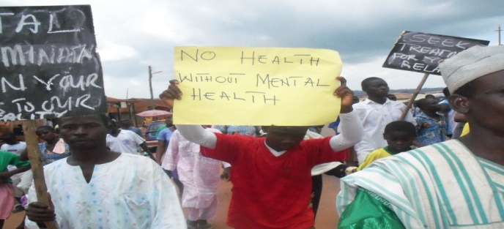
Unfinished business (5)
Global advocacy led by people with lived experience

Slide 25
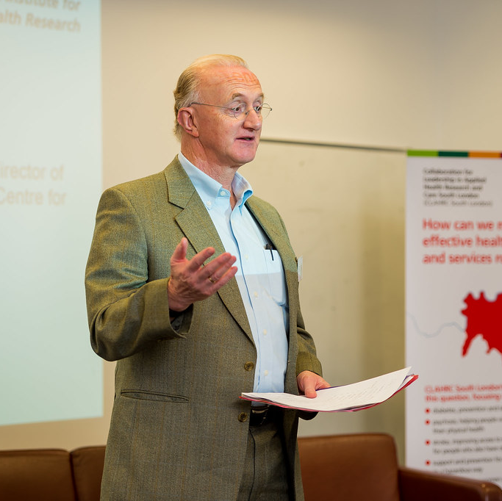
Unfinished business (6)
Taking forward the legacy of Prof Sir Graham Thornicroft

Slide 26
Funding acknowledgements

