Slide 1
Applied Health Research
Festschrift Conference for Professor Sir Graham Thornicroft
Local and Global Mental Health: So Near and So Far 11th March 2024
Jane Sandall CBE
Co-theme lead Maternity and Perinatal Mental Health
Professor of Social Science and Women’s Health
Department of Women and Children’s Health
Faculty of Life Course and Population Sciences and Medicine
King’s College, London

Slide 2
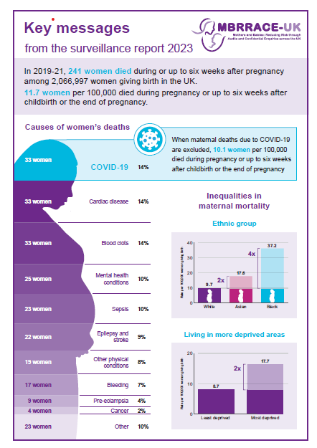
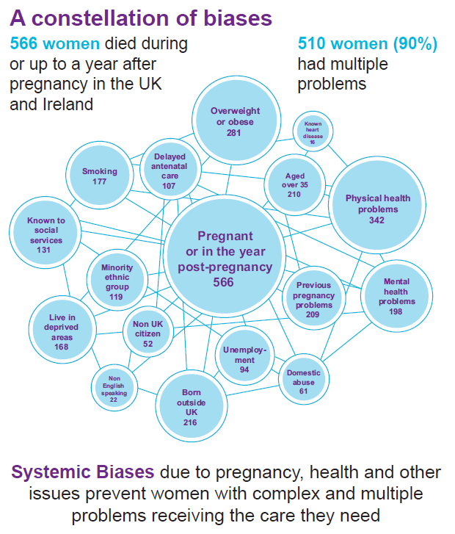
2020

Slide 3
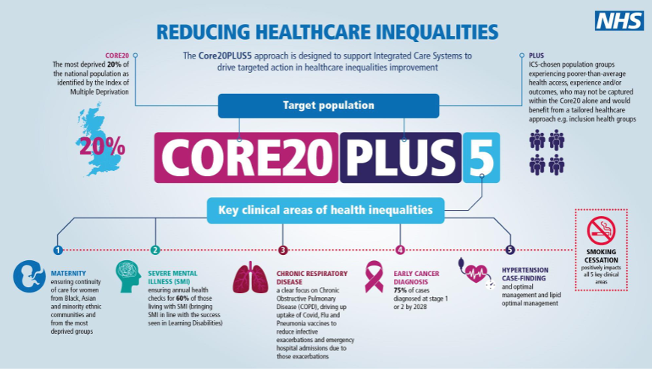
National and Local Policy and Health Need
NHS Long term plan
By 2023/24 access to perinatal mental health services to benefit an additional 24,000 women per year
Care provided by specialist perinatal mental health services will be available from preconception to 24 months after birth
‘Maternity outreach’ clinics will integrate maternity, reproductive health & psychological therapy for women experiencing mental health difficulties
Core20plus5, three year delivery plan, women’s health strategy
Improve personalised care and equity for mothers and babies
Midwife community-based continuity of care targeted to women from minoritized ethnic groups or living in areas of social deprivation who have the highest risk of poorest outcomes

Slide 4
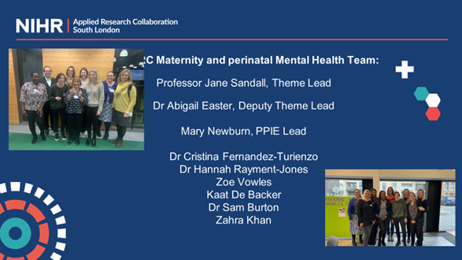
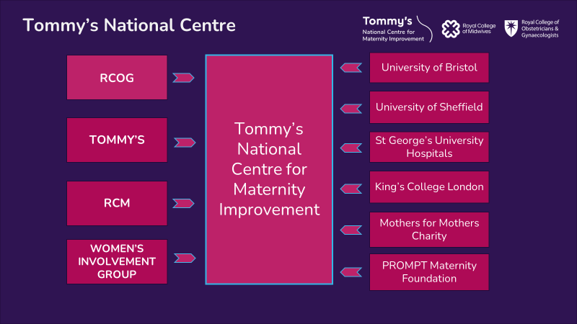
Maternal and Perinatal Systems and Policy Research Group
Our research is focused on two areas: healthcare quality and safety with a focus on novel innovations in health technologies and health system and service care delivery.
We focus on disparities in health and women with social, perinatal mental health and medical complexity.
Cross cutting themes include implementation research and complex intervention trials, evidence synthesis, realist research and data science.
Multidisciplinary – social science and clinical research
Research funding - NIHR, Tommys, Sir Halley Stewart Trust, KHP, Action Medical Research
Three research centres

Slide 5
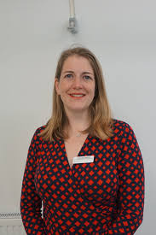
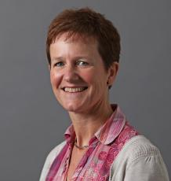
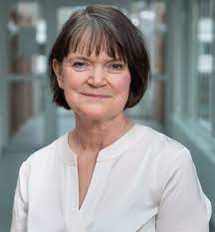
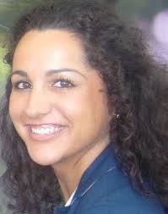
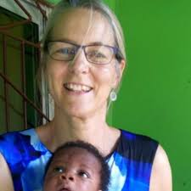
Thank you to all

Slide 6
Why is continuity of care important in health care?
Concept of continuity of care is rooted in primary care and involves care over time by the same care provider/s to improve personalised integrated care.
Continuity of care between primary care physicians and their patients is associated with:
better patient outcomes
diagnostic accuracy
improved patient satisfaction
fewer emergency department visits
fewer hospital admissions
better care co-ordination
reduced mortality
lower or more appropriate use of services
More humanised personal care

Slide 7
Why co-ordination of care is important
Improving coordination can sometimes save
resources and also improve quality.
Depends on which improvement is used, how it is implemented, and features of the health system, such as financing arrangements.
Those who suffer most from under-coordination are people who are poor, vulnerable and/or members of minority ethnic groups.
The needs of these groups have been neglected in research as well as within healthcare systems.

Slide 8
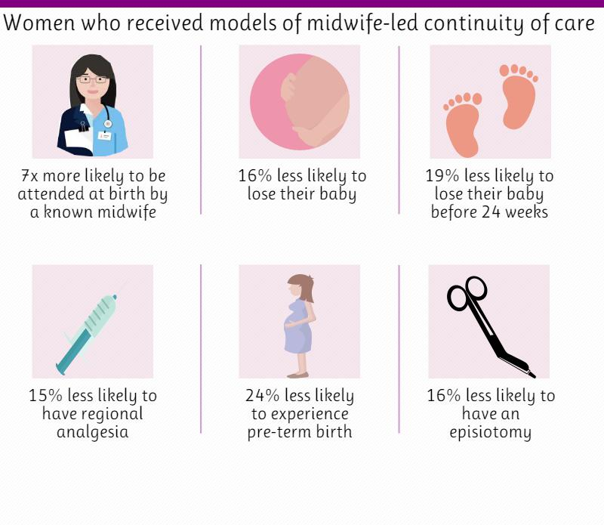
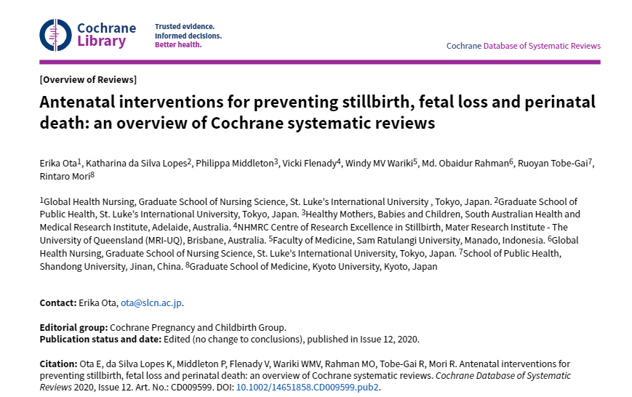
Why is continuity important in Maternity care?

Slide 9
Evaluating place-based models of maternity care for women living in an area of ethnic diversity and social disadvantage Dr Cristina Fernadez-Turienzo, Zahra Khan, Zoe Vowles, Dr Sam Burton Prof Jane Sandall
Do community placed based models1 of continuity of midwifery care improve pregnancy and birth outcomes and experience for socially disadvantaged and women from diverse ethnic groups in South London?
What are the processes and challenges to implementing and sustaining these models to meet the needs of this population?
https://www.england.nhs.uk/ltphimenu/placed-based-approaches-to-reducing-health-inequalities/place-based-approaches-for-reducing-health-inequalities/

Slide 10
LEAP Community based: care provided out of a central Brixton children’s centre Clients benefit from well-established referral pathways into wider LEAP and non-LEAP support (e.g., breastfeeding peer support; enhanced domestic abuse support; support with parent-infant relationships; community food support; etc.)
REACH
~600 LEAP babies since mid-2018
90% of LEAP caseload clients live in areas of greatest deprivation
62% of LEAP caseload clients identify their ethnicity as not white
Most common social risk factors include mild to moderate mental health problems, social care involvement, domestic violence, refugee status and survivors of childhood sexual abuse
https://www.england.nhs.uk/ltphimenu/placed-based-approaches-to-reducing-health-inequalities/place-based-approaches-for-reducing-health-inequalities/

Slide 11
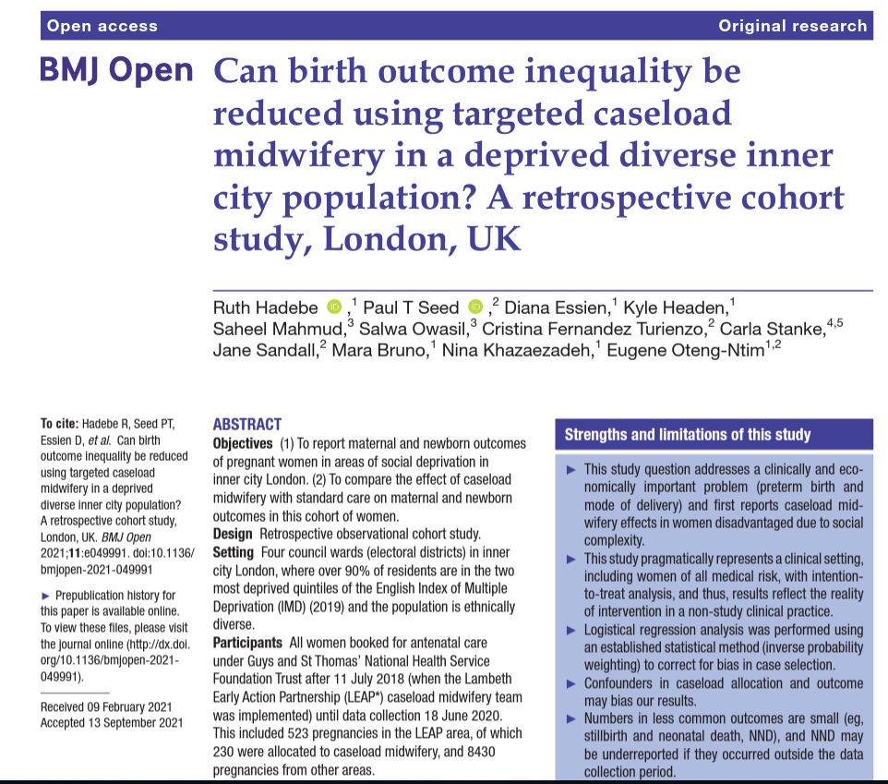
LEAP outcomes
Significant reduction in preterm birth rates in women
allocated to caseload midwifery care, when compared
with women who received traditional midwifery care
(5.1% vs 11.2%)
Caesarean births were significantly reduced in women
allocated to caseload midwifery care, when compared
with traditional midwifery care (24.3% vs 38.0%),
including emergency caesarean deliveries
(15.2% vs 22.5%)
Limitations
Retrospective analysis, mechanism of action unclear
Notes:
Birth outcomes show positive changes included reduction in preterm birth and caesareans births for this group of women living in the LEAP patch and receiving caseload midwifery care

Slide 12
Component 1: eLIXIR project (maternity-child data linkage)
Eight community-based caseload teams (including LEAP) supporting pregnant women in most disadvantaged postcodes at GSTT/KCH
eLIXIR data linkage to compare outcomes between women and babies receiving these model of care and matched women receiving standard maternity care​
Analysis currently ongoing
Component 2: Qualitative study with staff & stakeholders
Qualitative study with stakeholders and healthcare providers to understand development, implementation, sustainability
Ongoing
Component 3: Longitudinal qualitative study
Longitudinal interviews only with LEAP women
Intersectionality approach
Ongoing

Slide 13
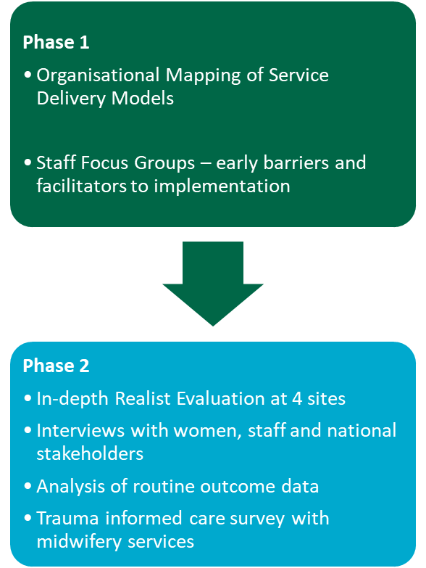
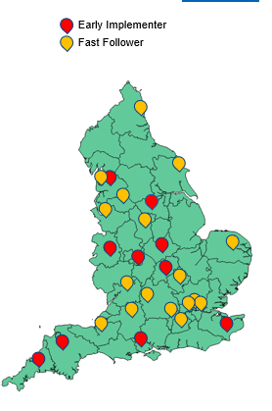
ESMI-III (Effective Implementation of Maternal Mental Health Services) Lead Dr Abigail Easter
MMHS are being established nationally as part of the NHS Long Term Plan
33 Early Implementer & Fast Follower sites
To improve mental health care for women with birth trauma, perinatal loss and bereavement
ESMI-III utilises a realist methodology to understand:
National variation in service models
How & why models work in different areas
Challenges & solutions to implementing MMHS in different contexts
Inform future sustainability and scale up of the services
Notes:
Abby ESMI study

Slide 14
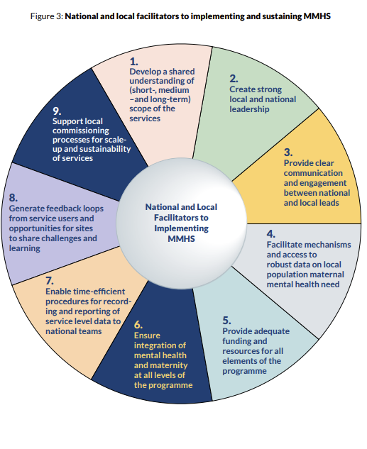
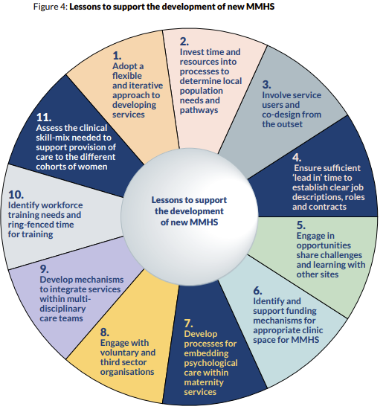
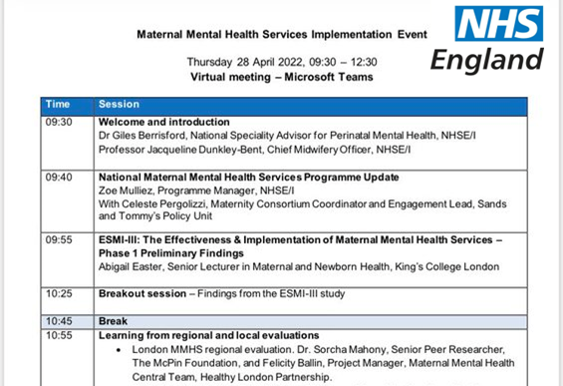
ESMI-III: Recommendations Integrated into National Guidance
Notes:
IMPACT: Phase 1 completed and integrated into NHS England Implementation Guidance
Additional funding received to continue the study until March 2025

Slide 15
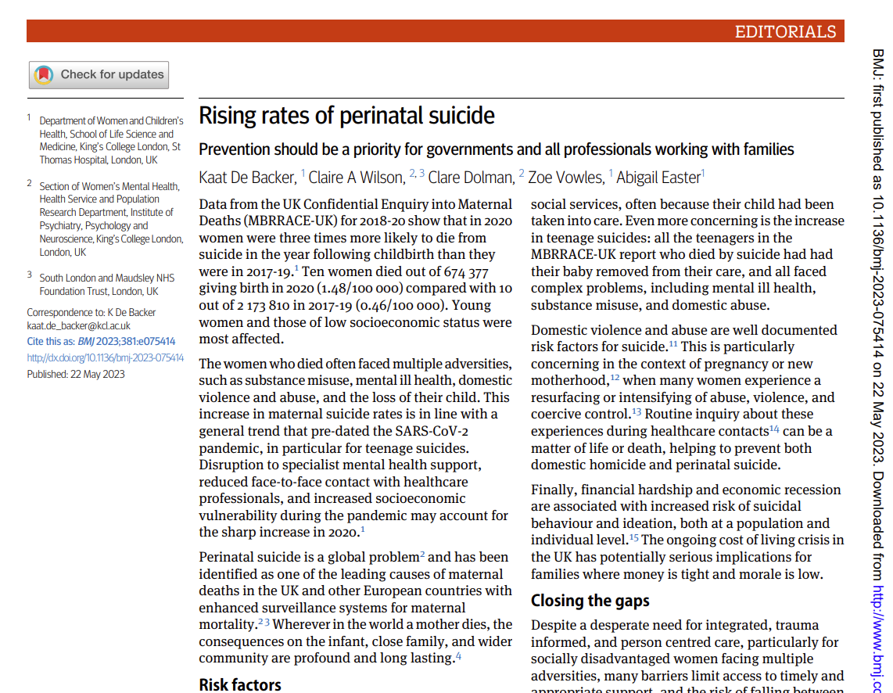
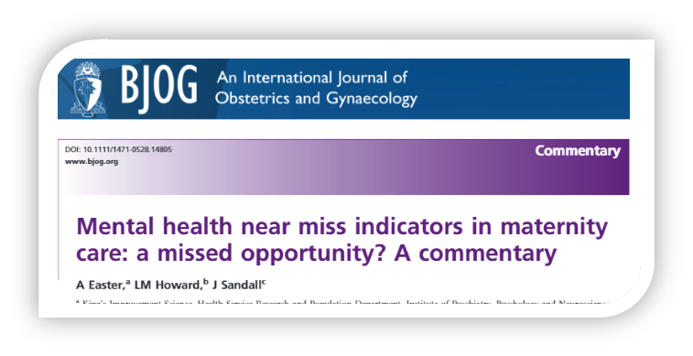
Obstetric & mental health near miss events in the perinatal period - Lead Dr Abigail Easter
Aim: Mixed-methods investigation of the rates & factors surrounding obstetric near misses and attempted suicides in the perinatal period
Data analysis using linked CRIS/HES data set has been analysed to investigate the rates of near misses and self-harm admissions
In-depth qualitative analysis of mental health records of 50 women
ASPEN Study (Attempted Suicide in the Perinatal Period)
In-depth qualitative study of women and significant others experiences, support and healthcare needs
Notes:
Planned policy/stakeholder event early 2024 to synthesise learning and recommendations

Slide 16
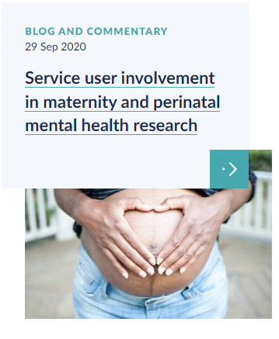
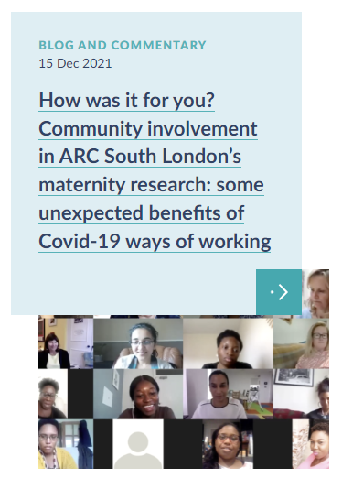
Patient and Public Involvement and Engagement
Community engagement and PPIE is at the heart of this research
Regular PPIE meetings
Dedicated PPIE blogs and publications
PPIE Network / Strategy Group
PPIE Network supported via WhatsApp group
Social media - Facebook, Twitter and Instagram
PPIE good practice
Participatory appraisal events
Mary Newburn, PPIE Lead

Slide 17
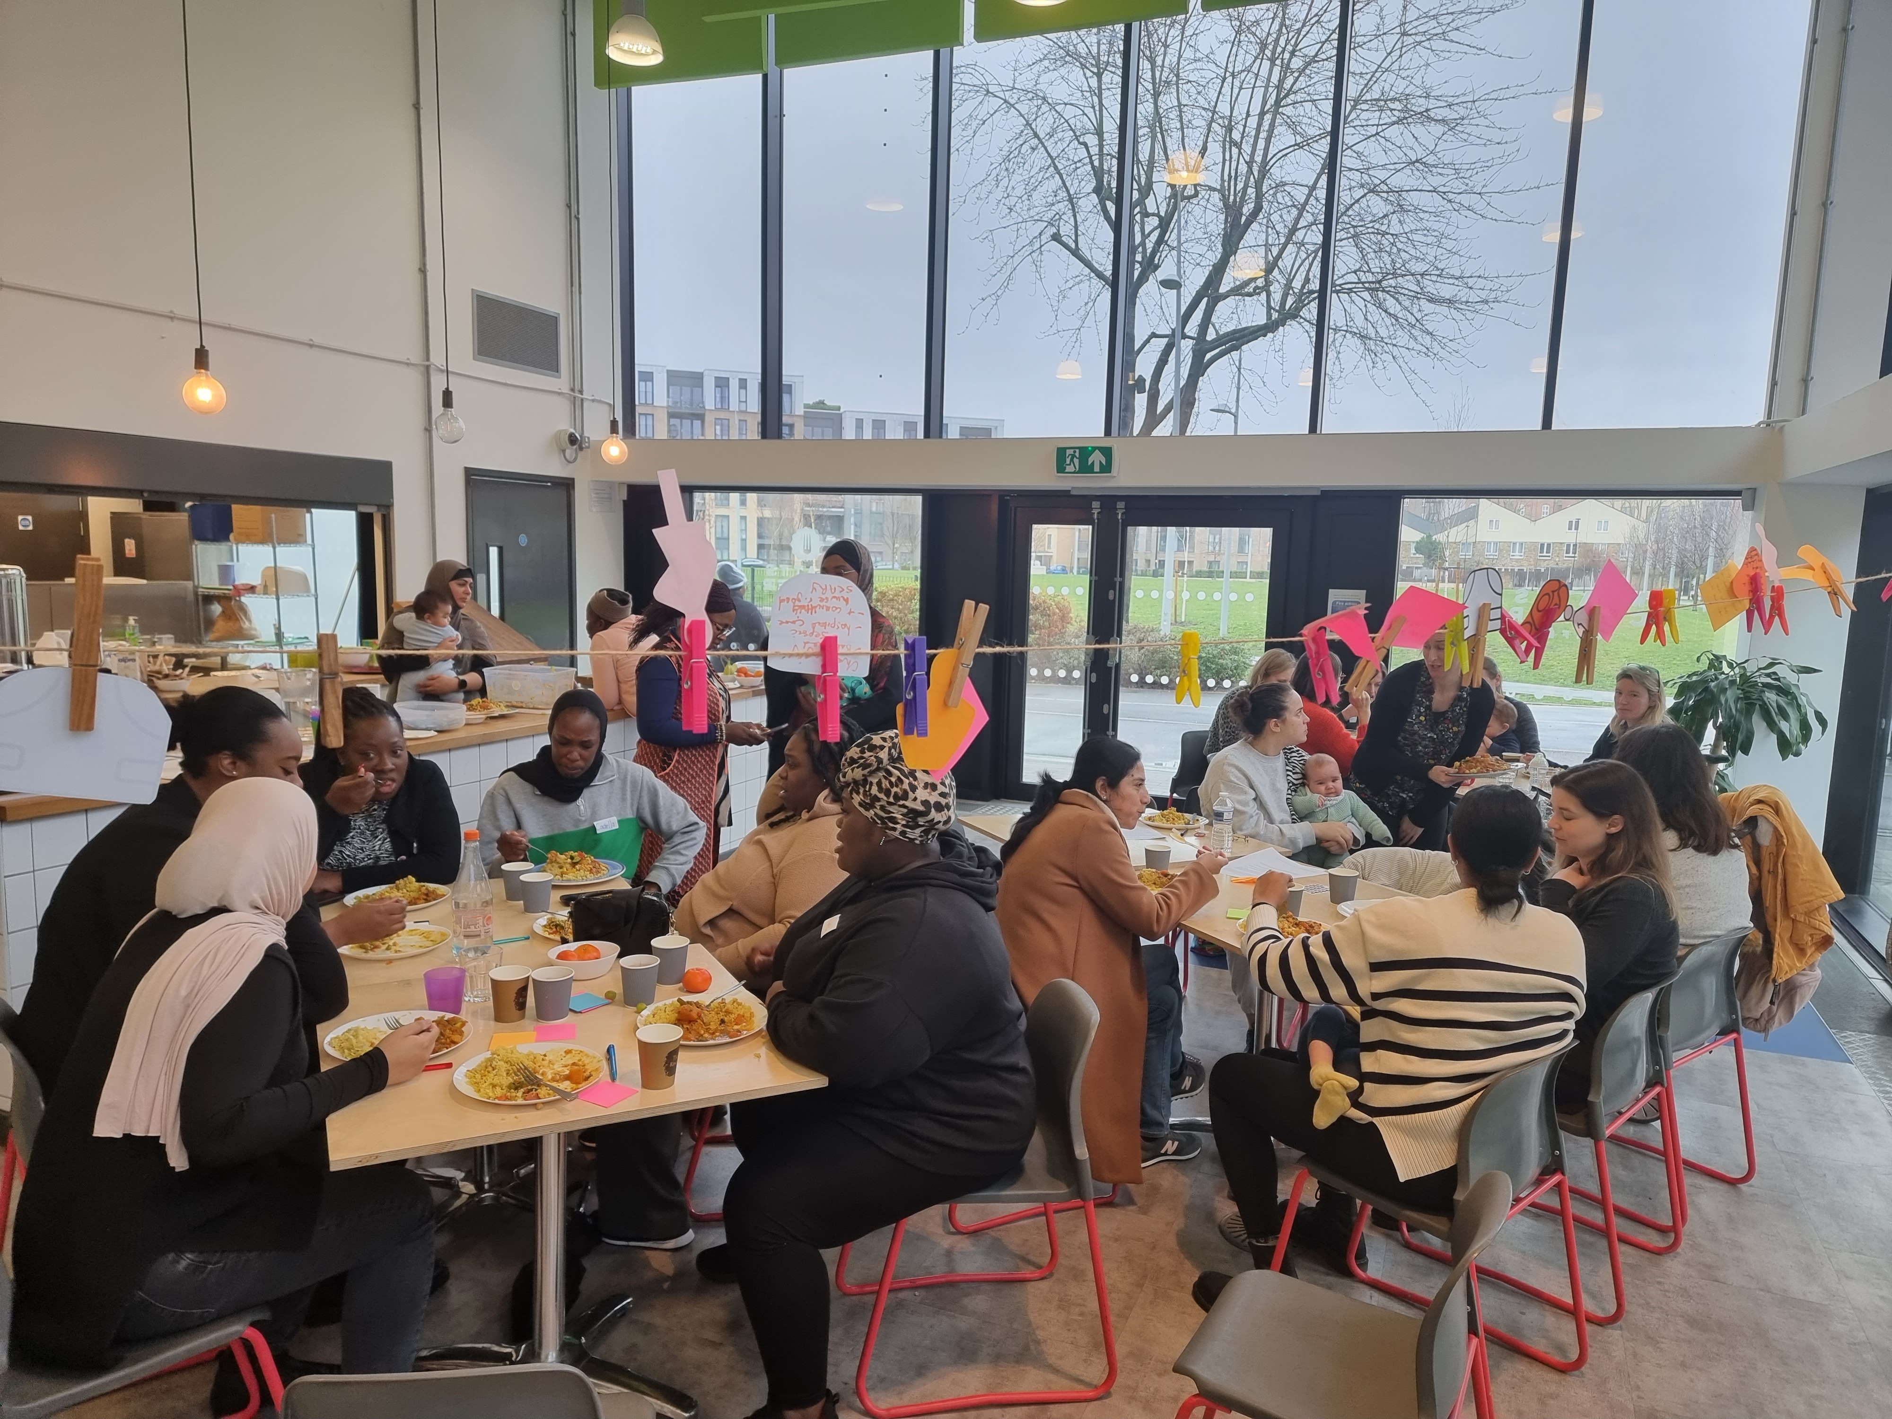
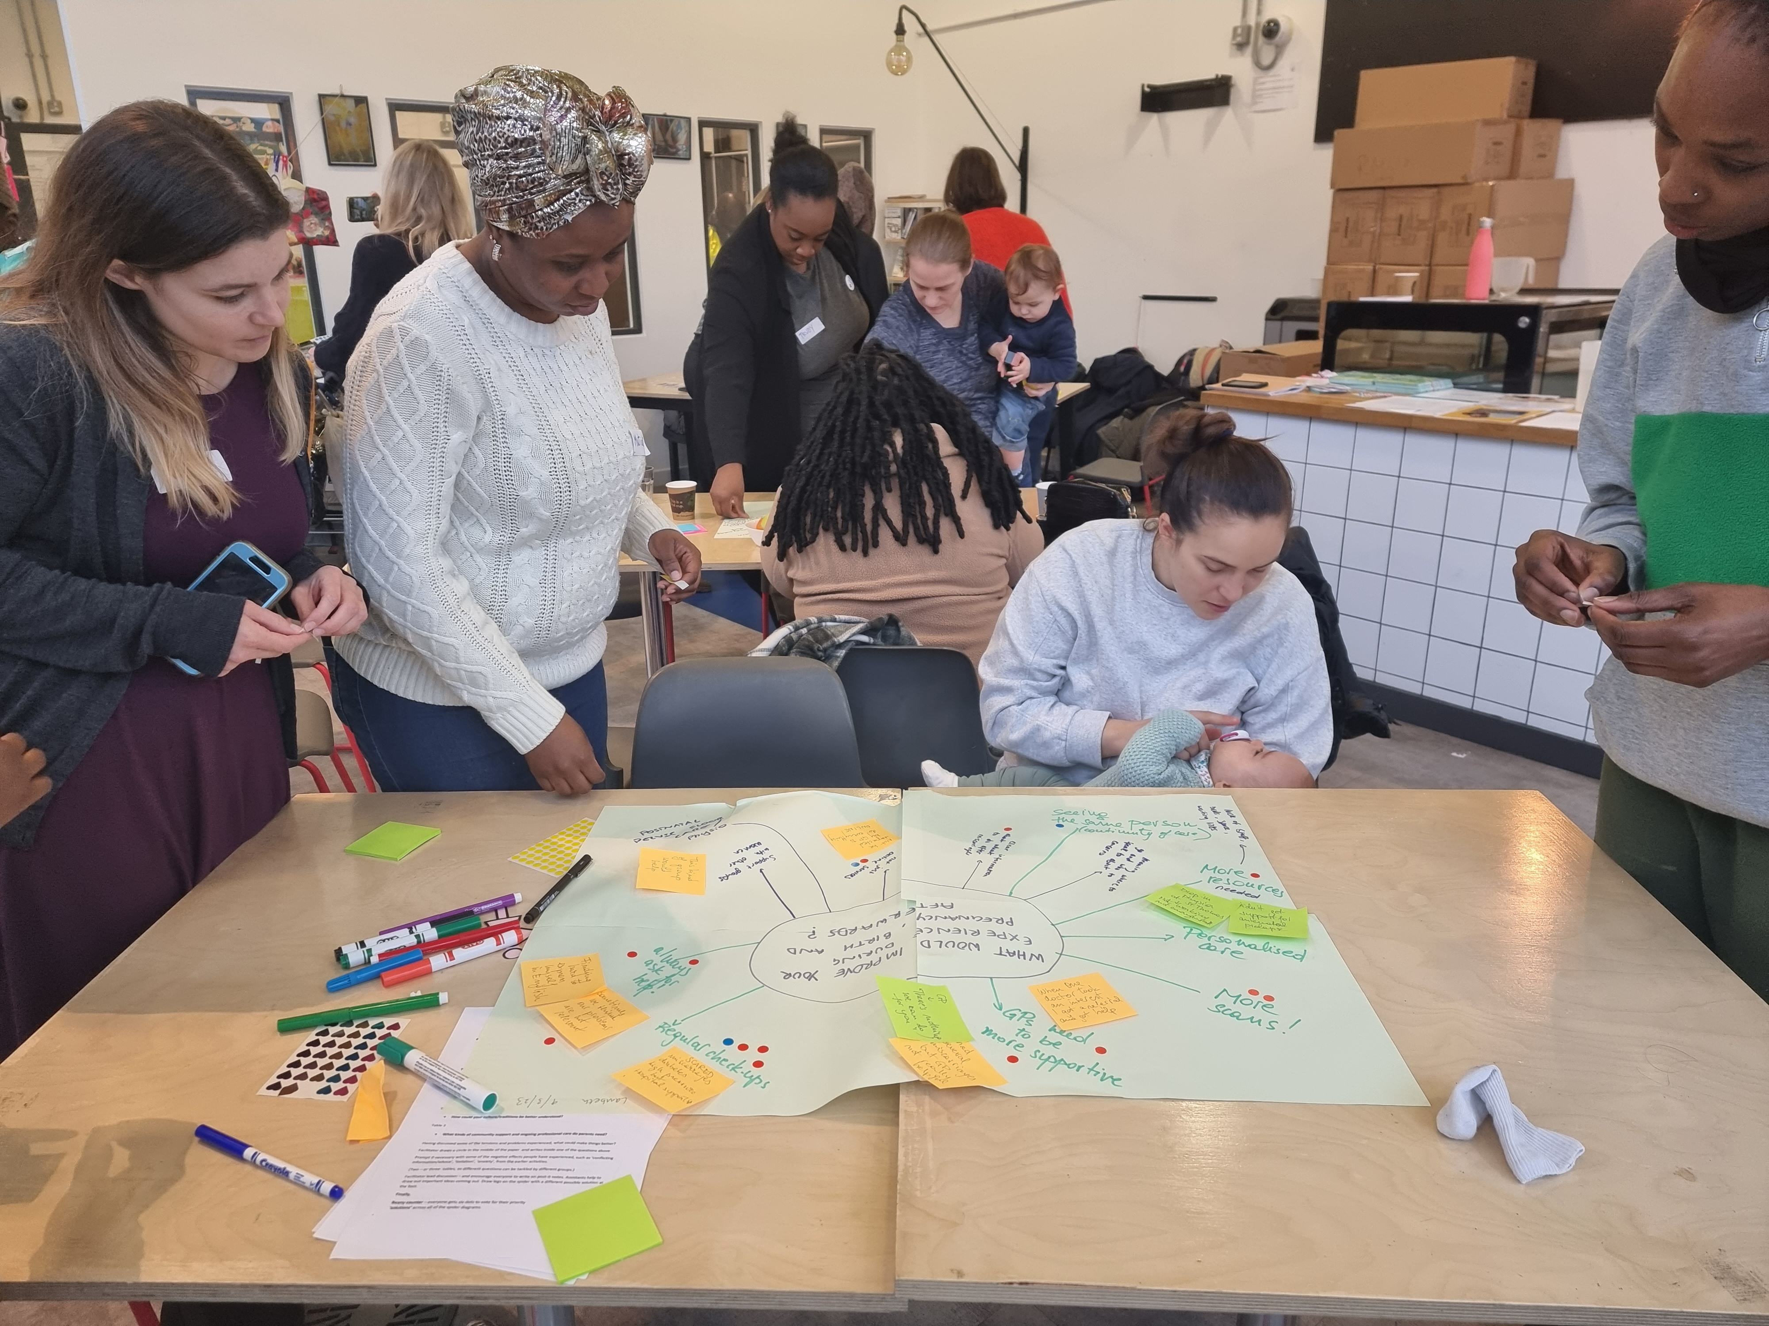
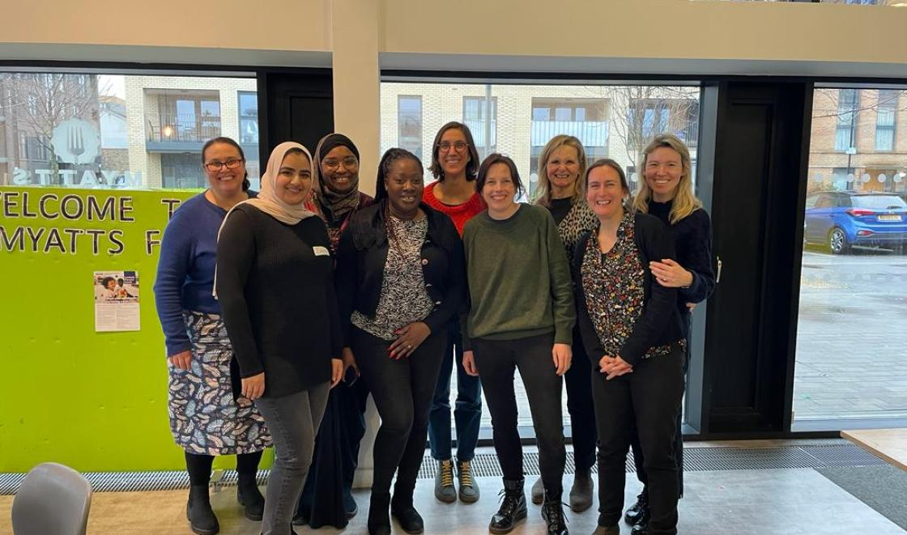
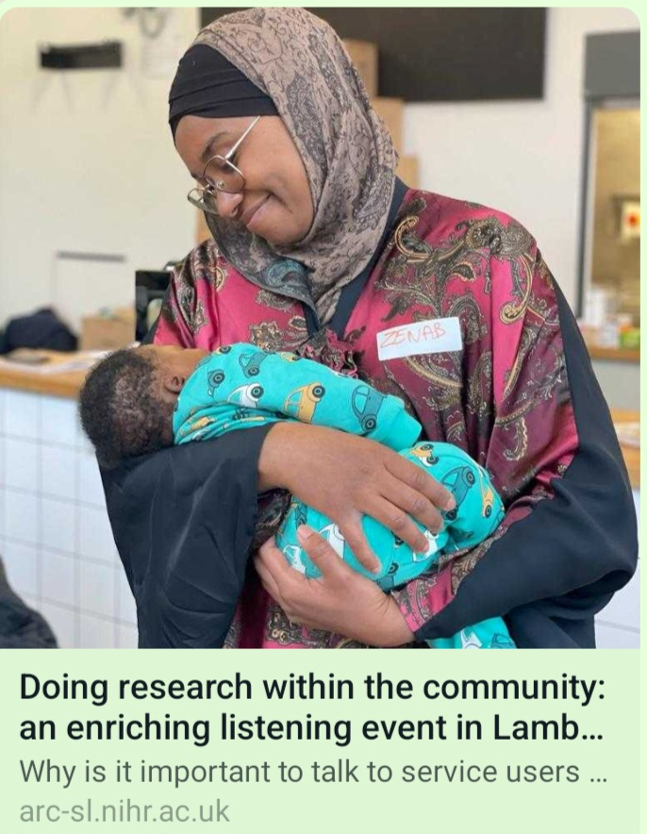
Lambeth Parents’ Lunch: A community listening event
Aim: to hear from a diverse group of women about their experiences and prioritise future research initiatives
Two community participatory research events held in the community
Co-led by ARC researchers and peer researchers
Lambeth community centre, with local community organisations providing crèche and lunch

Slide 18
CRIBS, Innovations to reduce maternal mortality and build research capacity in Sierra Leone – NIHR Global Health Group, Pi Prof Andy Shennan
PALMS (Prevalence of Abnormal Lights in Maternity Systems)
CRADLE 5: SW cRCT hybrid 2 real-world national scale up of the CRADLE Vital Signs Alert device and obstetric emergency training across rural SL.
Trial ends: June 2023
Three observational studies to evaluate point-of-care tests (shock index, creatinine, PLFG) for improved detection of key causes of maternal mortality in Freetown and 10 surrounding rural areas.
Ongoing
Pilot trial study of a community based mentoring intervention for pregnant and parenting adolescent girls
Recruitment & qual ongoing
Individual, institutional and system capacity building,
Community engagement and involvement

Slide 19
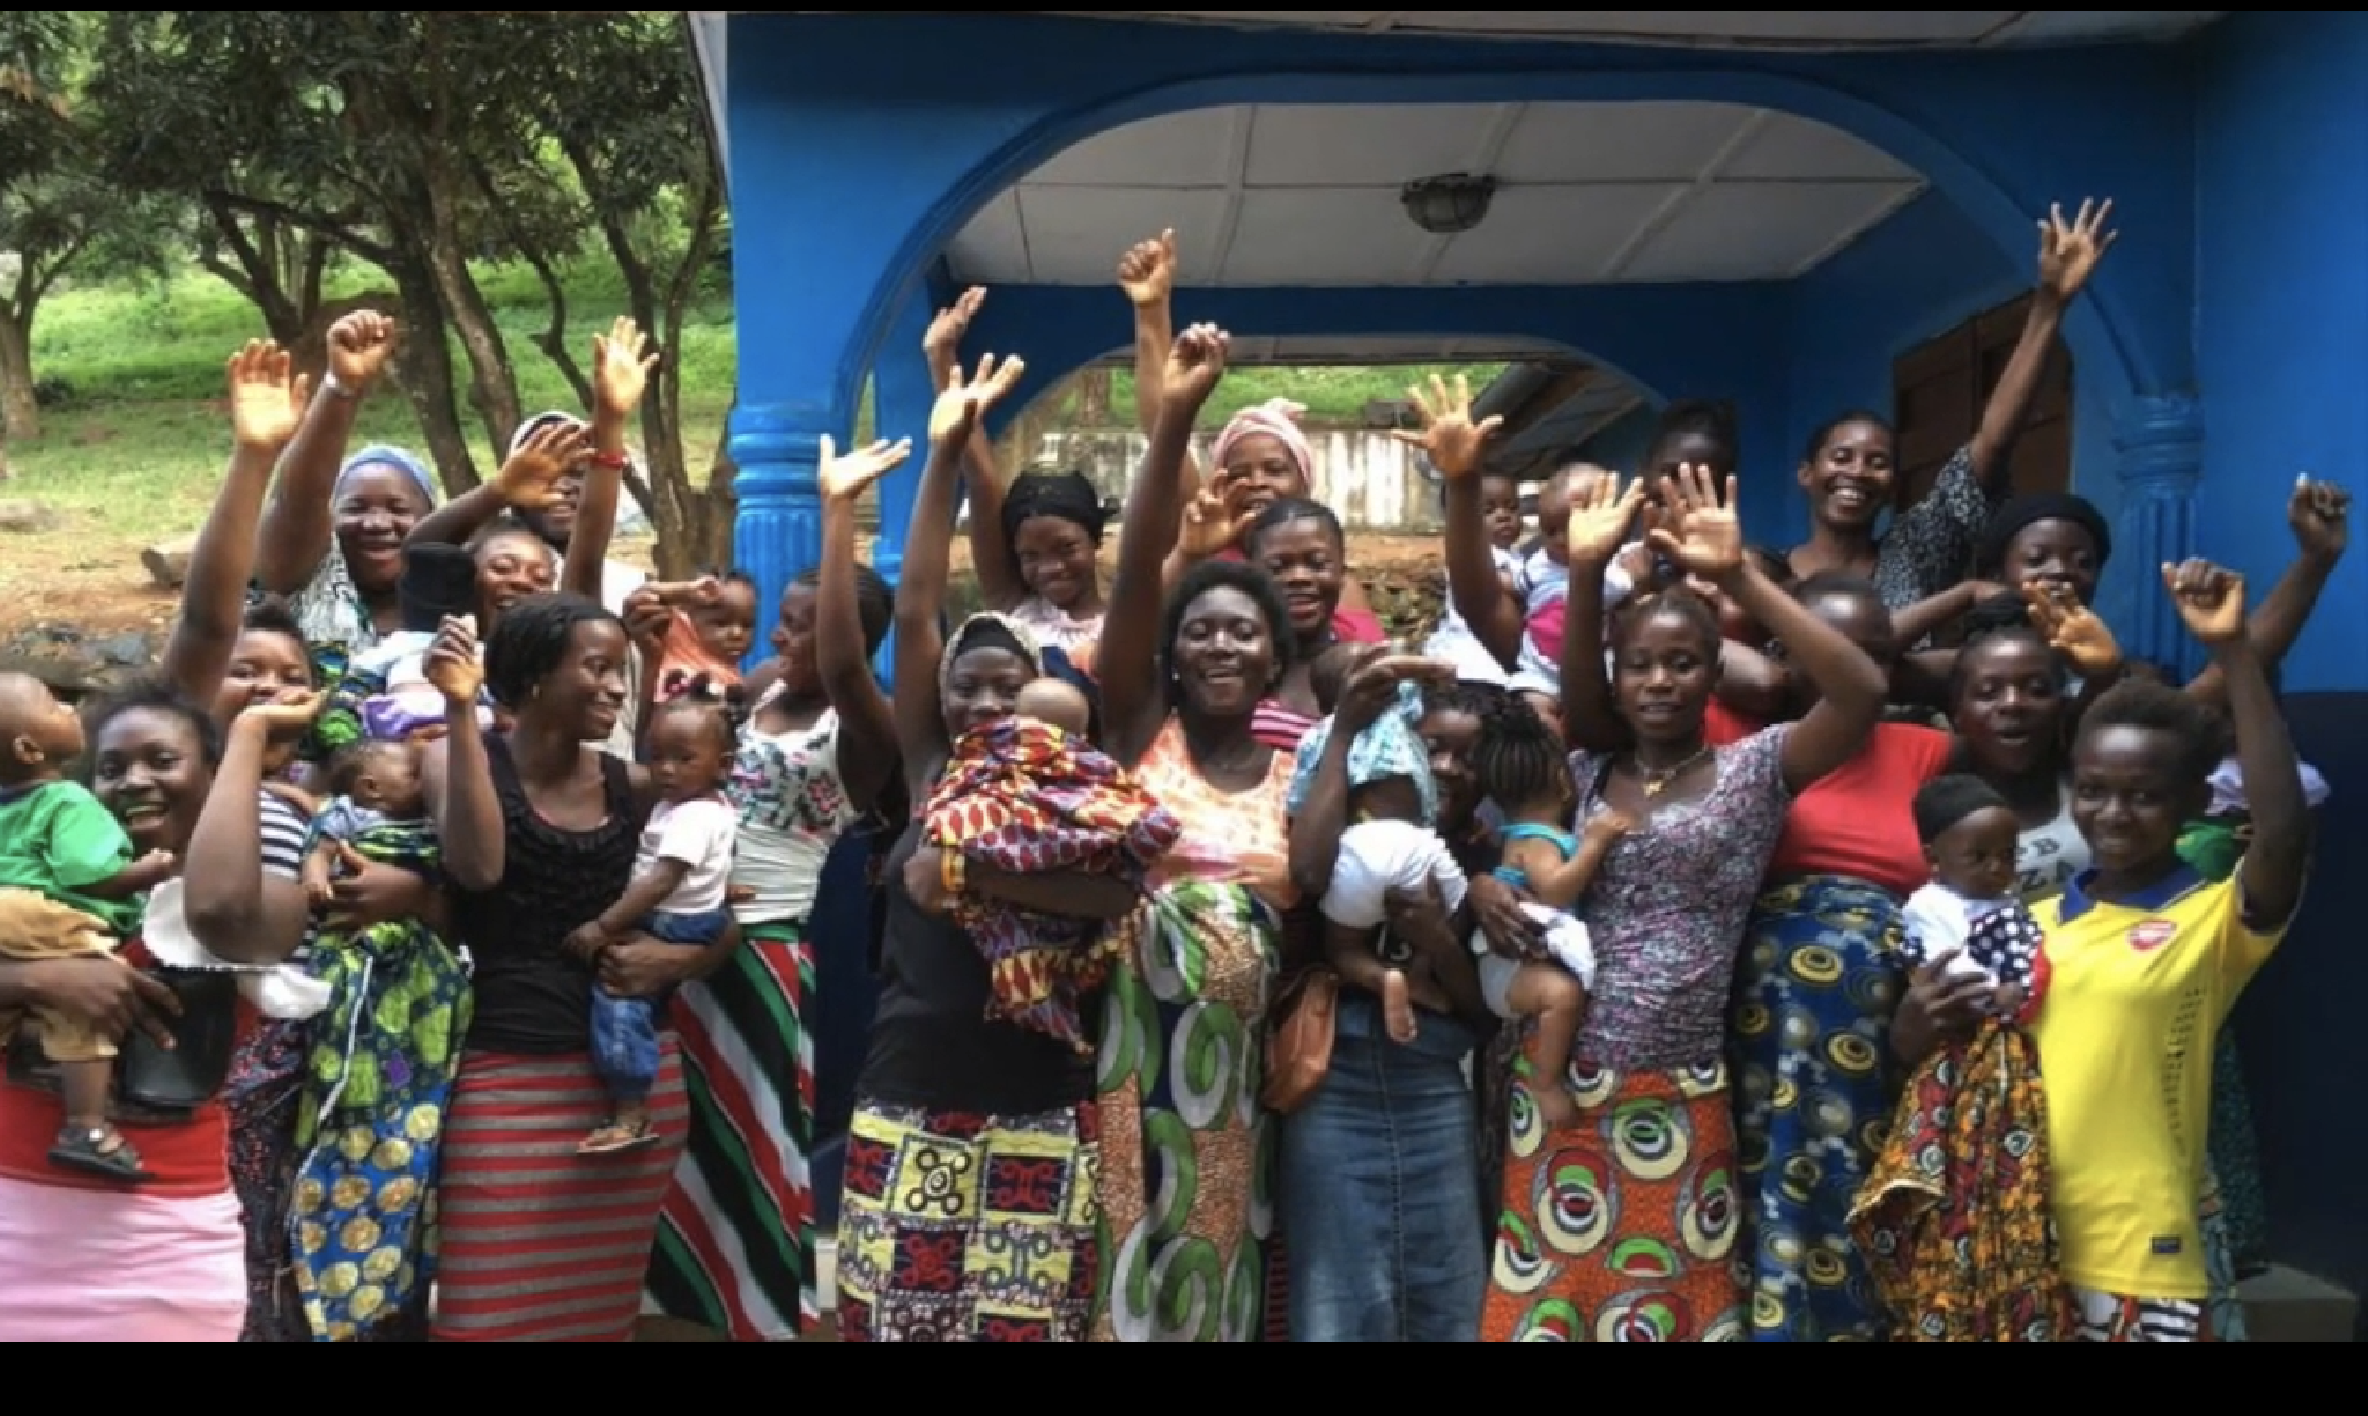
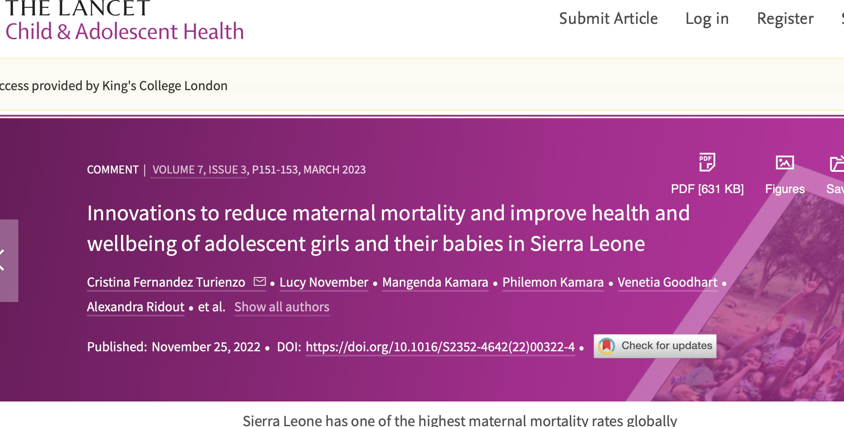
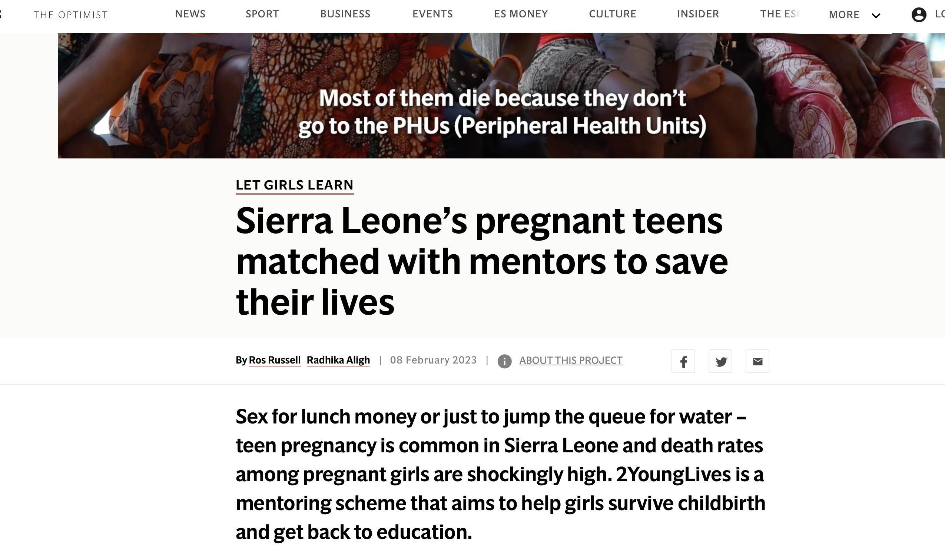
2YoungLives Pilot Cluster- trial Dr Cristina Fernandez-Turienzo, Lucy November, Jane Sandall
Developed in 2018 after results from a community based survey showing high adolescent maternal and infant deaths in Eastern Freetown, and a qual study exploring causes of adolescent maternal mortality
Aim: To assess the feasibility and implementation of the 2YoungLives mentoring scheme for adolescent pregnant girls in new communities to inform trial procedures for a subsequent fully powered cluster RCT

Slide 20
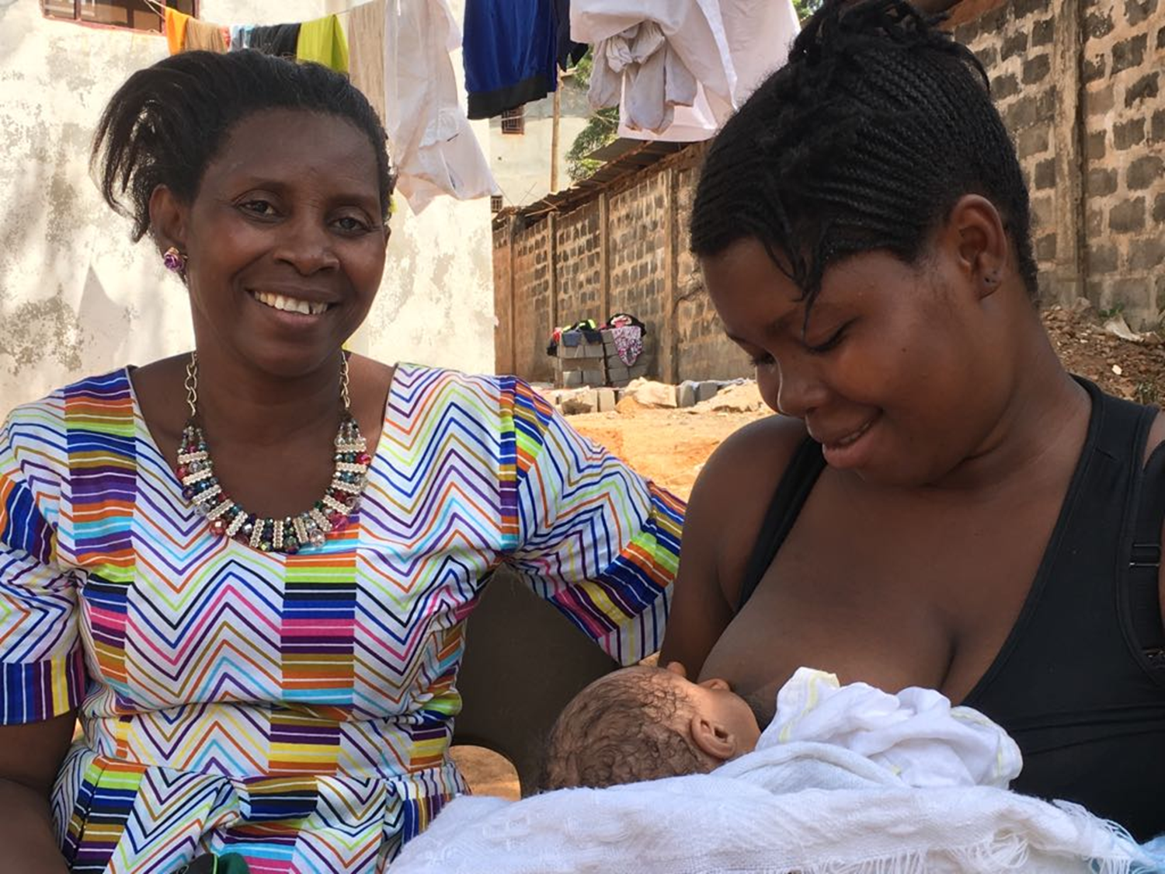
Overview of elements of 2YL mentoring
At least weekly 1:1 interaction between mentor and mentee
Advocacy with families (if safe and appropriate)
Support to run a small business (Le 150,000)
Accompany for ANC and birth if required
Support to take up postnatal contraception
Support with baby care
CRIBS

Slide 21
Monthly meetings with all mentors and mentees, cook and eat, health discussion with visiting midwife, peer support
CRIBS

Slide 22
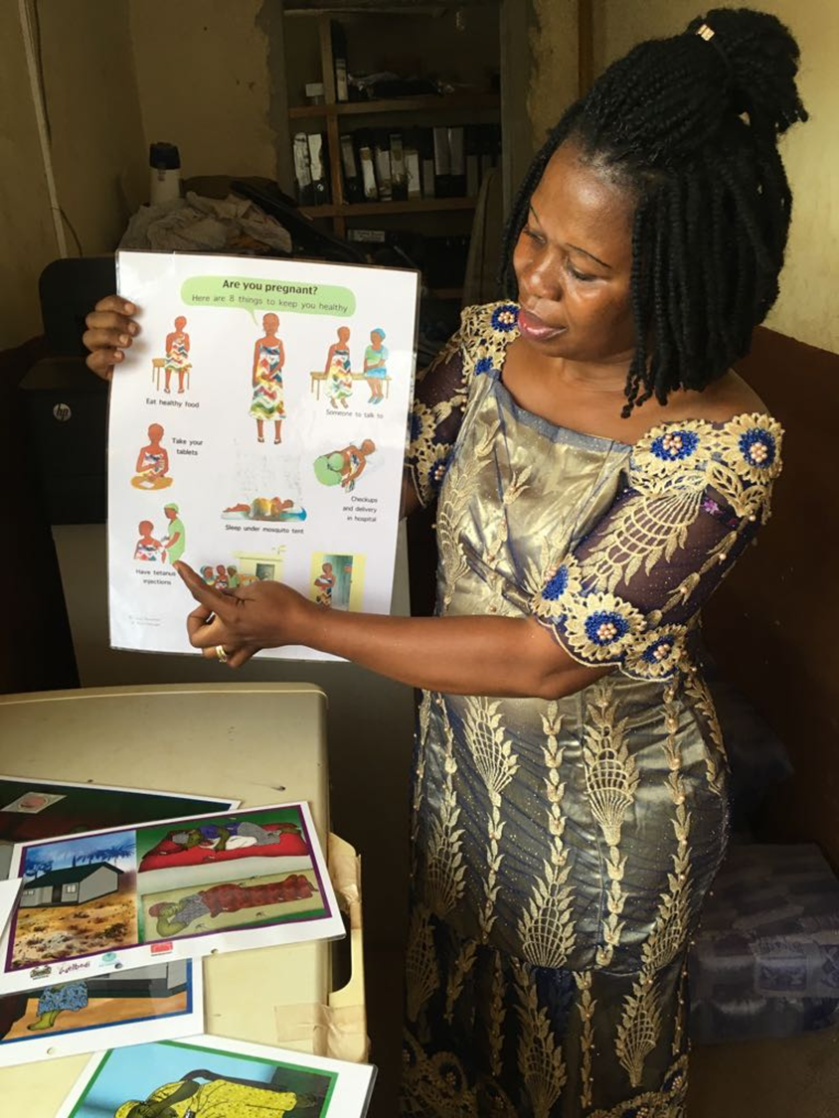
Encourage staying in school or returning to school / technical vocational when ready after birth
2-day workshop in schools on implementation of radical inclusion policy (new element introduced after stakeholder engagement / ToC discussions)
CRIBS

Slide 23
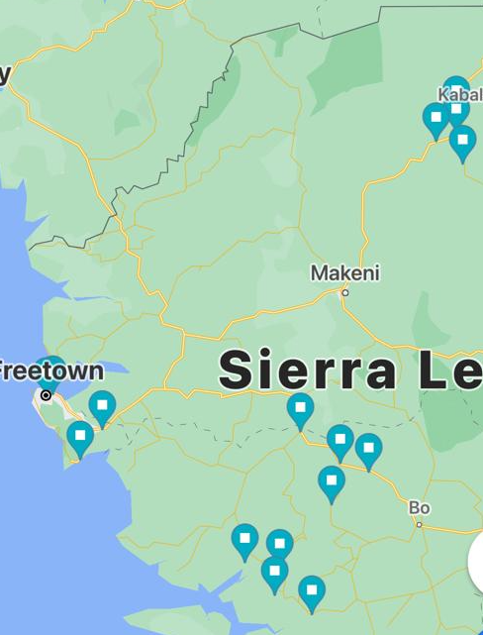
Methods
Study Design: pilot cluster RCT with a nested process evaluation
Setting: Communities served by 12 PHUs covering rural + urban areas
Population: adolescent pregnant girls (under 18)
Intervention sites: 2 Young Lives Mentoring + Standard care
Control sites: Standard care
Tombo town CHC | Moriba Town (Lower Banta) CHP
Mattru Town CHC | Madina (Bum) CHC
Mano (Dasse) CHC | Senehun (Kamajei) CHC
Taiama (Kori) CHC | Moyamba Junction CHC
Lengekoro CHP | Heremakono MCHP
PAYCY's Clinic | Calaba Town CHC
CRIBS

Slide 24
Methods
Data collection:
Primary and secondary clinical outcome: routine data collection registers (e.g. mother and neonate health, maternity and delivery, family planning, referral registers, hospital registers)
Experiences and processes/implementation: quantitative + qualitative data from referrals, checklists, local docs and reports, focus groups; semi-structured interviews; photovoice project.
CRIBS

Slide 25
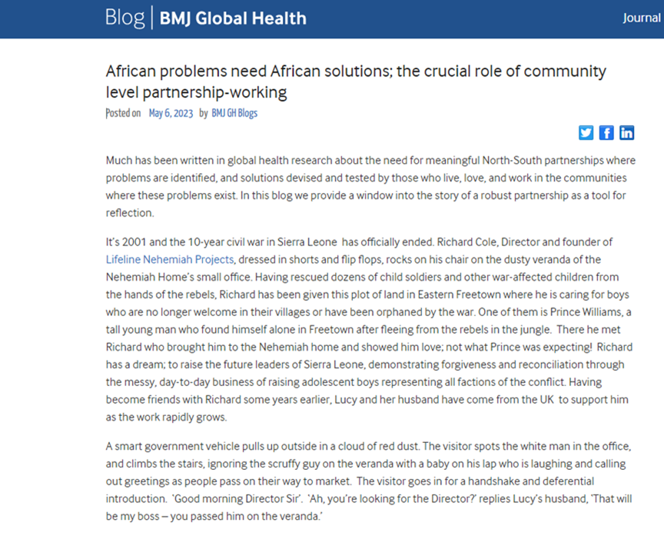
CRIBS, 2YoungLives - engagement
Core element of 2YoungLives
Strategy of initial visits
Need for ongoing input to respond to issues
Examples (chiefs invited to Freetown)

Slide 26
NIHR CRIBS Group & Collaborators:
Mrs Francess Williams, Lifeline
Mrs Lucy November, KCL
Dr Cristina Fernandez Turienzo, KCL
Mrs Mangenda Kamara
Mr Appiah Kingsford Mustapha
Mr Samuel Saidu, COMAHS
Mr Osman Conteh
Ms Mary Tipson
Mr Peter Koroma
Mr Michael Munu
SIPHRE & APRICOT:
Dr Rosetta Cole, PCMH
Dr Foday Janneh, PCMH
Dr Katy Kuhrt, KCL
Dr Ekundayo Williamson-Taylor, PCMH
Mr Eric N'dolenge, PCMH
Mr Daniel Jah, PCMH
Mr Paul Kpaka, PCMH
Matron Irene Sesay, PCMH
Sister Lucy Macauley, PCMH
Sister Kadiatu Keister, PCMH
Sister Millicent Bockarie, PCMH
Sister Michaela Kallon, PCMH
Matron Christiana Squire, PCMH
Sister Wallumatu Conteh, PCMH
Prof Andrew H Shennan, KCL
Prof Sahr Gevao, University of Sierra Leone
Prof Mohamed Samai, MoHS
Prof Adetunji Adeniji, MoHS, PCMH
Prof Jane Sandall, KCL
Prof Lucy Chappell, KCL
Dr Sartie Kenneh, MoHS
Dr Francis Smart, MoHS
Mr Tom Sesay, MoHS
Dr Matthew Vandy, MoHS
Matron Mary Fullah, CNMO, MoHS
Matron Margaret Mannah, MoHS
Dr Joan Shepherd, National School of Midwifery
Mrs Patricia Bah, MoHS
Dr Kate Bramham, KCL
Mr Andrew Leather, KCL
Sister Betty Sam, Welbodi
Dr Cristina Fernandez Turienzo, KCL
Dr Haja Wurie, COMAHS
Dr Alexandra Ridout, KCL
Mr Sorie Samura, MoHS
Mr Abdul Rahman Wurie, MoHS
Mr Abu Bakar Jalloh, MoHS
Mr Moi Tenga Sartie, MoHS
Mr Sam Massaquio, MoHS
Mr Thaimu Bangura, MoHS
Dr Asha Pun, UNICEF
Dr James Bunn, WHO SL
Dr Fatu Forna, Mama-Pikin Foundation
Mr Shunsuke Suzuki, Amda Minds
Dr Venetia Goodhart, Welbodi
Ms Simren Herm-Singh, Welbodi
Mr Paul Seed, KCL
Ms Suzanne Thomas, Welbodi
Dr Harriet Boulding, UCL
Drs Claudia Caracciolo, CUAMN
Dr Luigi Pisani at CUAMM
CRADLE:
Dr Francis Moses, MoHS
Mr Daniel Kamara; Welbodi
Mr Tamba Justice Moitenga, Welbodi
Mr Moijueh Vagie Koroma, Welbodi
Mr Abdul Rhaman Barrie, Welbodi
Mr Mohammed Sesay, Welbodi
Mr Bundu Kargbo, Welbodi
Mr Raymond Dowrie, Welbodi
Mr Senesie Sheriff, Welbodi
Mr Fancis G Momoh, Welbodi
2 Young Lives:
Mr Prince Tommy Williams, Lifeline
Mr Philemon Kamara, Lifeline
CRIBS

Slide 27
ARC Contacts
https://www.arc-sl.nihr.ac.uk/
Follow us on Twitter: @arc_S_L and https://twitter.com/arc_S_Lppi
Sign up to our newsletter to keep up to date with all of our latest news and events.
Maternity and PMH theme Facebook https://www.facebook.com/groups/629588497824374
Theme lead - jane.sandall@kcl.ac.uk
Deputy lead – abigaill.easter@kcl.ac.uk
PPIE lead-mary.1.newburn@kcl.ac.uk

