Slide 1
Applied Research- science in real life
Fiona Gaughran
Lead Consultant, National Psychosis Unit
Director of R&D, South London and Maudsley Trust
Professor of Physical Health and Clinical Therapeutics in Psychiatry, KCL
Theme Lead for Applied Informatics, NIHR ARC South London

Slide 2
Hey, I’m an applied health researcher!

Slide 3
Translational Science
Applied Research
Clinical Practice

Slide 4
Some day-to-day questions:
How do we best work with those living with a major mental illness to improve physical health and its management?
What makes for better experience, equity and outcomes?
Can informatics/digital help?
And will people use them?

Slide 5
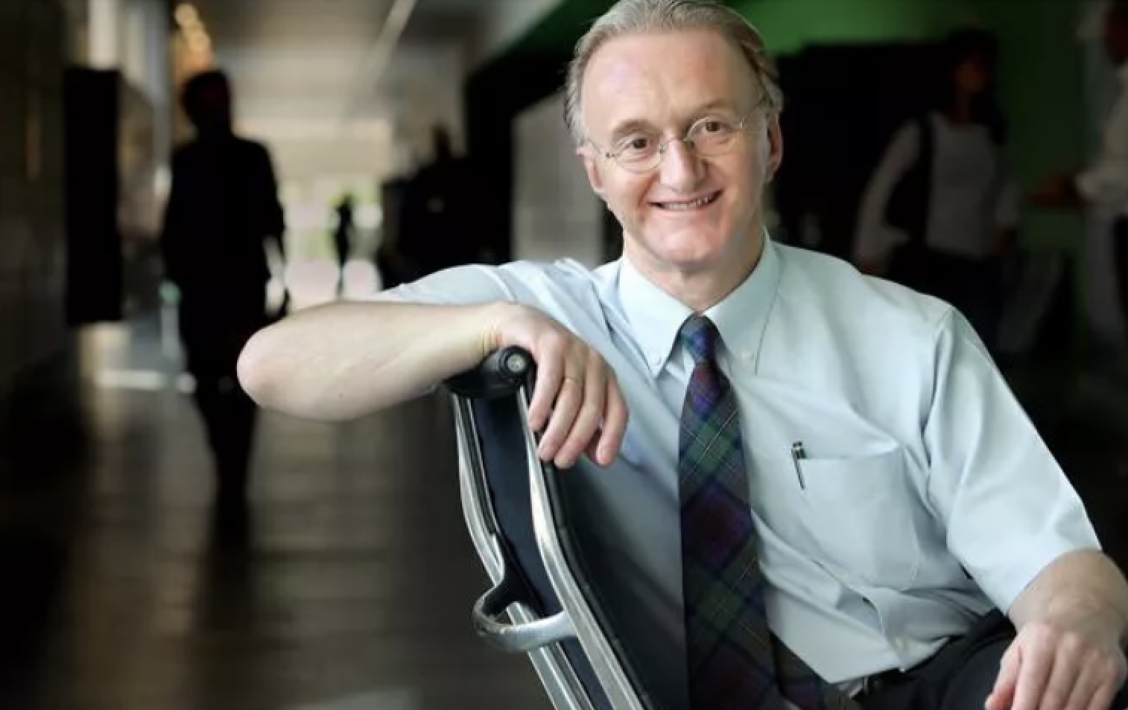
“More than 26,000 adults with severe mental illness die prematurely each year from preventable physical illnesses, analysis by the Royal College of Psychiatrists suggests”. May 2023

Slide 7
Applied informatics to support real-world care
Lots of digital tools – but will they be used and do they help?
Limited evidence on implementation and integration of digital tools to support physical health in mental health care.

Slide 8
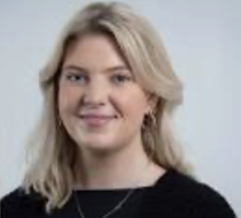
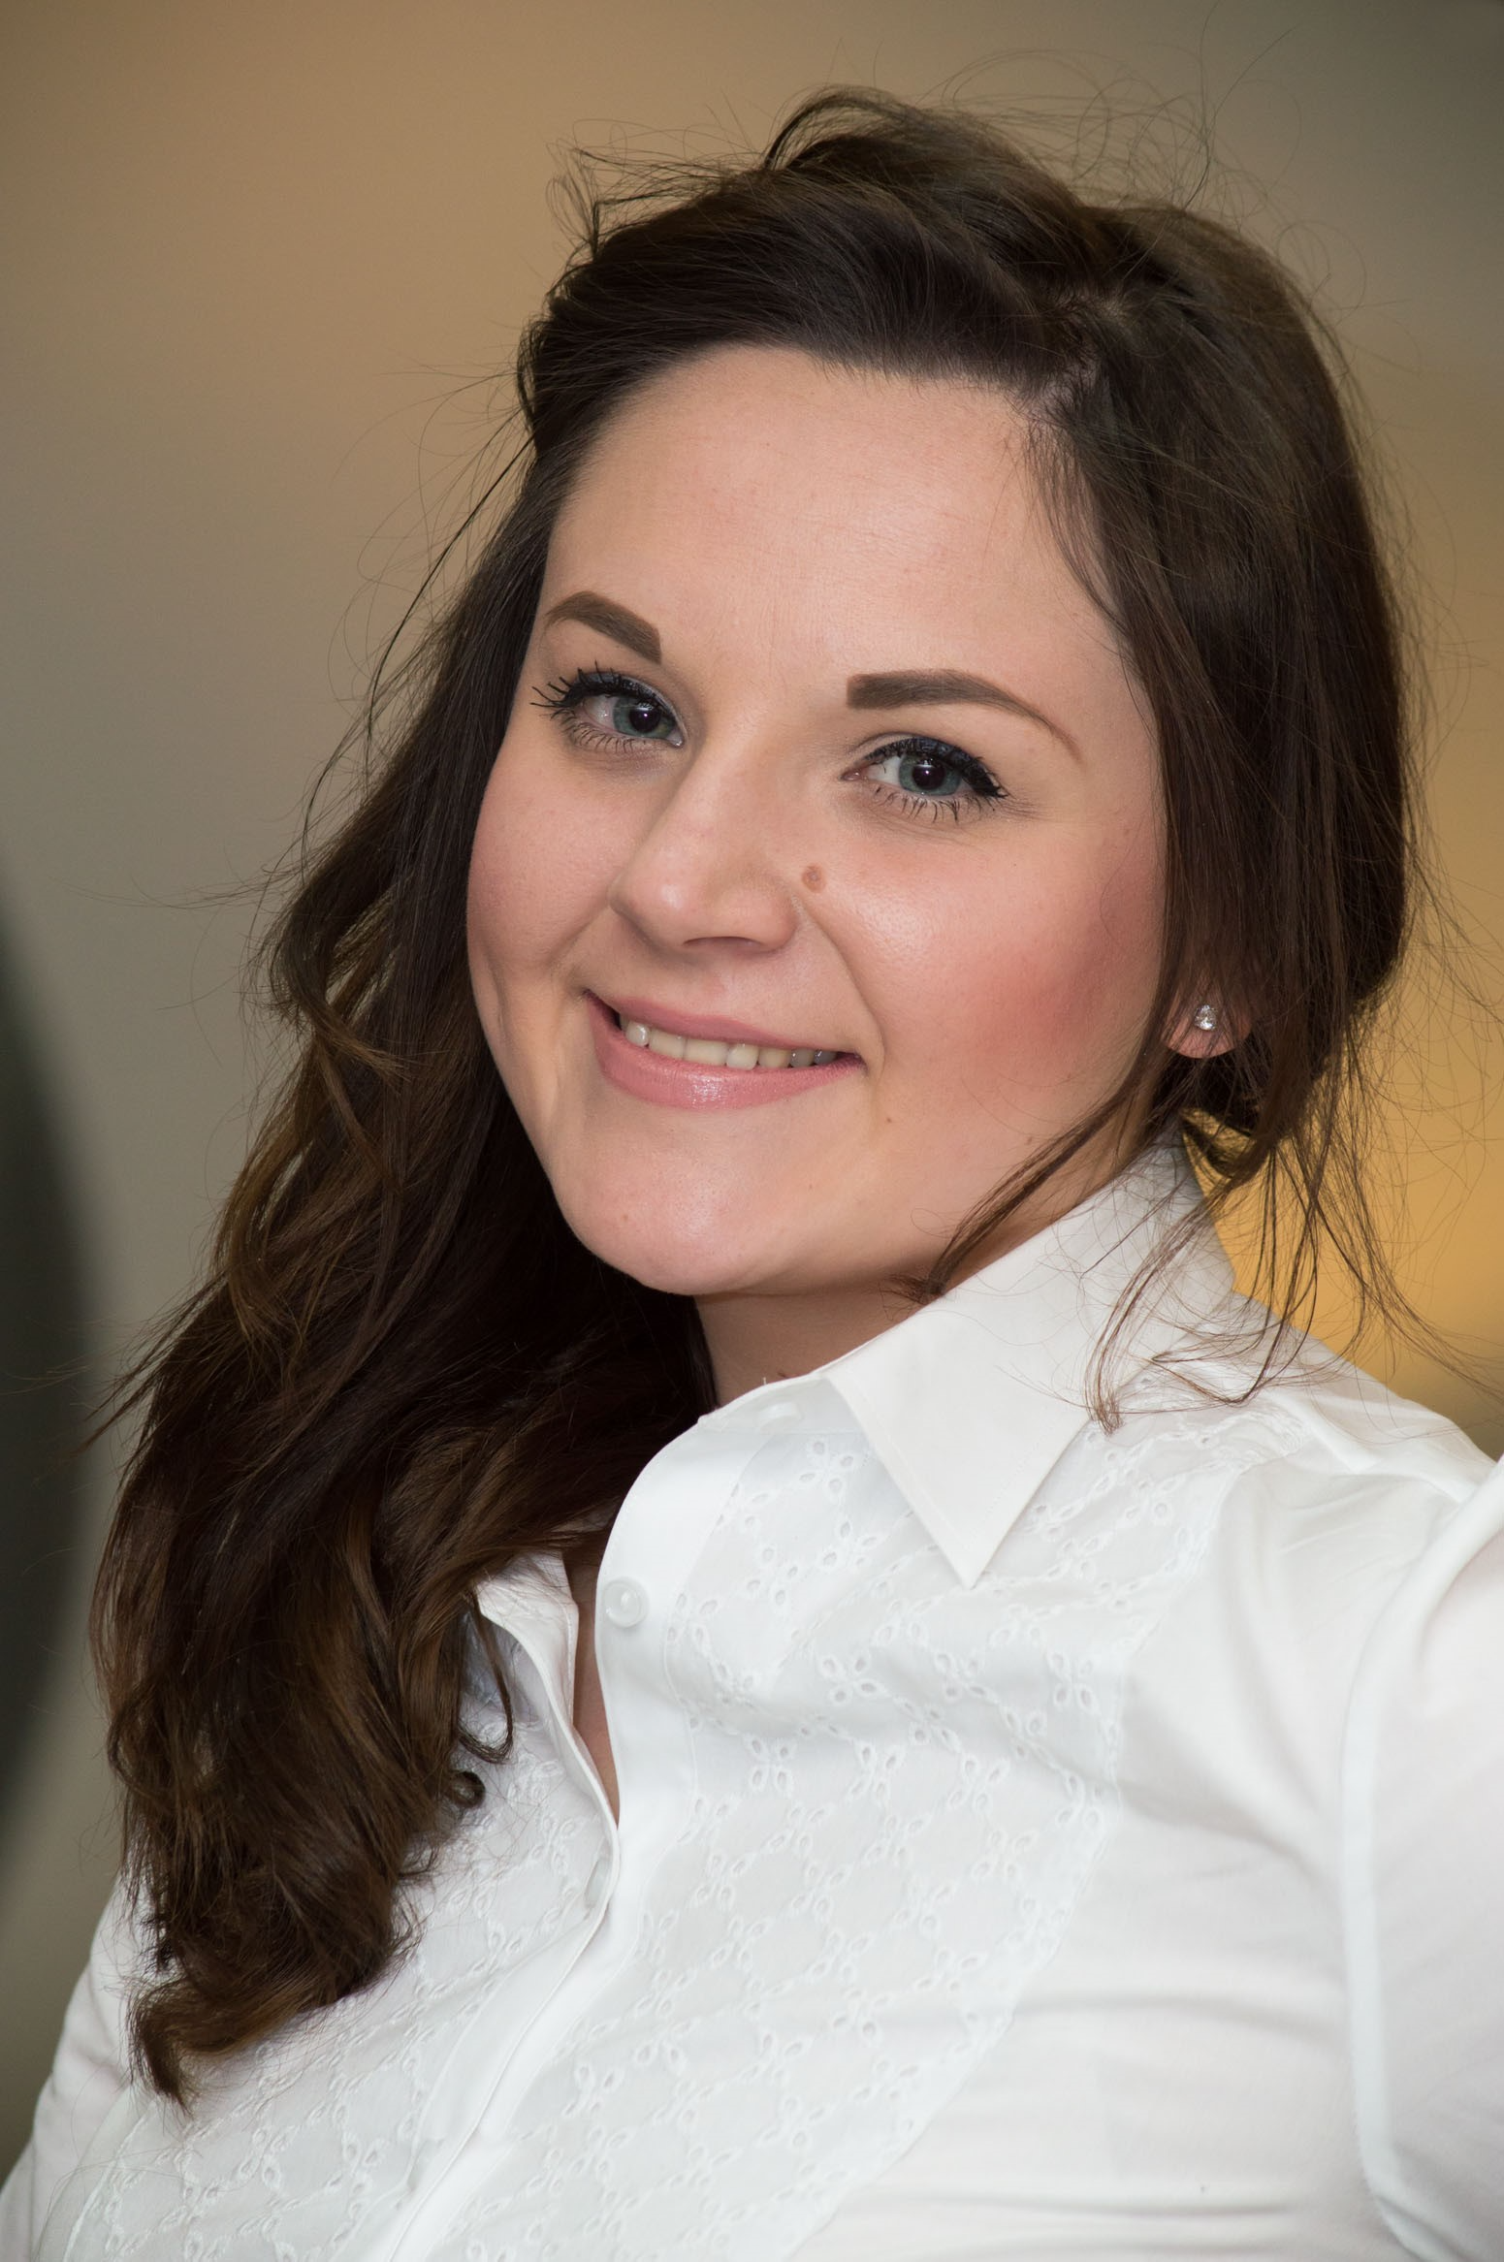
How people with Serious mental Illnesses (SMI) use technology to manage their physical health
Cathy Gillis, Julie Williams, Gracie Tredget, and all the IMPHS TEAM
Digital health interventions (DHIs); apps, websites, wearables
Mixed methods
survey, interviews , workshops:
Which DHIs people are using
Do these meet their needs?
Barriers and facilitators
Perceived impact on physical health & health service use.
Gillis et al, 2024
Notes:
What do we mean by digital interventions?
For the purpose of this study, we defined digital interventions as those that can be used to improve health behaviours (such as smoking or alcohol consumption) or support an existing health condition (such as diabetes or heart disease).
Examples include smartphone apps, wearable devices (such as fitbits), websites, or patient portals.

Slide 9
What did people think?
"And I think that’s what it’s all about. It’s seeing that you’ve achieved something. No matter what it is, you’ve done something.“ – Jeff, M
Real appetite for information on DHIs : realistic and scalable addition to augment clinical care - for some
Want to know more about available DHIs, & perhaps DHIs developed with consideration to needs and preferences of people living with SMI
“I’ve been psychotic and hospitalised, and I’m recovering, it’s gone from zero ..and then you have to reinvent your life again and focus on social stuff, voluntary work, I guess, or dealing with other people, educational stuff. Just a range of things…When you can quantify things, and I’ve shared that information with services to say, ‘I’m on track. I am seriously trying to keep abreast of where I’m at with this”- Carl, M
"I love monitoring myself. I feel good when I’m doing it. But I feel like I’ve got some control and I can feel like I can see where problems are starting to come up or what I’ve done in the past where I could actually do better. “- Julia, F
Gillis et al, 2024

Slide 10
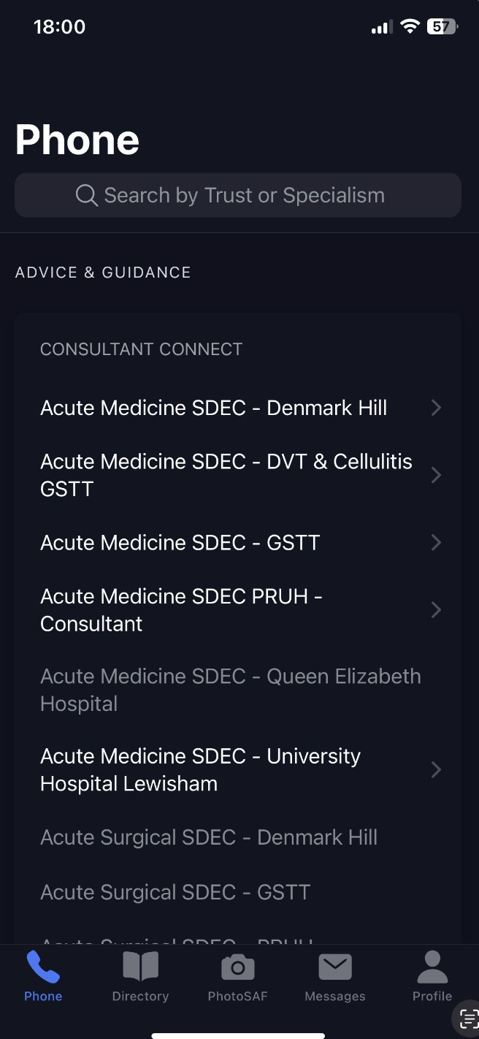
Integrating our Mental and Physical Healthcare Systems (IMPHS)
Consultant Connect
Implementation of ‘Consultant Connect’ physical health lines
Clinicians at South London & Maudsley NHS Trust use CC to contact hospital doctors in >80 specialties to discuss our patients.
Provides short-term, responsive advice to improve physical care and prevent unnecessary referrals or transfers from acute wards to inpatient services.
First Mental Health Trust in the UK to use this intervention.
AWARDS & NOMINATIONS:
‘Best Mental Health Partnership with the NHS’ Award Finalist at the HSJ PARTNERSHIP AWARDS 2022
‘The Future NHS’ Award Nominee at the PARLIAMENTARY AWARDS 2022
Benefits include:
>2,000 calls made to in roughly 65 acute specialities
70% of calls with a recorded outcome led to physical health care being provided in a mental health setting
Avoiding unnecessary and potentially distressing transfers to an acute setting
Notes:
Positive attitudes towards HIIT: with beliefs it may help patients feel more relaxed, provide health benefits, provide a break from the monotony of the ward environment and the format is engaging.
Feasibility and acceptability: in >70% of attended sessions the full length of the HIIT session was completed (19 minutes including 4 min warm-up and 4 min cool down)

Slide 11
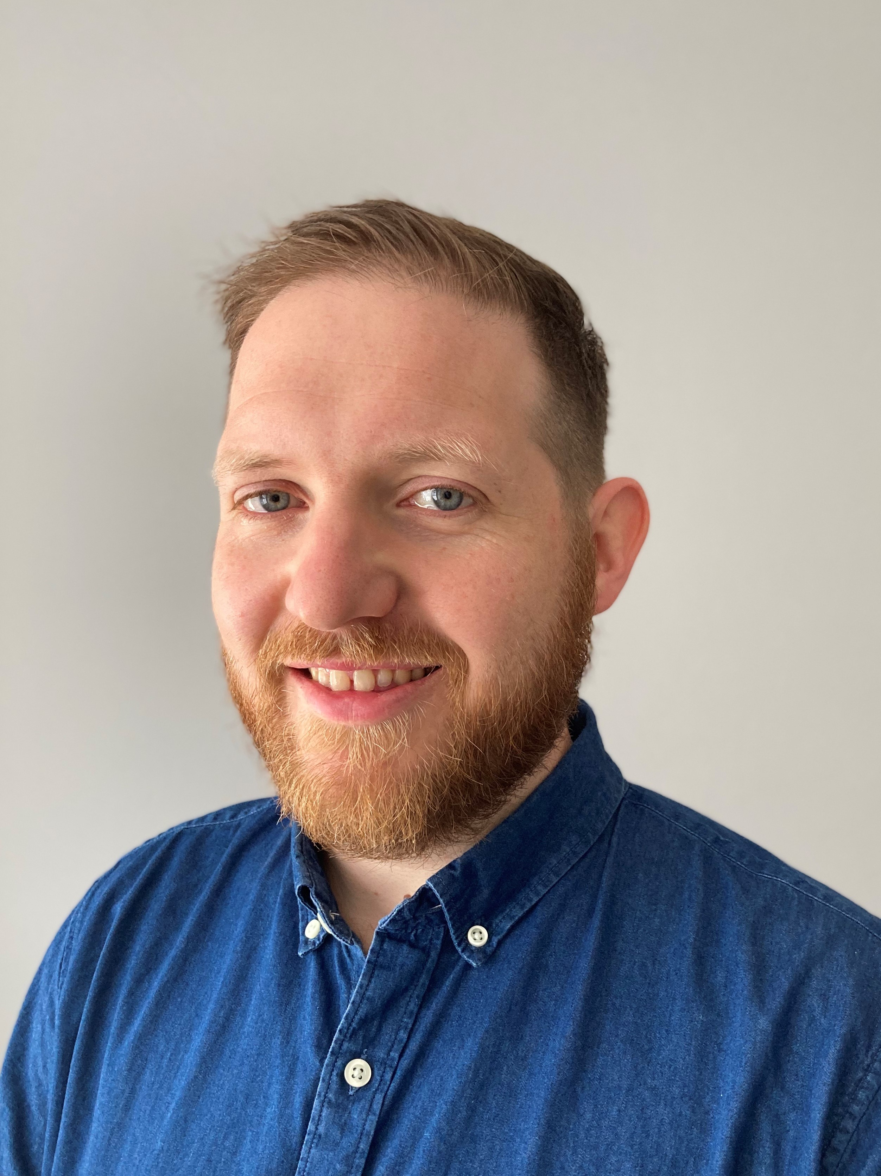
Ray McGrath, Julie Williams, Gracie Tredget, Nick Sevdalis, Eoin Gogarty, Fiona Gaughran & IMPHS team
Evaluation protocol
Three aims:
to understand the process of rapidly implementing Consultant Connect
to establish the acceptability and feasibility of Consultant Connect
to understand the economic implications of running the service
DOI https://doi.org/10.1186/s43058-021-00113-0

Slide 12
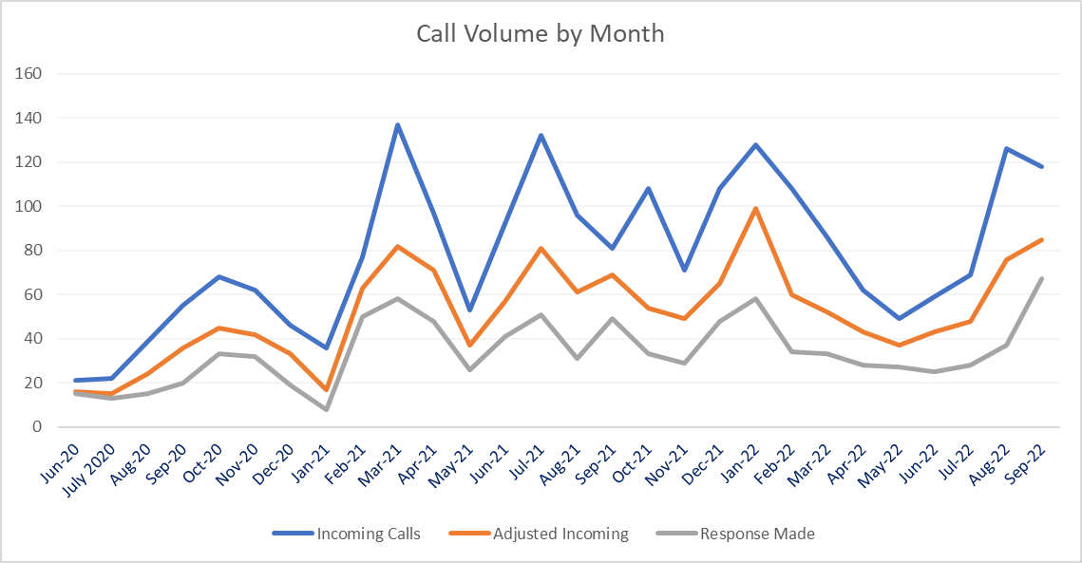
Ray McGrath, Julie Williams, Gracie Tredget, Nick Sevdalis, Eoin Gogarty, Fiona Gaughran & IMPHS team
Strategies for implementation
Expert Recommendations for Implementing Change (ERIC) Framework for systematic reporting of implementation strategies prospectively & retrospectively. (Powell BJ, et al. 2015)
73 discrete implementation strategies
7 implementation domains: Analysis, Incentivisation, Knowledge, Relationship building, Resource, System (context) System (project)
Domain

Slide 13
Ray McGrath, Julie Williams, Gracie Tredget, Nick Sevdalis, Eoin Gogarty, Fiona Gaughran & IMPHS team
Analysing data for health economic analysis
Clinical feedback
“I received excellent support … and managed to avoid sending a Dementia patient to A&E to wait for a long time and instead managed to organise appropriate scans to make a diagnosis. Very pleased with the service.”
Positive feedback from 50 clinicians e.g.,
“It really has reduced the number of patients I have had to send to hospital/ ambulatory care for treatment, and the appropriateness of care and referrals. Which is ultimately better for the patient as well as staff” – Consultant
“It's amazing. Moving to a trust which doesn't have it just emphasises how good it is…”
“I think this application is FANTASTIC. I really do think the photo/message function should be extended …”

Slide 14
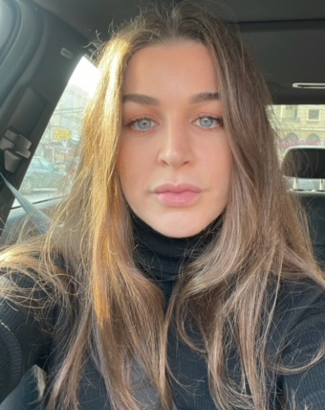
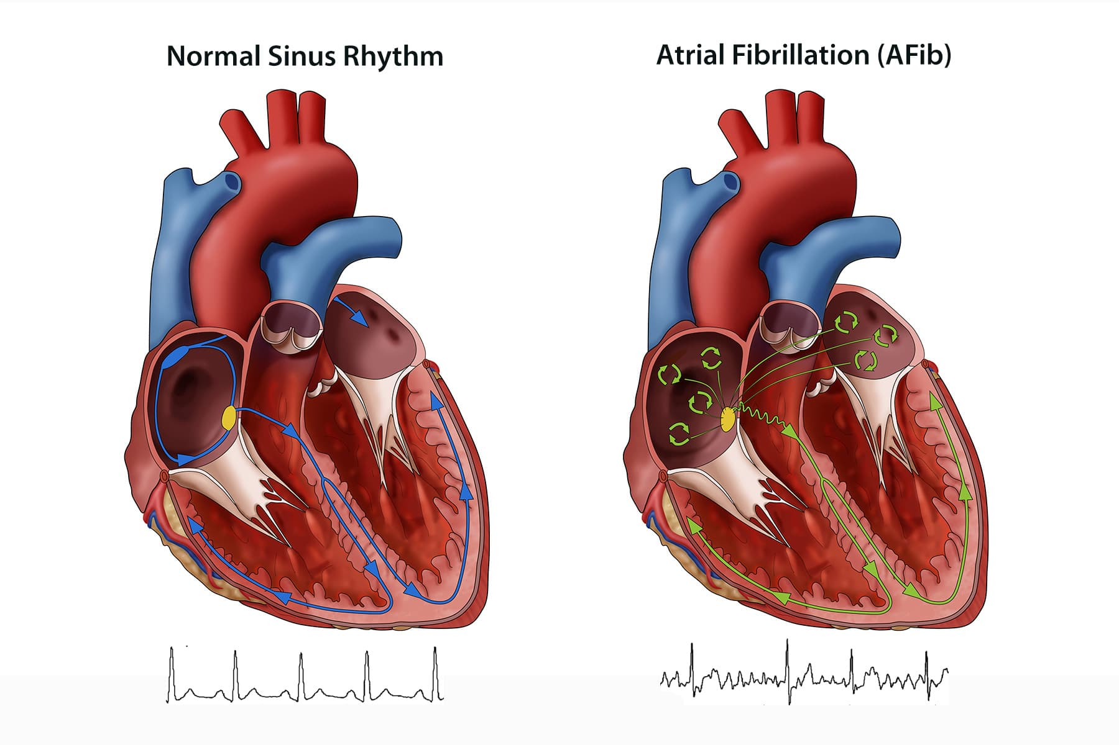
Stroke prevention in people with Atrial Fibrillation & Mental Health Co-morbidity
CHA₂DS₂VASc
ORBIT
Oral anticoagulation (OAC) therapy
Identify Atrial Fibrillation
Stroke risk
Stroke and bleeding risks

Slide 15
Stroke prevention in people with Atrial Fibrillation & Mental Health Co-morbidity
Systematic review/ Meta-analysis;
Compared to General population controls, people with serious mental illness (SMI) are less likely to get oral anti-coagulants (OAC)
Anticoagulation in a general hospital
Vs controls, those with SMI had higher stroke & bleeding risks & were less likely to be prescribed an OAC if at risk of stroke (p < 0.001) … until 2019
OAC prescription among people with AF in a mental health Trust
Among people with AF/SMI, warfarin less prescribed to people with self-injury, hallucinations or delusions, activities of daily living impairment and alcohol or substance dependency
Dina Farran et al, 2022 a, b, 2024

Slide 16
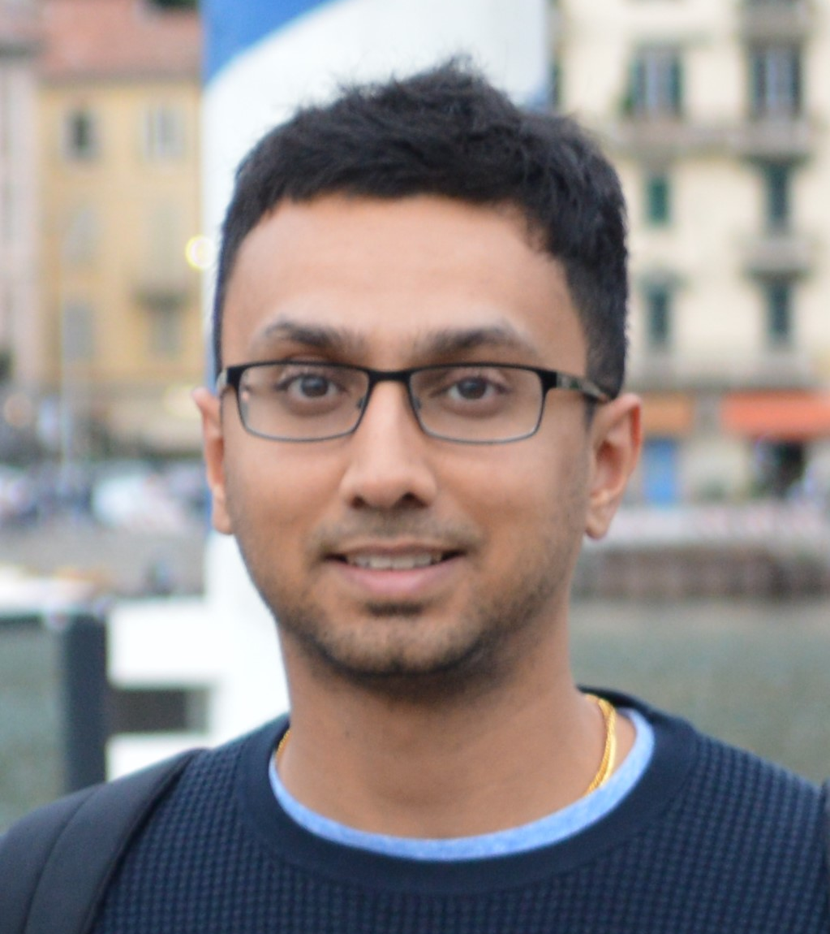
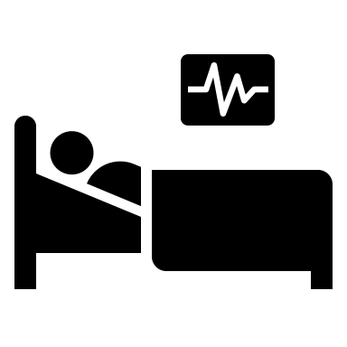
Feasibility/ Acceptability of an electronic clinical decision support prompt to improve screening for atrial fibrillation (AF) stroke prevention
Under analysis
Similar intervention under analysis for management of dysglycaemia – high blood sugar measure (HbA1c) (Dipen Patel et al, 2022)
Mental Health of Older Adults ward
AF
Electronic notes

Slide 17
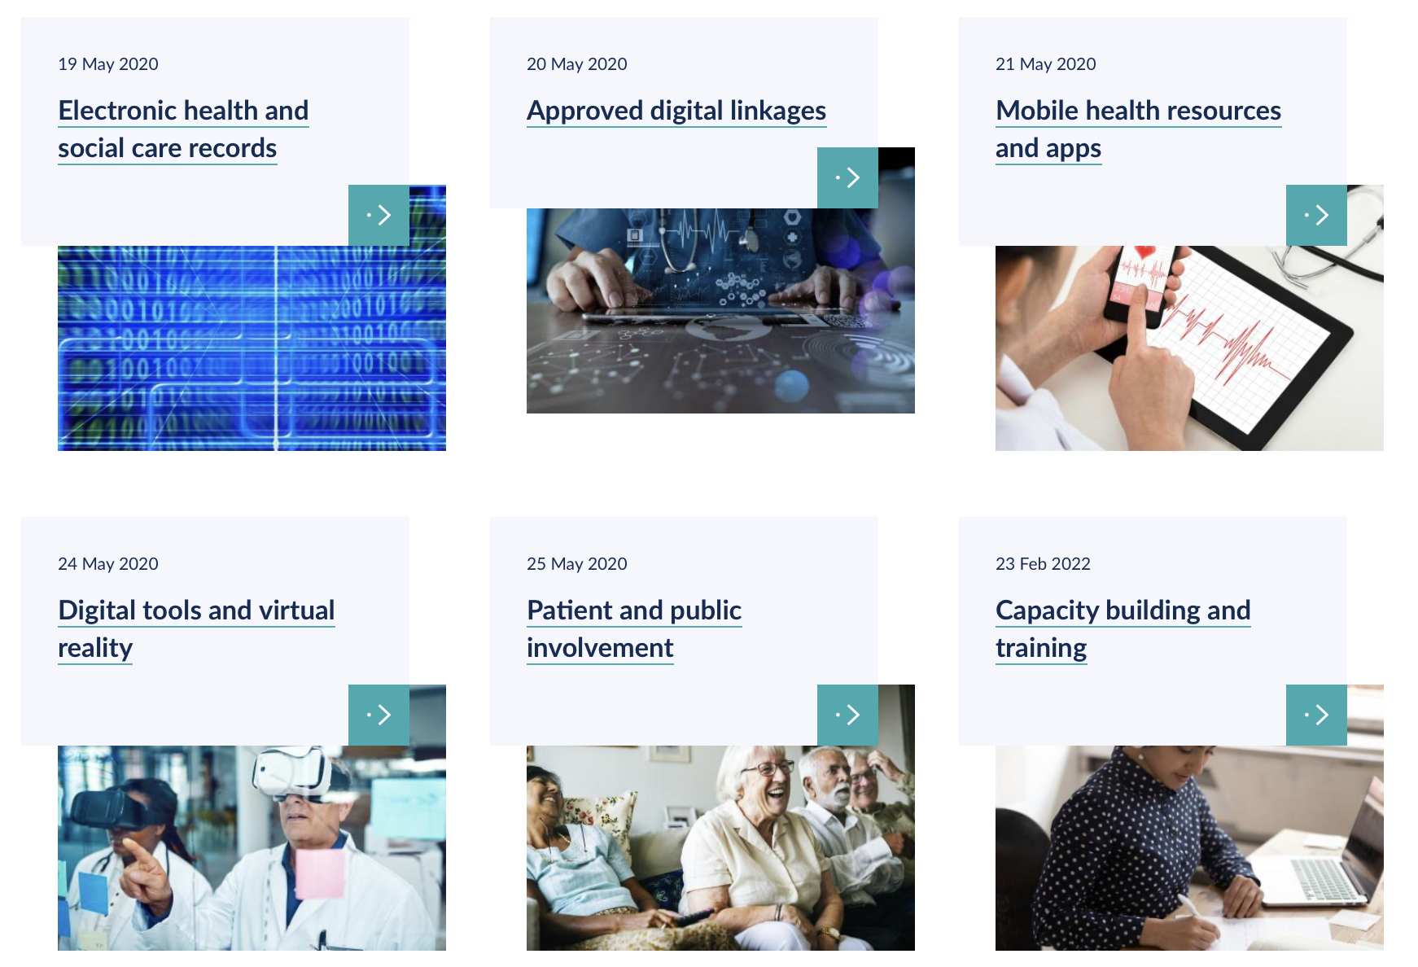
Applied Informatics Hub https://www.arc-sl.nihr.ac.uk/research-and-implementation/our-research-methods/applied-informatics/applied-informatics-hub

Slide 18
Acknowledgements …
These projects involved many people, staff, patients and carers to whom we are grateful
These project were supported by the National Institute for Health Research (NIHR) Applied Research Collaboration South London (NIHR ARC South London) at King’s College Hospital NHS Foundation Trust, the NIHR Maudsley Biomedical Research Centre, the Maudsley Charity, The Mind & Body Programme at King’s Health Partners and the South London and Maudsley NHS Foundation Trust ​
The views expressed are those of the presenter and not necessarily those of the funders, the NIHR or the Department of Health and Social Care
And thanks to…

Slide 19
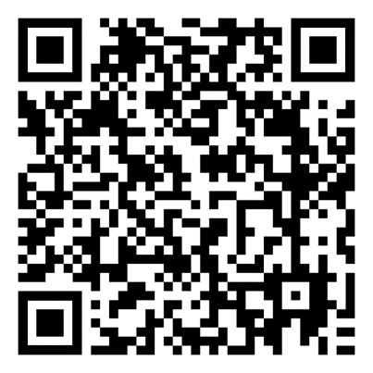
Thank you all, and thanks to:
Graham Thornicroft, Dipen Patel, Rob Stewart, Richard Dobson, Dina Farran, Rebecca Martland, Brendon Stubbs, Juliana Onwumere, James MacCabe, Toby Pillinger, David Taylor, Siobhan Gee, Eromona Whiskey, Robin Murray, Khalida Ismail, Lade Smith, Zerrin Atakan, Kathy Greenwood, Anita Patel, Daniel Stahl, Dominic Stringer, David Hopkins, Tony David, Maurice Arbuthnott, Bee Harries, Philippa Lowe, Poonam Sood, John Lally, Susan Moore, Brendon Stubbs, Stefania Bonaccorso, Anna Kolliakou, Conan O’Brien, Ali Featherman, Catherine Fung, Margaret Heslin, Gill Todd, Manyara Mushore, Diana Orr, Oliver Howes, Ruth Ohlsen, Evangelos Papanastasiou, Mudasir Firdosi, Jonas Eberhard, Alex Dregan, Ann McNeill, Debbie Robson, Marco Colizzi, Marta Di Forti, John McGrath, Gracie Tredget, Julie Williams, Nick Sevdalis, Ray McGrath, Eoin Gogarty, Nikeysha Bell, Gideon Tutaleni, Kevin O’Gallagher, ARC Applied Informatics PPI group, SLaM Connect and many others
Patients and Staff in participating NHS Trusts
Funders: NIHR Maudsley BRC; NIHR Applied Research Collaboration South London; Maudsley Charity The views expressed are those of the speaker and not necessarily those of the NIHR or the Department of Health and Social Care

Slide 20
Download our Learning Report

Slide 21
What is Research?
What is Applied Research?
The NIHR Applied Research Collaborations
Map
Pop up headshot of Graham

