Slide 1
Community care can support personal recovery
Mike Slade
School of Health Sciences, Institute of Mental Health
University of Nottingham
12 March 2024

Slide 2
Personal recovery
A deeply personal, unique process of changing one’s attitudes, values, feelings, goals, skills and roles. It is a way of living a satisfying, hopeful and contributing life even with limitations caused by the illness.
Anthony WA (1993) Recovery from mental illness:
the guiding vision of the mental health service system in the 1990s,
Psychosocial Rehabilitation Journal, 16, 11-23.

Slide 3
Recovery processes: CHIME framework
Connectedness
Hope and optimism
Identity
Personal
Recovery
Meaning and purpose
Empowerment
Leamy M, Bird V, Le Boutillier C, Williams J, Slade M (2011) A conceptual framework for personal recovery…systematic review and narrative synthesis, British Journal of Psychiatry, 199, 445-452.
Notes:
97 papers included (5,208 papers identified 366 reviewed): 13 Characteristics of the Recovery Journey; 4 Recovery Processes (shown); Recovery Stage descriptions

Slide 4
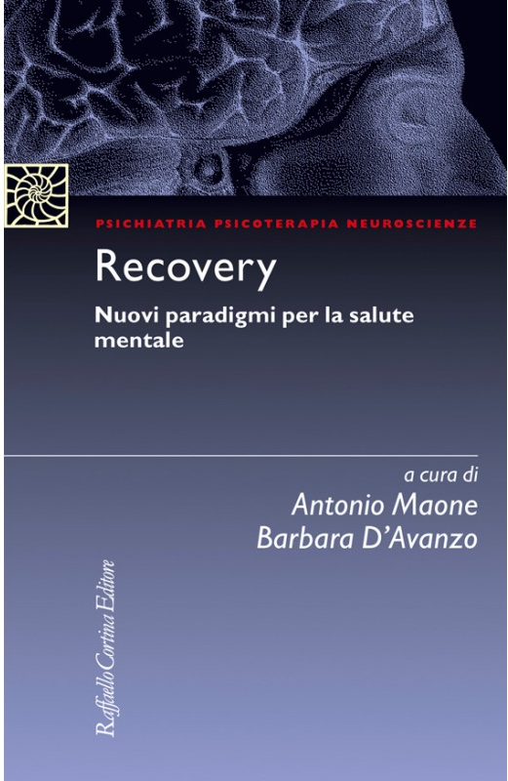
Anguilla
Australia
Canada
Ethiopia
Germany
Hong
Kong
Italy
South
Africa
Lebanon
Malaysia
Netherlands
Palestine
Qatar
Scotland

Slide 5
…are able to exercise the full range of human rights and to access high
quality, culturally-appropriate health and social care in a timely way to promote recovery, in order to attain the highest
possible level of health and participate fully in society and at work, free from stigmatization and discrimination
2021

Slide 6
Peer support
A “credible role model”
Davidson L, Rakfeldt J, Strauss J (2010)
The roots of the recovery movement in psychiatry,
Chichester: Wiley-Blackwell
All mental health services will be expected to recruit and train service users as part of the workforce
Department of Health (2001) The Journey to Recovery –
The Government’s vision for mental health care, London: Department of Health.

Slide 7
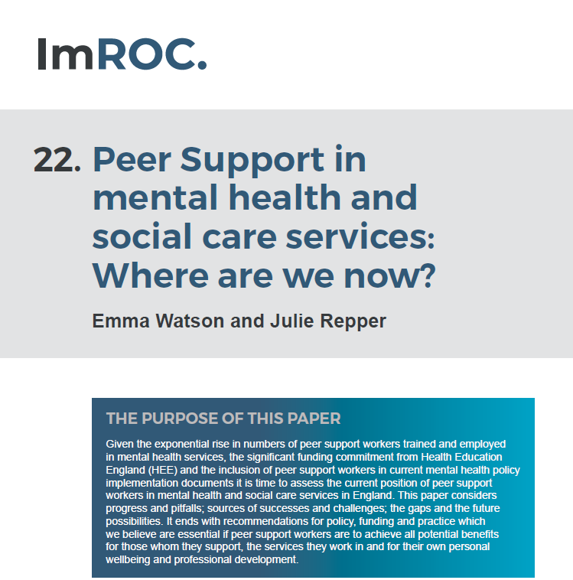
2023
The NHS long-term plan…envisages numbers of peer
support workers growing to 2,780 new peer workers employed in mental health services in 2023/4

Slide 8
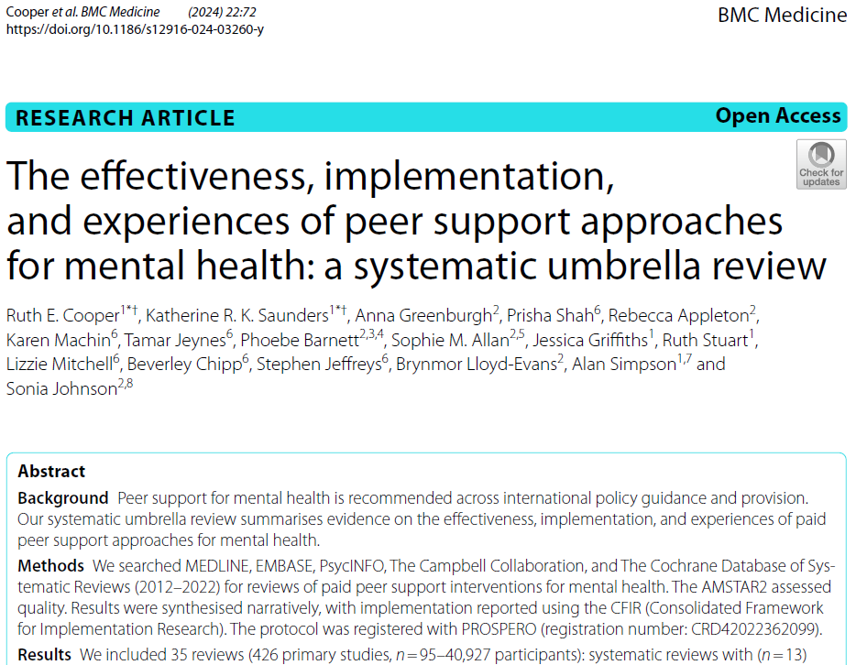
35 reviews
2024
More consistent evidence was found indicating peer
support improves recovery outcomes.

Slide 9
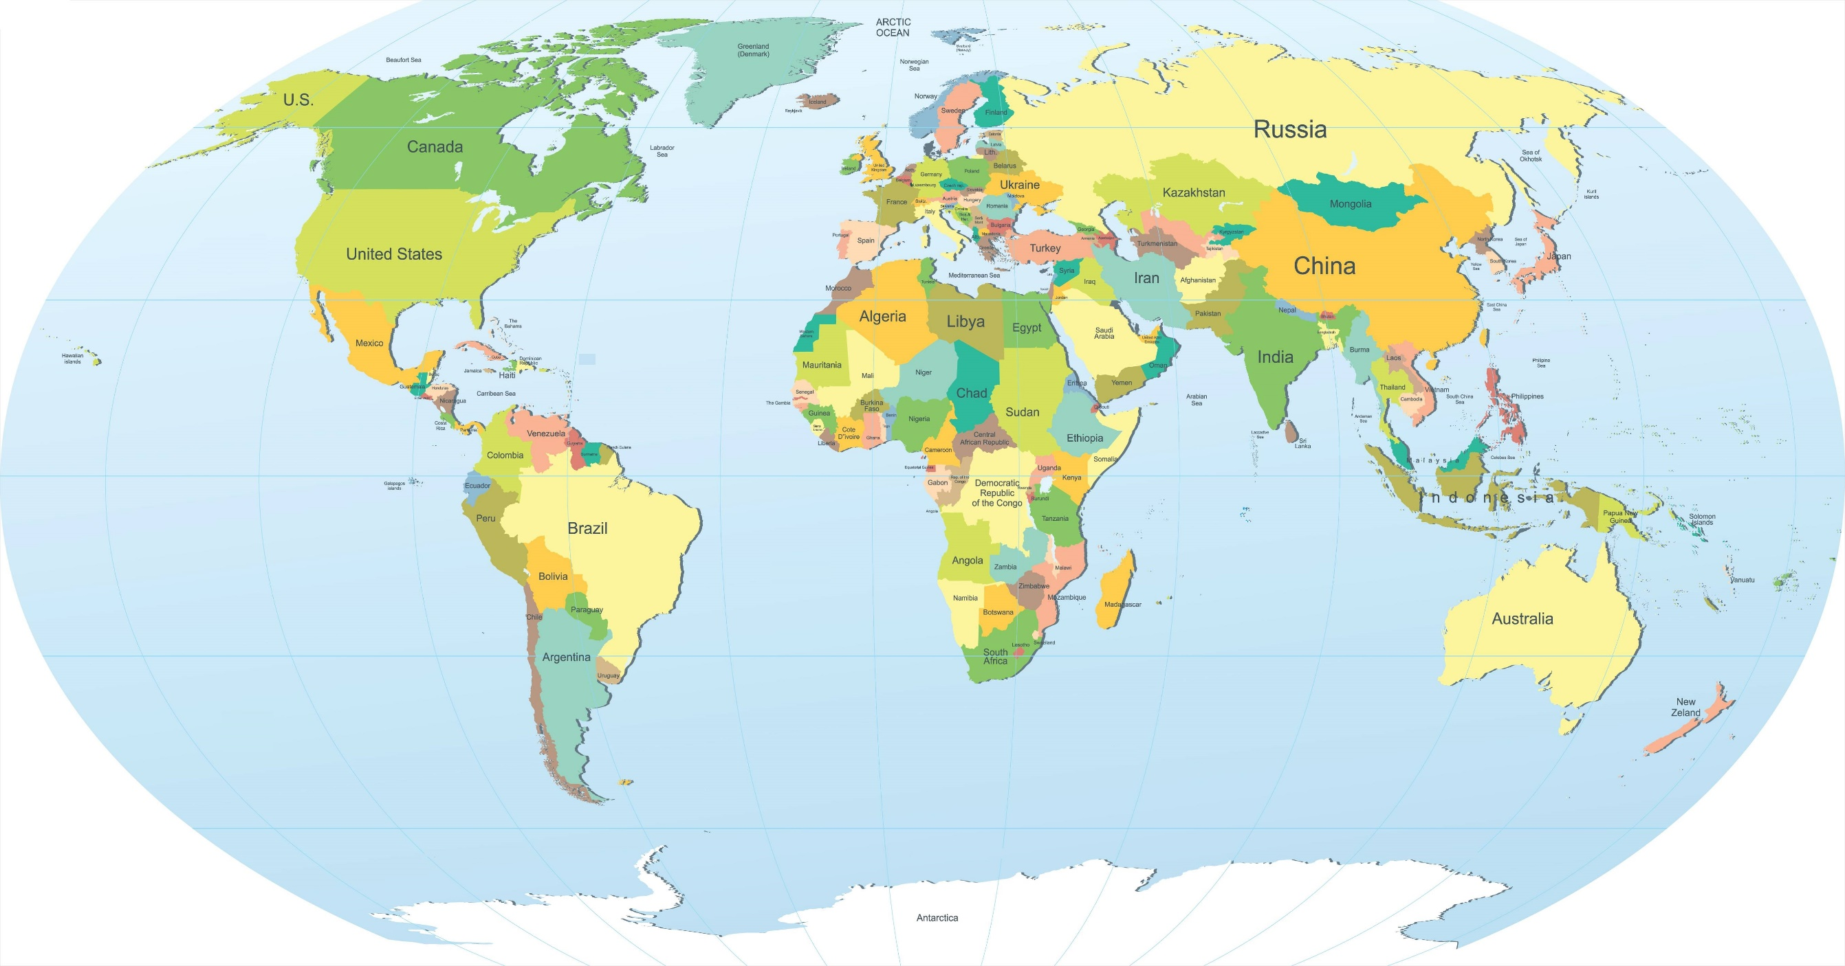

Slide 10
UPSIDES Study – upsides.org

Slide 11
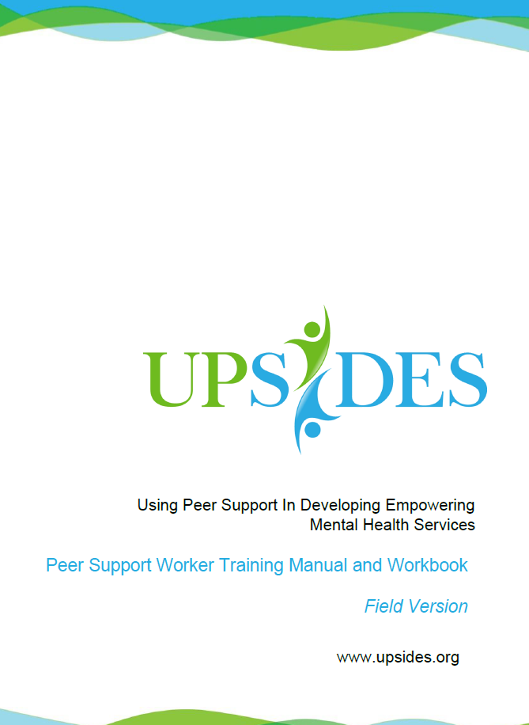
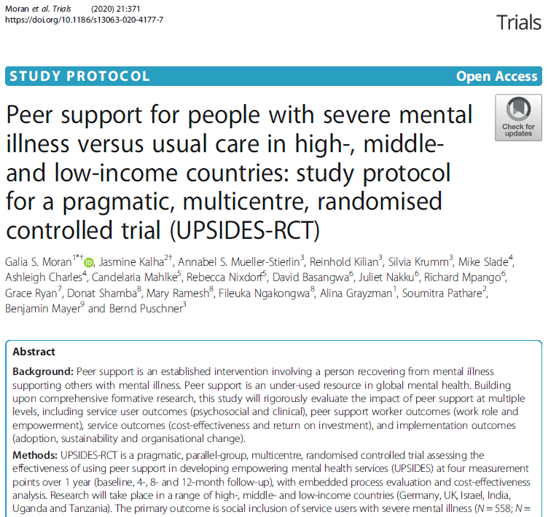
2020
2020
https://www.upsides.org

Slide 12
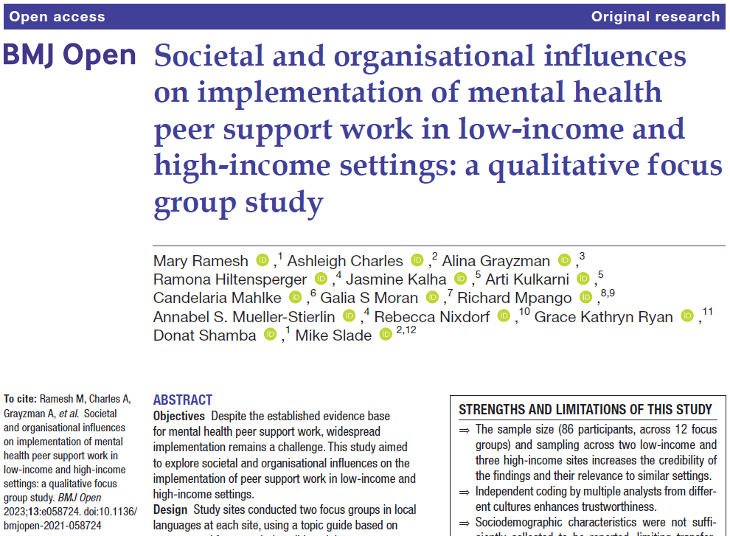
2023
Community and staff attitudes Role definition
Organisational culture Resource availability
Peer support network Training and support

Slide 13
What is a recovery narrative?
First-person lived experience accounts, include elements of both adversity / struggle and of strength / success / survival related at least in part to mental health problems, and which refer to events or actions over a period of time.
Llewellyn-Beardsley J et al (2019) Characteristics of mental health recovery narratives: systematic review and narrative synthesis, PLOS ONE, 14, e0214678.

Slide 14
Narrative Experiences Online NEON
Create world’s largest repository of recorded mental health recovery narratives
Develop an interface using machine learning to match people to stories
Conduct randomised controlled trials

Slide 15
From the ‘Riding the Storms’ collection, edited by Emily Davey
Published by Recovery Devon

Slide 16
https://www.recoverystories.uk/

Slide 17
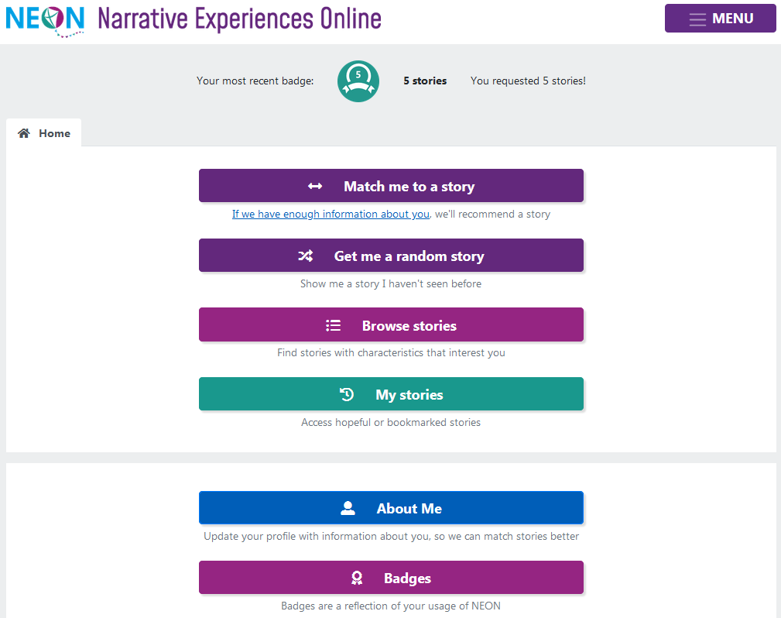

Slide 18
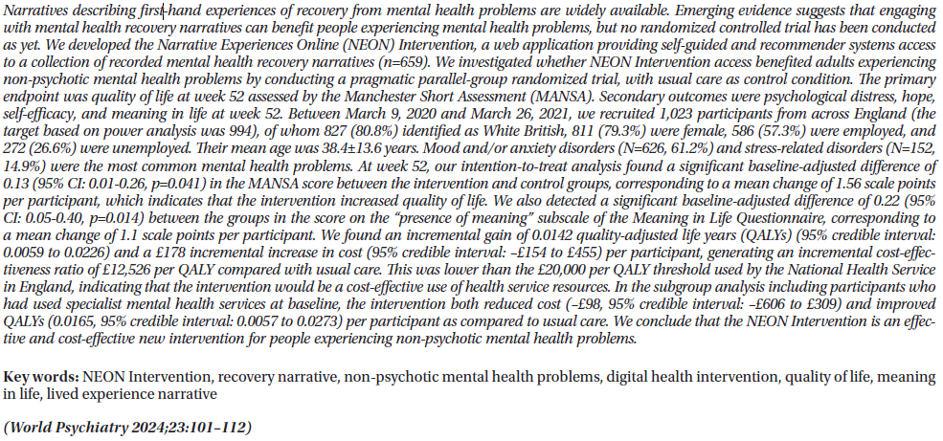
2024
The NEON Intervention is a low-intensity self-management intervention which has demonstrated effectiveness and cost-effectiveness for people with non-psychotic mental health problems in an England-wide trial

Slide 19
Thank you
E: m.slade@nottingham.ac.uk
W: researchintorecovery.com

