Slide 1
Changing Mind(s) in a Changing world: from hospital to community
2 Decades of Mental Health Policy in 5 Slides

Slide 2
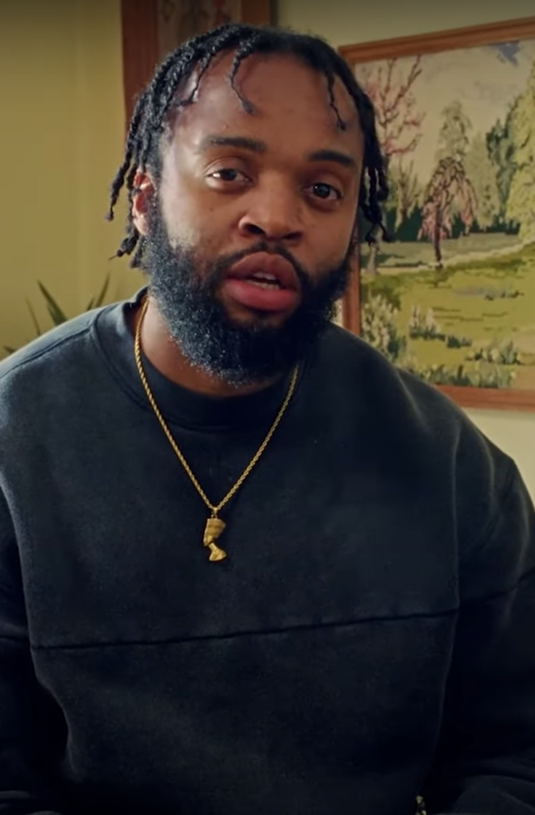
Why are we here?

Slide 4
The National Service Framework 1999
Mental health promotion
Primary care and access to services
Effective services for people with severe mental illness
Caring about carers
Preventing suicide

Slide 6
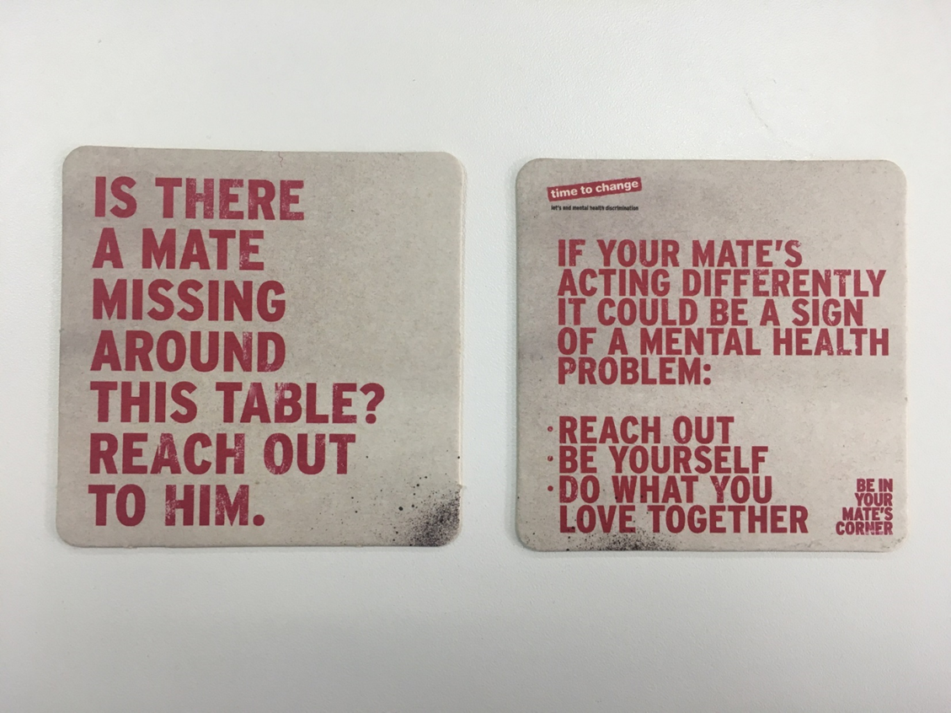

Slide 8
5 Year Forward View for Mental Health-2016

Slide 9
Mental Health Law-unfinished business

Slide 10
https://www.youtube.com/watch?v=JP3oTRLPq1E
https://www.youtube.com/watch?v=hdPZ7rw0wMc
https://www.youtube.com/watch?v=_y97VF5UJcc
https://www.youtube.com/watch?v=crp4VojqAdo
https://www.youtube.com/watch?v=cyEdZ23Cp1E
https://www.youtube.com/watch?v=h1NvUkR2Jw4

Slide 11
https://www.mirror.co.uk/news/uk-news/asda-says-sorry-after-advertises-2303405

