Slide 1
12/03/24
Festschrift Conference for Professor Sir Graham Thornicroft
Local and Global Mental Health: So Near and So Far
INDIGO
International Study of Discrimination and Stigma Outcomes
Petra Gronholm, PhD
Institute of Psychiatry, Psychology & Neuroscience; King’s College London, UK
petra.gronholm@kcl.ac.uk
@gronholmpetra

Slide 2
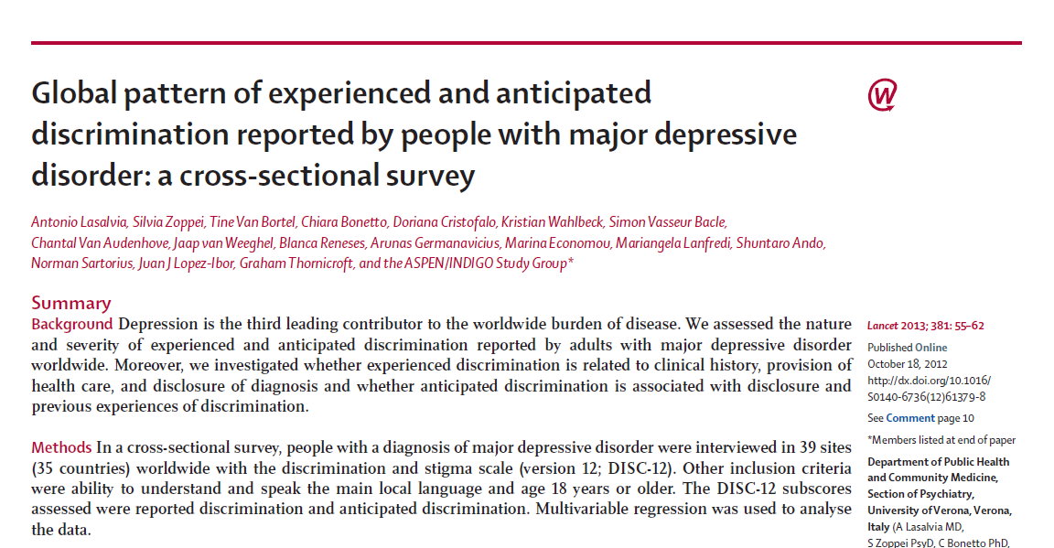
INDIGO background
People with diagnosis of schizophrenia: 90% reported discrimination (27 countries) (Thornicroft et al., 2009)
People with diagnosis of depression: 79% reported discrimination (35 countries) (Lasalvia et al., 2013)

Slide 3
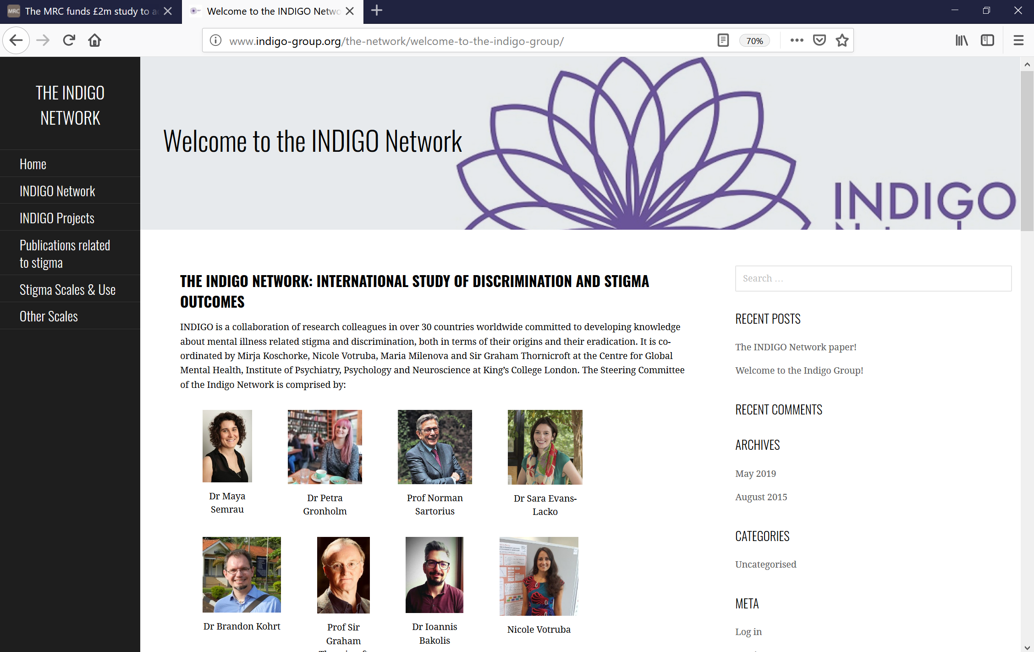
http://www.indigo-group.org/

Slide 4
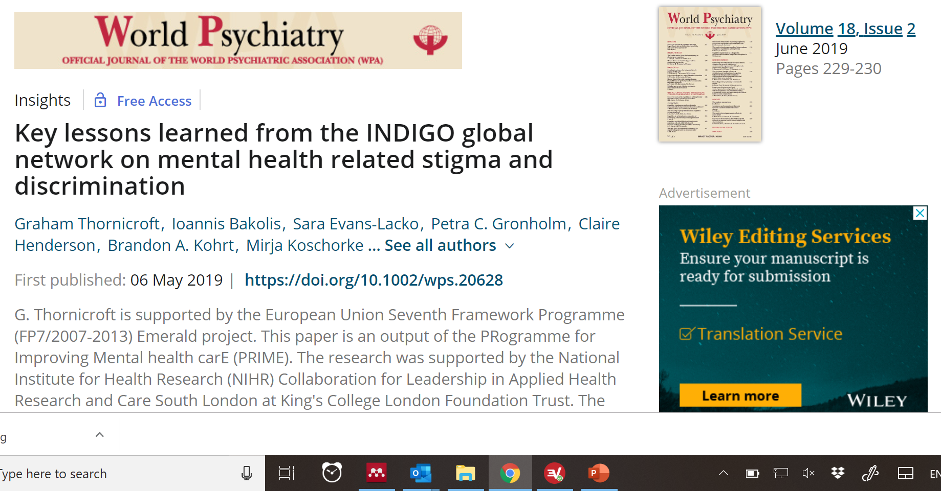
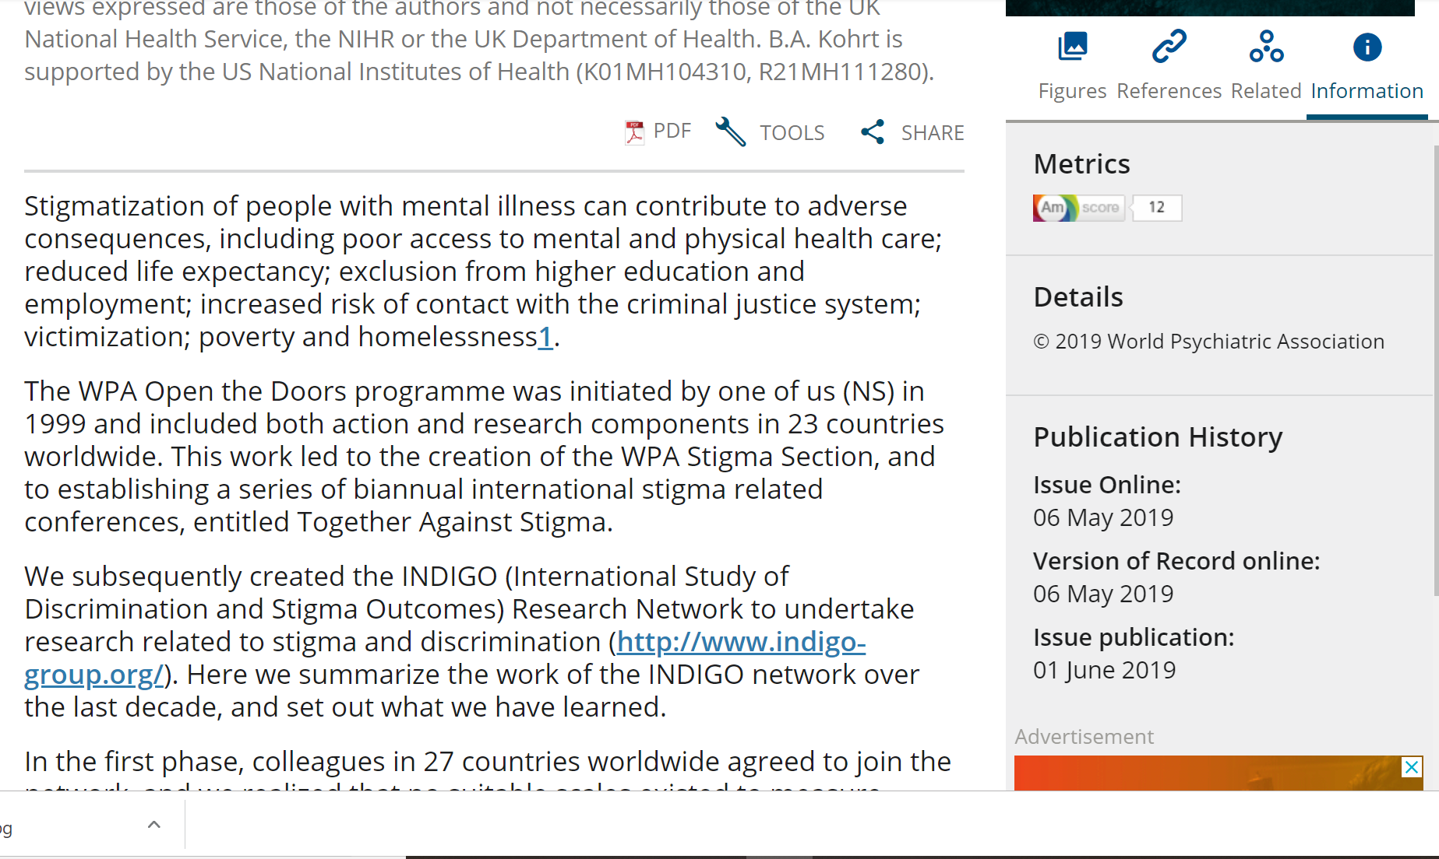
http://www.indigo-group.org/

Slide 6
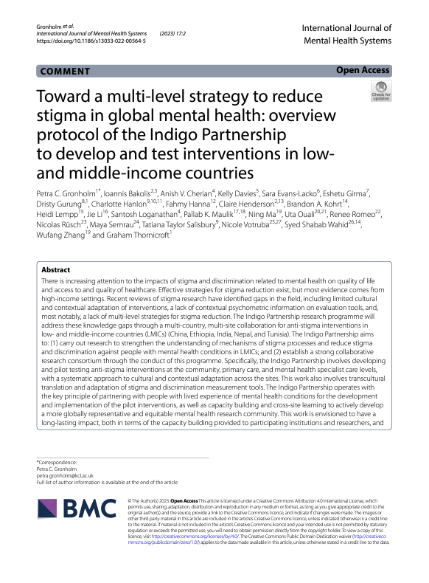
Programme to develop and pilot stigma-reduction interventions in LMICs
China, India, Nepal, Tunisia, Ethiopia
Understand stigma processes, contextually and culturally adapted anti-stigma interventions and measures
Establish a strong collaborative research consortium, capacity building

Slide 7
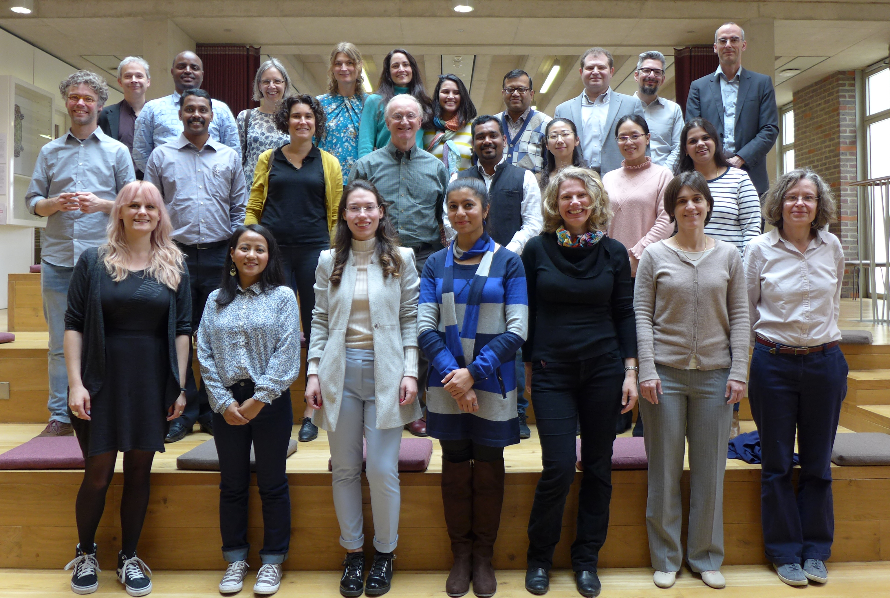
Indigo Partnership team

Slide 8
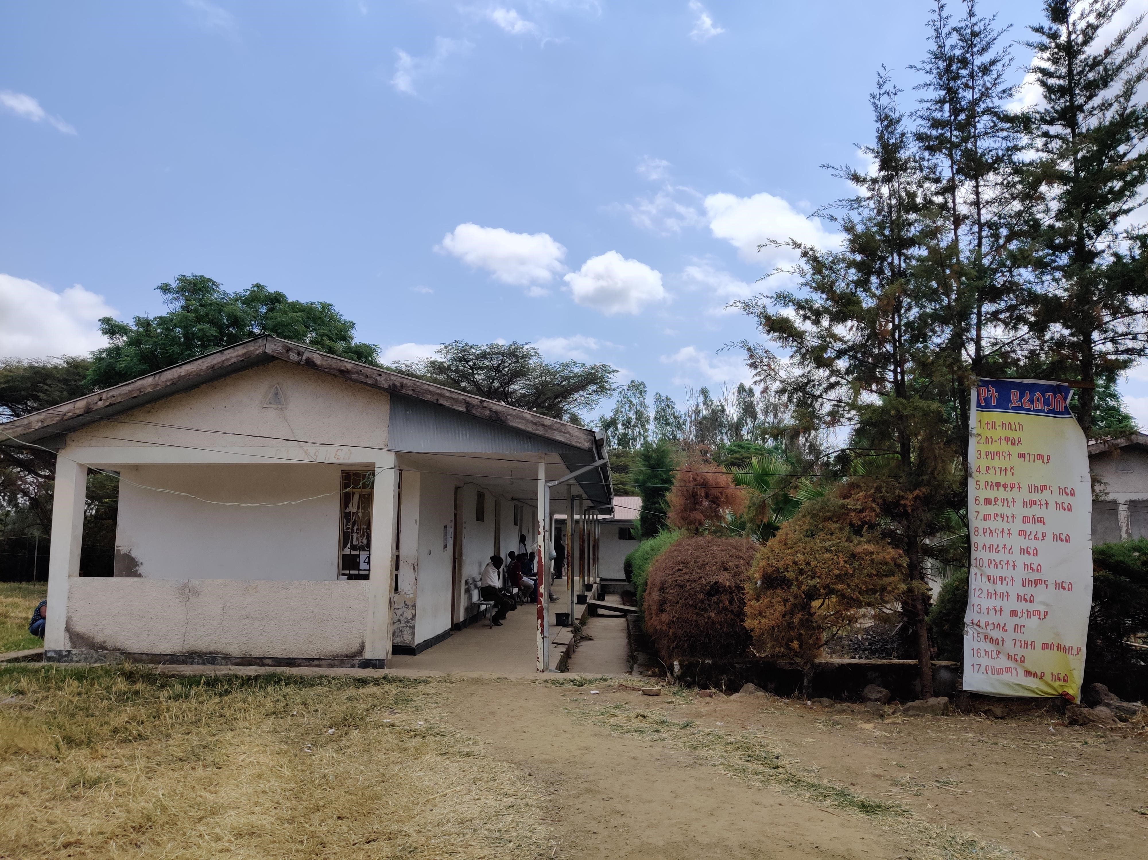
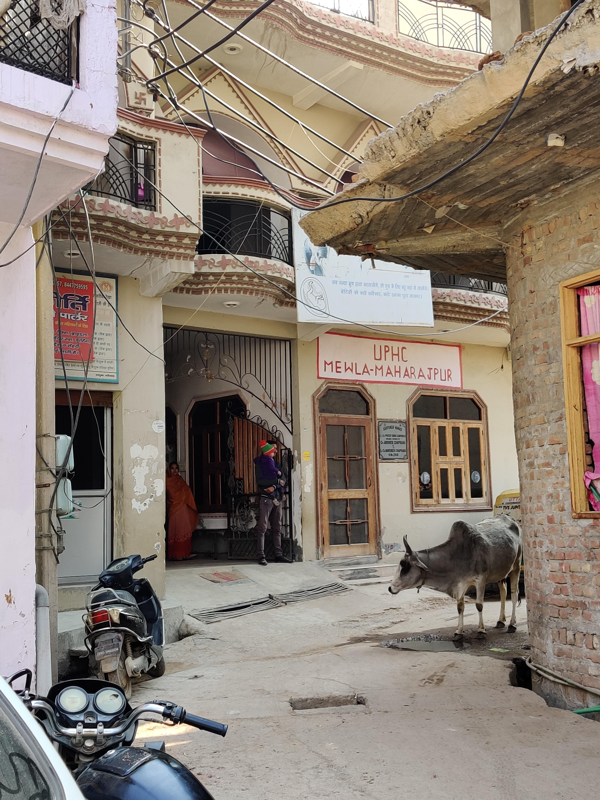
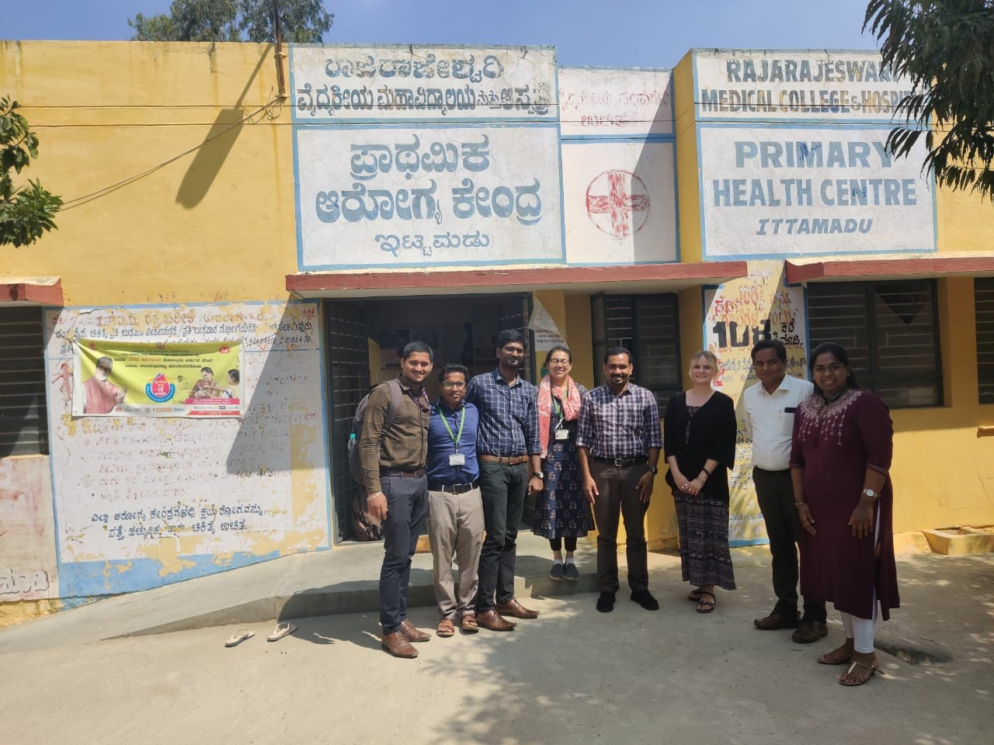
Implementing sites
Culturally varied settings, diverse contexts
Low, lower-middle, and upper-middle income; rural vs. urban
District Health Centre; Sodo, Ethiopia
Urban Primary Health Centre; Faridabad, India
Zengcheng Zhongxin Hospital; Guangdong Province, China
Ittamadu Primary Health Centre; Karnataka, India

Slide 9
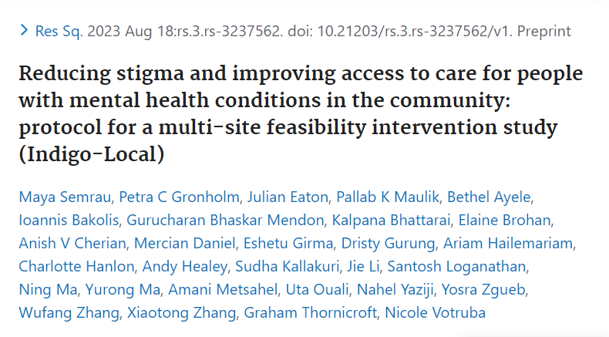
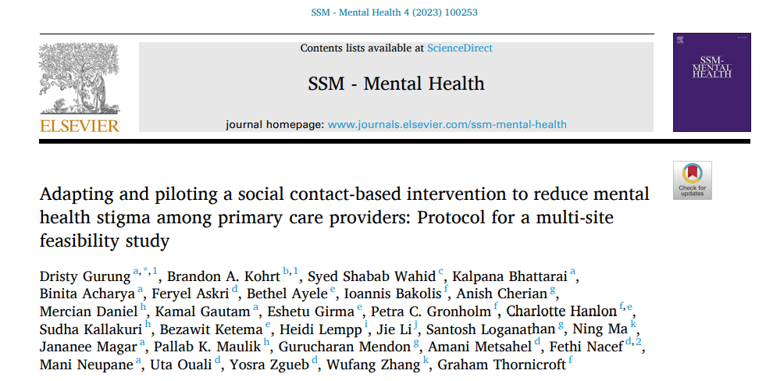
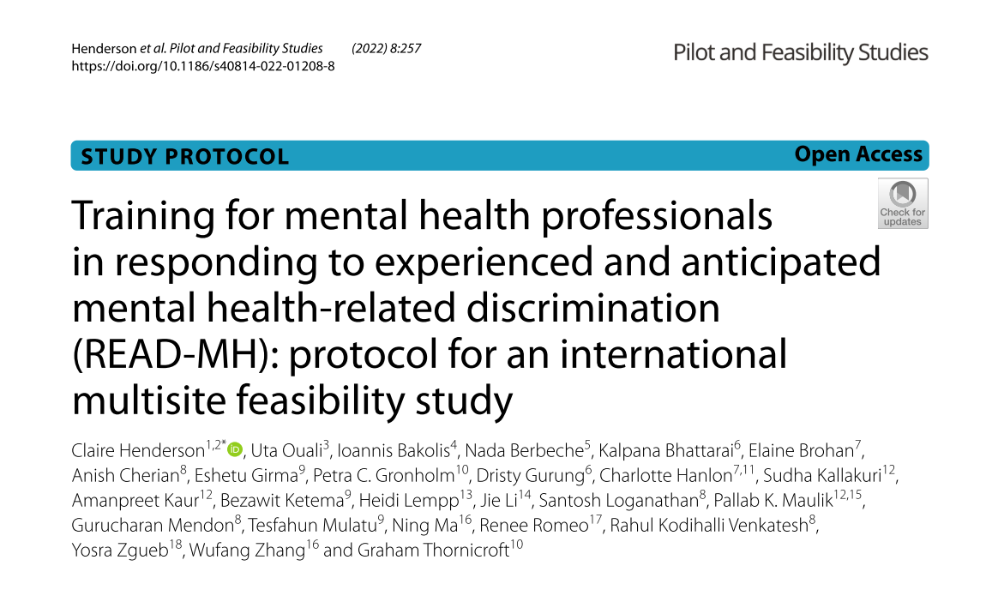
Three stigma reduction interventions
Local: Community awareness-raising intervention to reduce stigma and increase
Primary: Reducing stigma among primary health care workers through sharing recovery stories
READ: Training for specialist health service staff to respond to stigma affecting service users

Slide 10
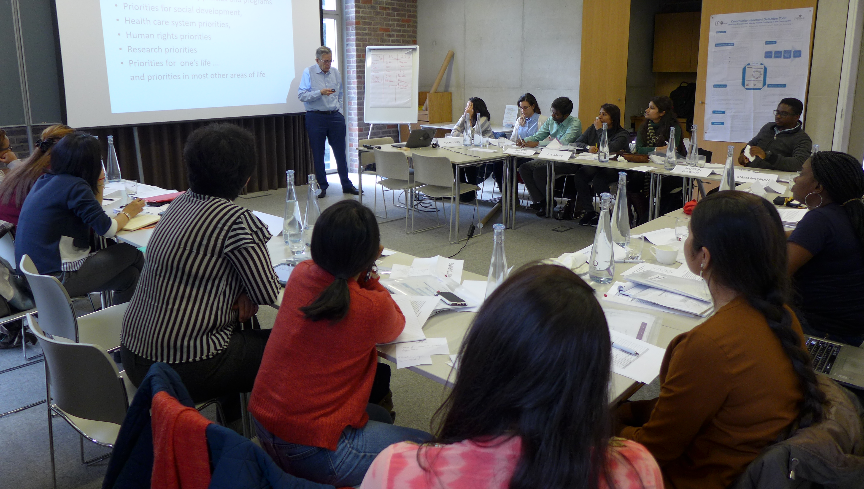
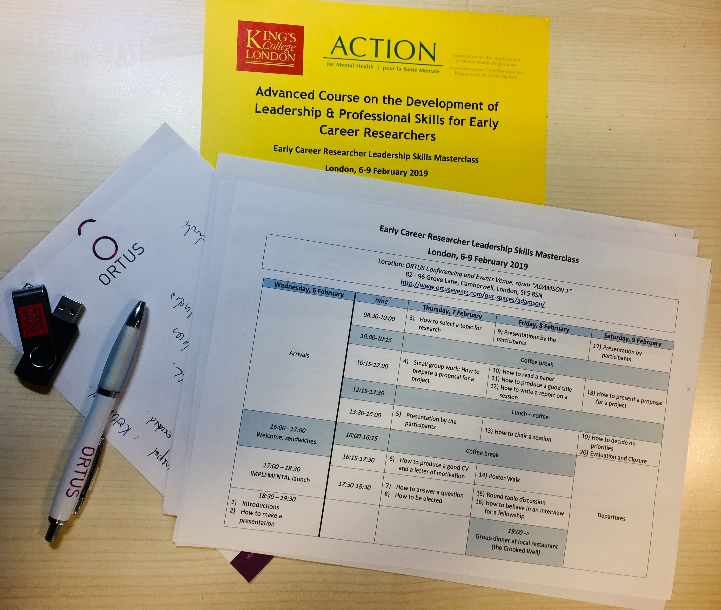
Collaboration, capacity building
Cross-project leadership
Satisfaction survey
ECR training
Mentoring scheme
Publication agreement
MSc, PhD students

Slide 11
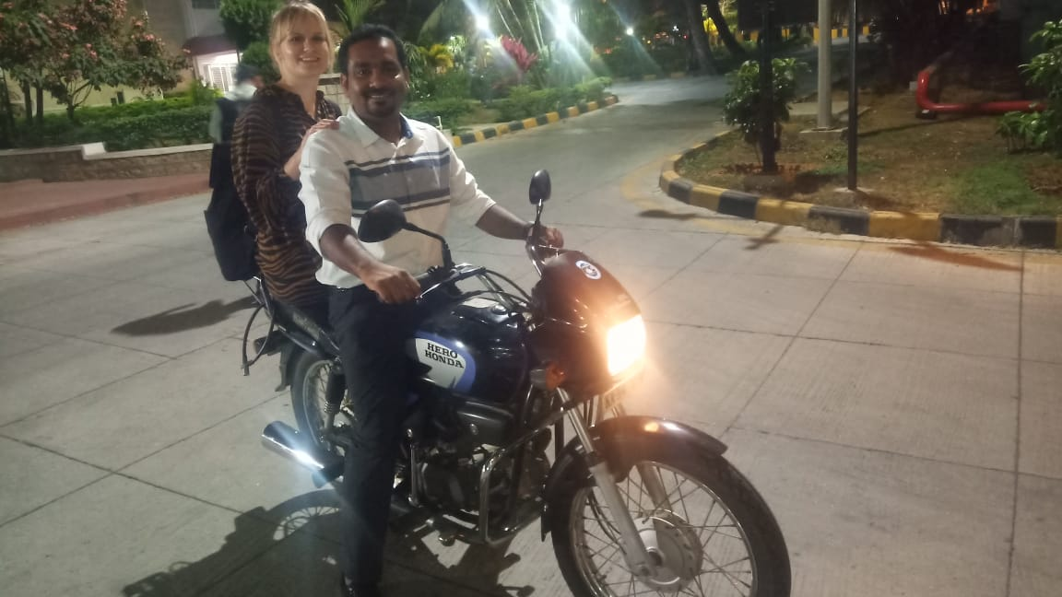

Slide 12
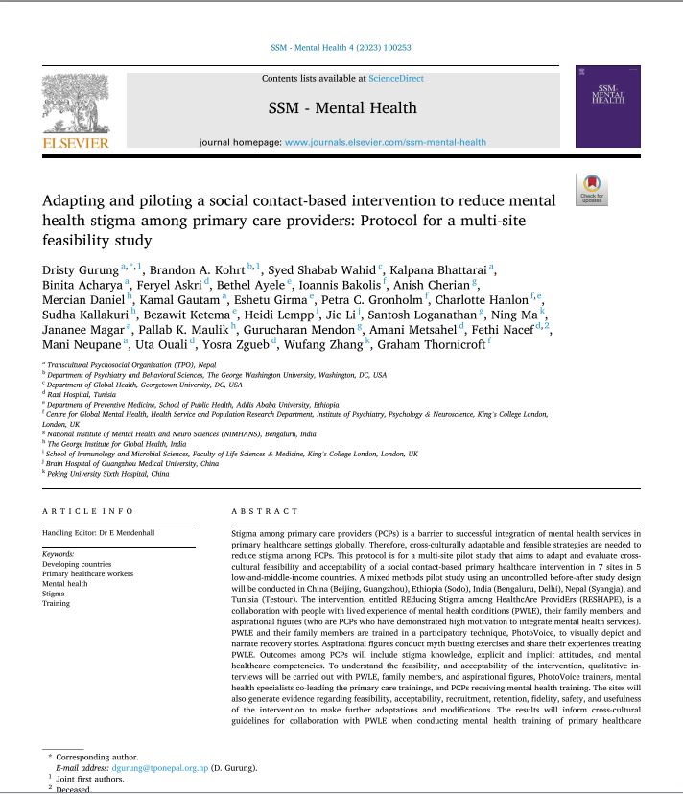
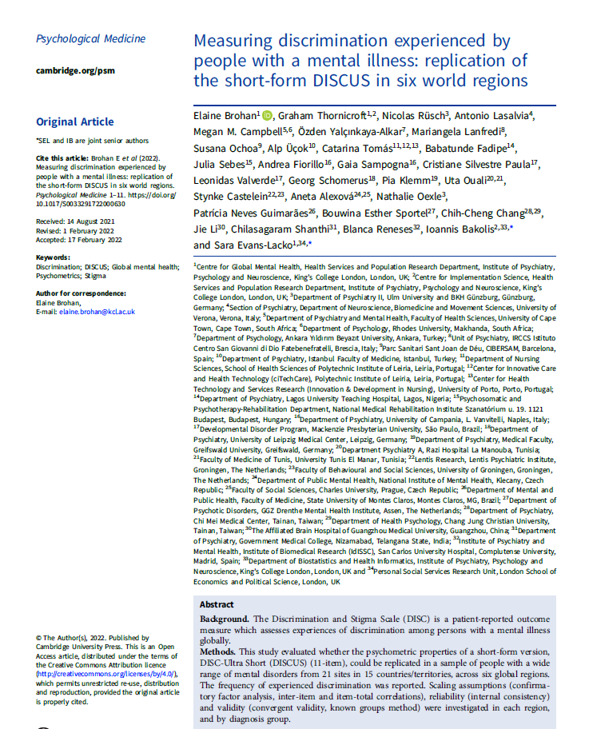
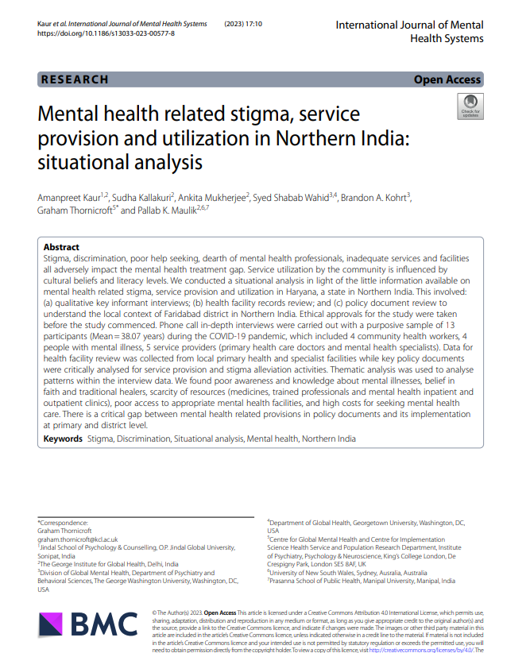
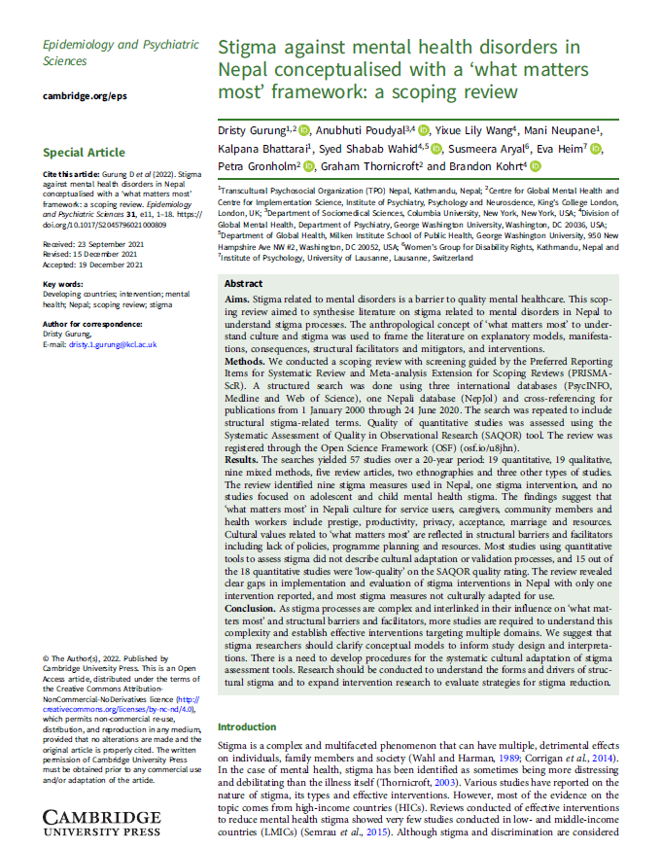
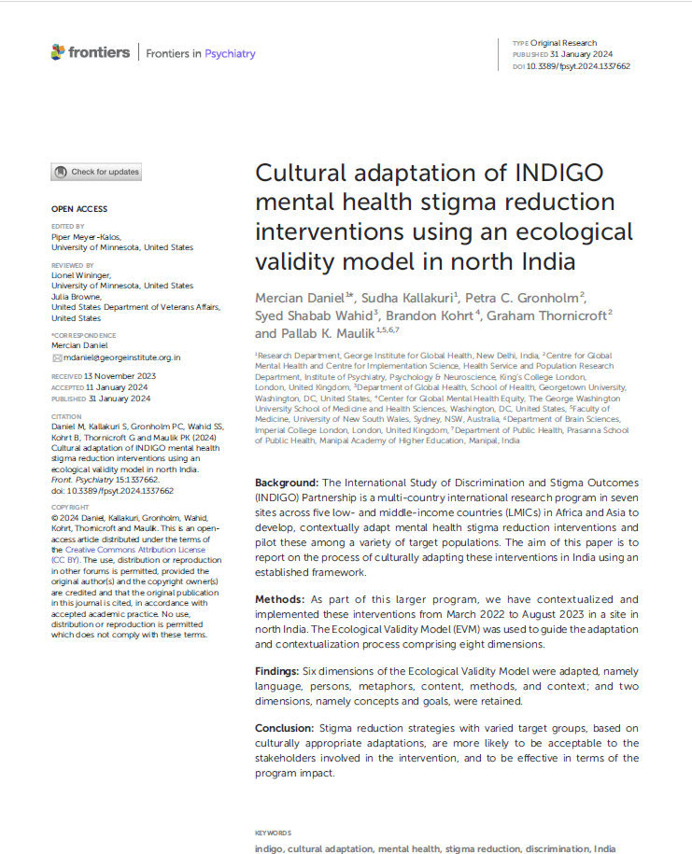
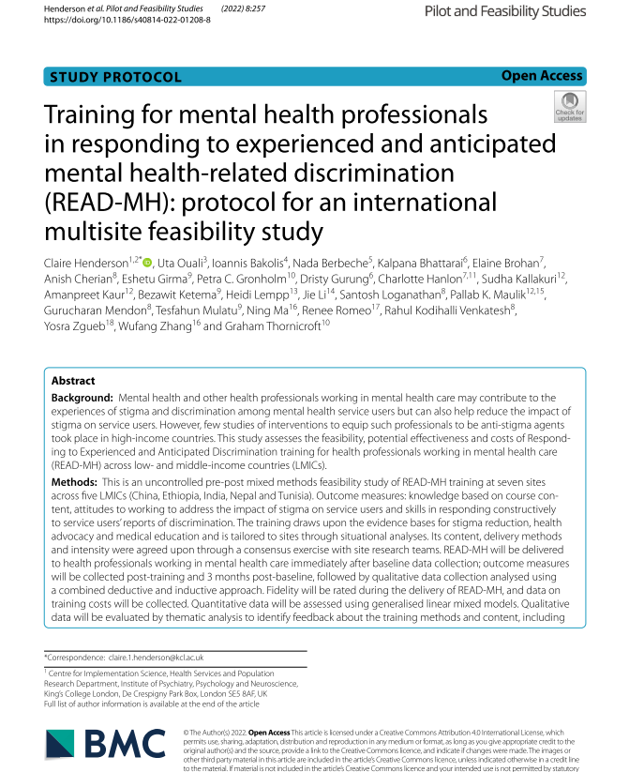
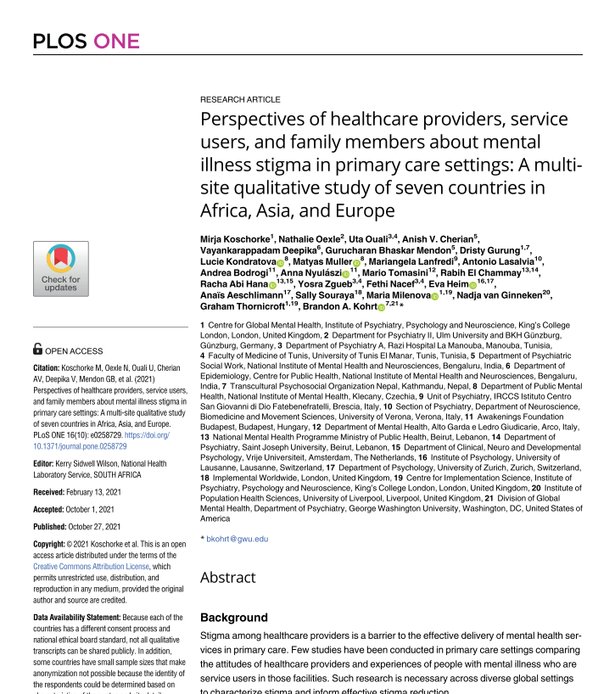
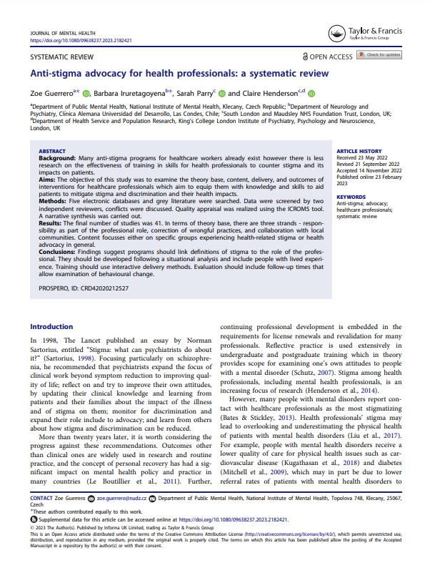
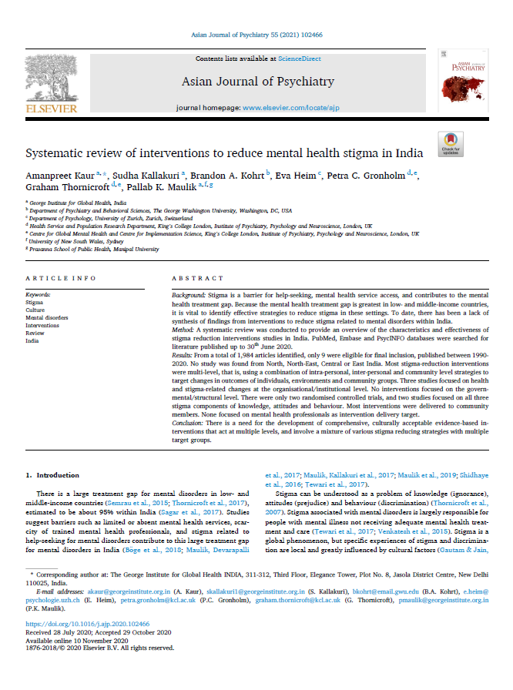
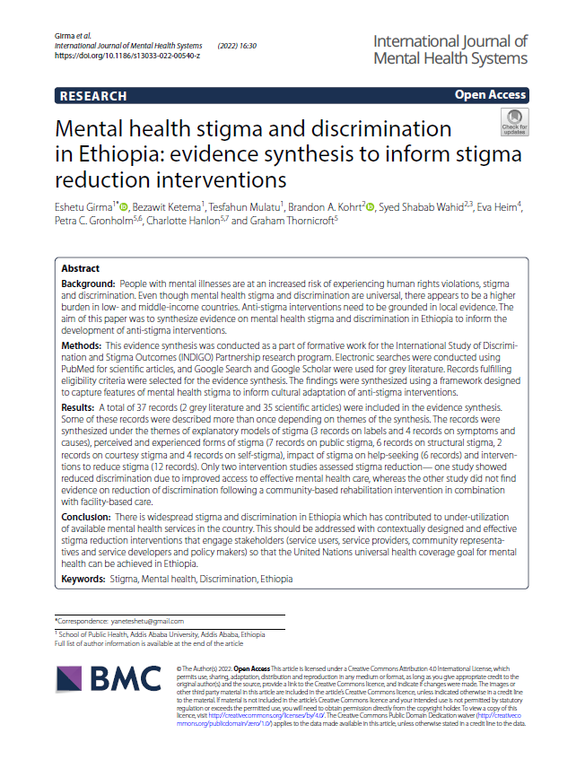

Slide 13
20+ directly related publications, 50+ indirectly related
… and counting!
20+ directly related publications, 50+ indirectly related
… and counting!

Slide 15
Recapping key resources

Slide 16
Thornicroft et al., 2022

Slide 17
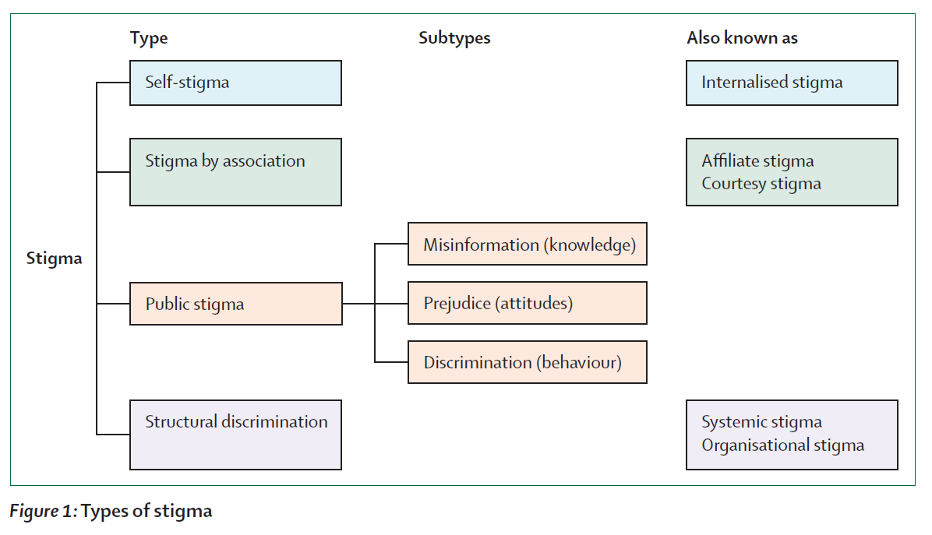
Thornicroft et al., 2022

Slide 18
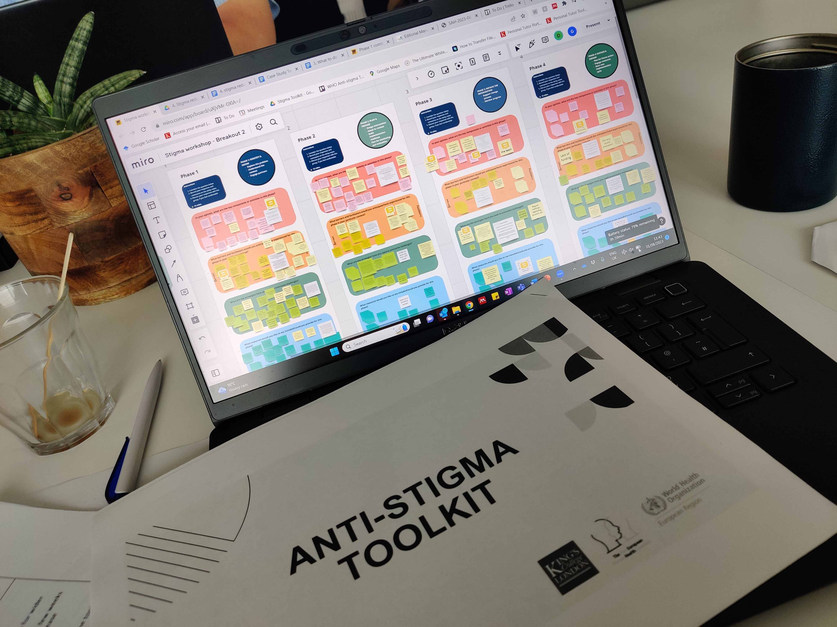
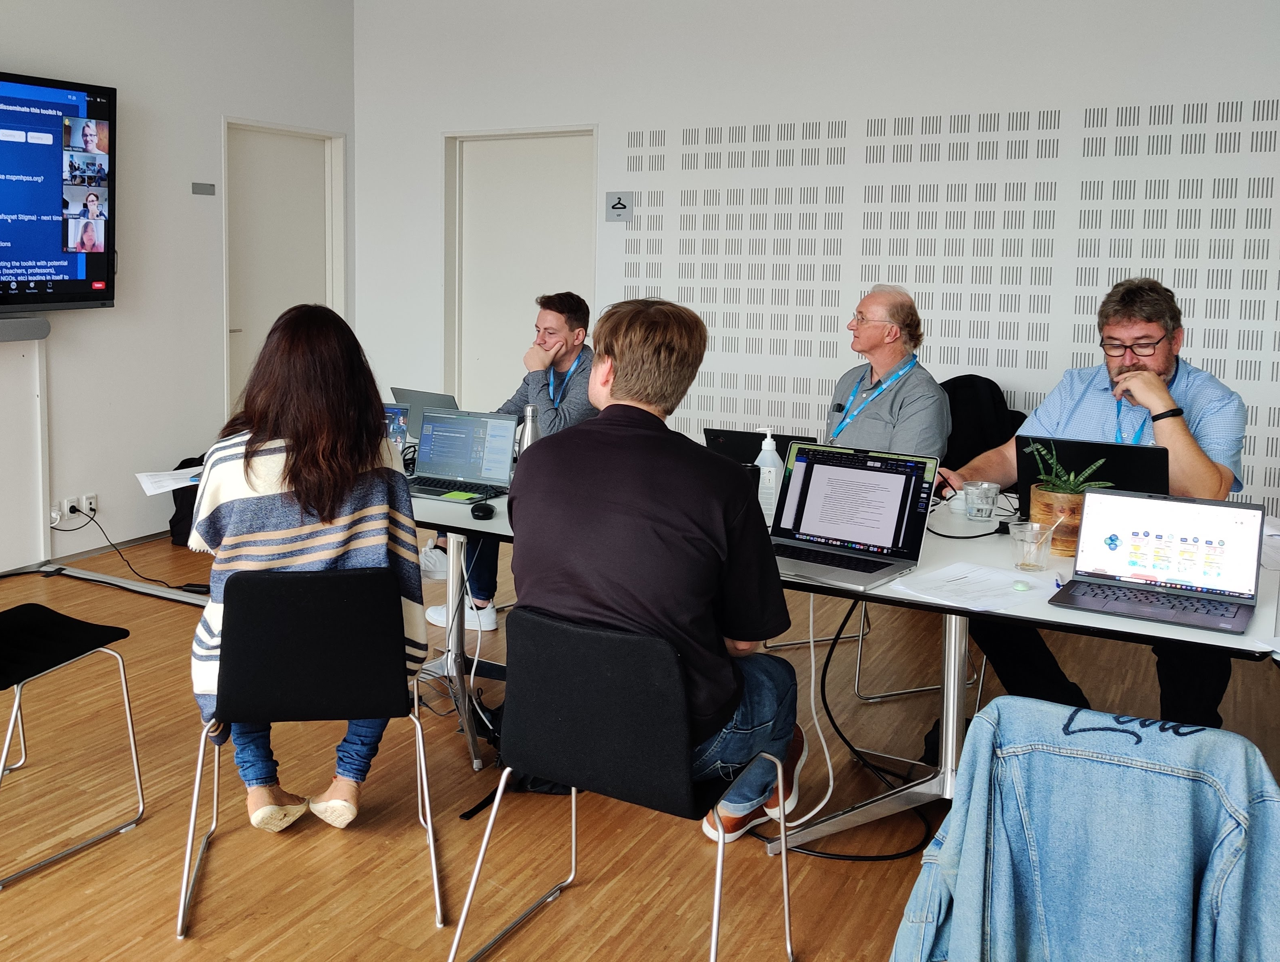
The WHO Toolkit to Reduce Stigma and Discrimination in Mental Health

Slide 19
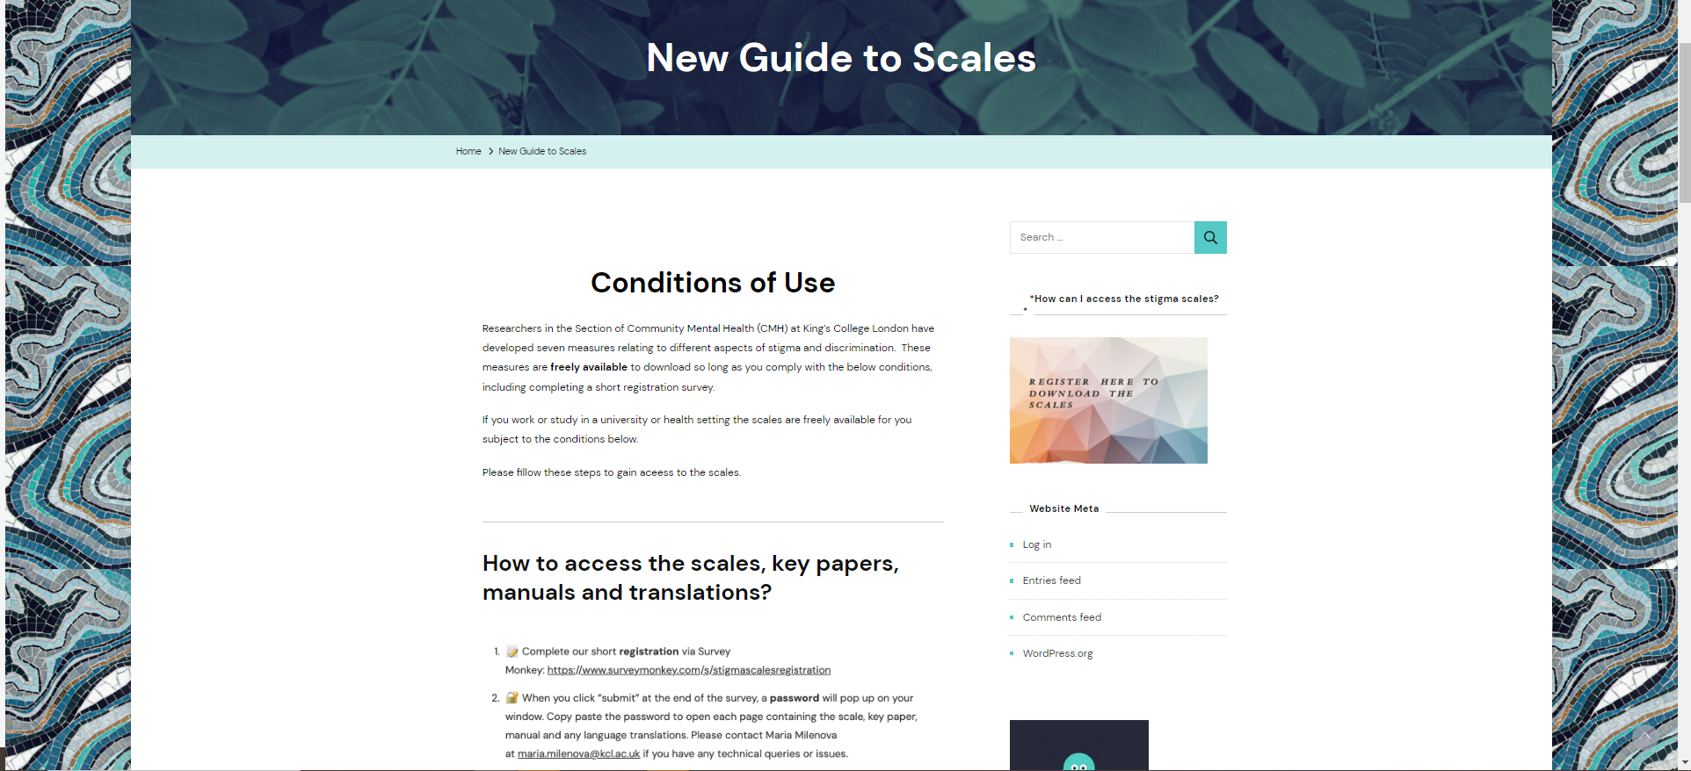
https://www.indigo-group.org/new-guide-to-scales/

Slide 20
https://www.indigo-group.org/new-guide-to-scales/
Barriers to access to care scale BACE
Costs of discrimination assessment CODA
Discrimination and stigma scale DISC, DISCUS
Mental health knowledge schedule MAKS
Mental illness: clinicians’ attitudes scale MICA
Reported and intended behaviour scale RIBS

Slide 21
https://changingmindsglobally.com/

Slide 22
https://www.mhinnovation.net/resources/global-anti-stigma-toolkit-conversations-change-lives

Slide 23
petra.gronholm@kcl.ac.uk
@gronholmpetra
http://www.indigo-group.org/

