Slide 1


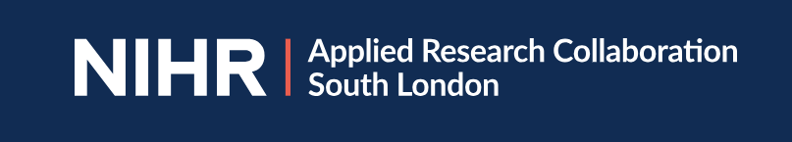
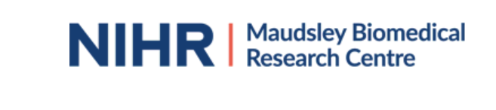
Marginalised and excluded, tackling premature deaths in people with severe mental health conditions
Dr Jayati Das-Munshi
Clinical Reader in Social and Psychiatric Epidemiology,
Honorary Consultant Psychiatrist

Slide 2
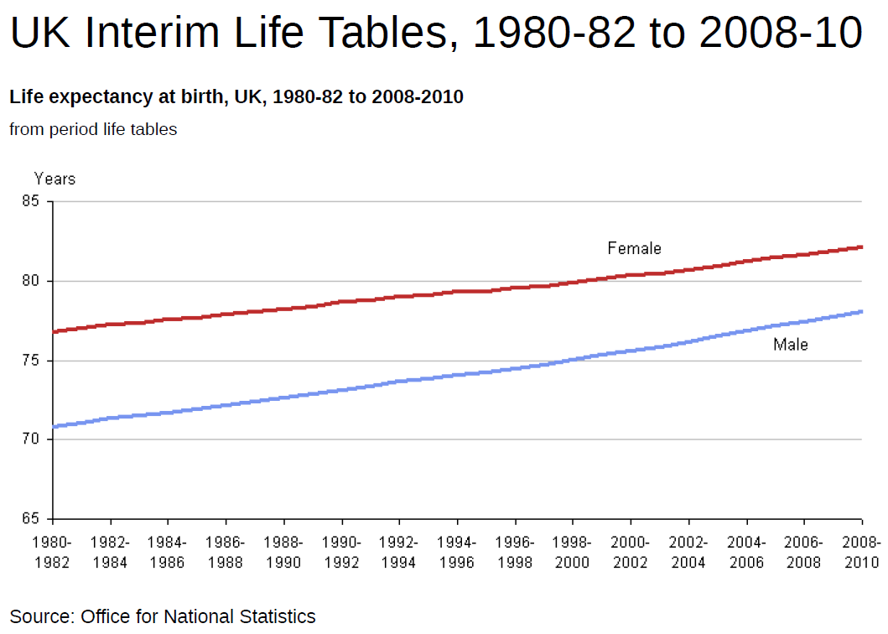
Female
SMI
Male
SMI

Slide 3
a global issue
Hjorthoj C., et al Lancet Psychiatry 2017

Slide 4
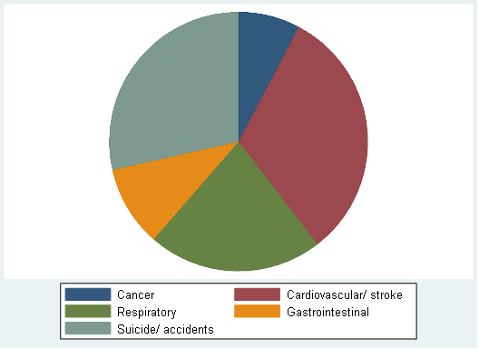
most causes of death are from preventable physical conditions
top five causes of death in people with schizophrenia and bipolar disorders (UK sample)
Das-Munshi et al, Lancet Psychiatry 2017

Slide 5
evidence based recommendations for practitioners
Liu N., et al. World Psychiatry 2017

Slide 6
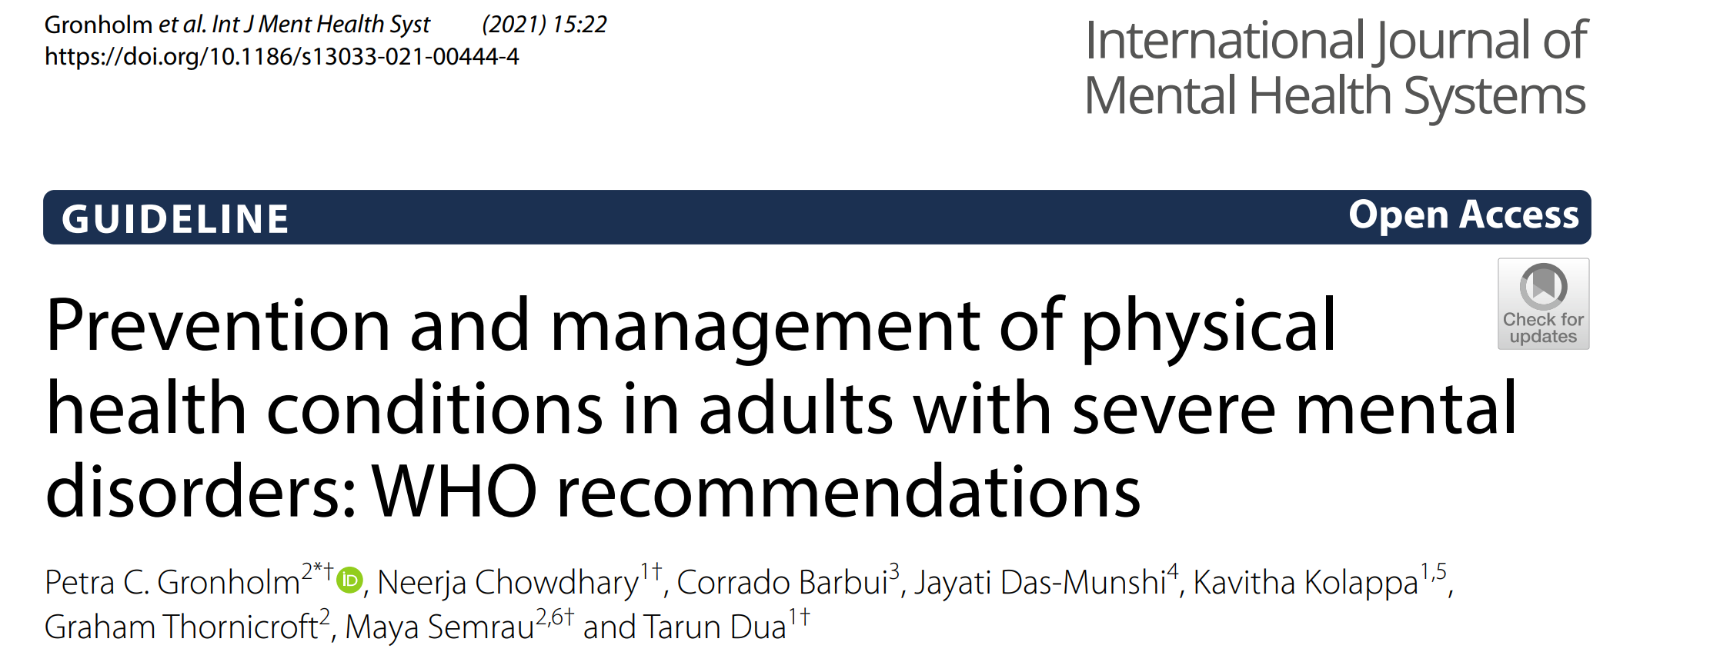
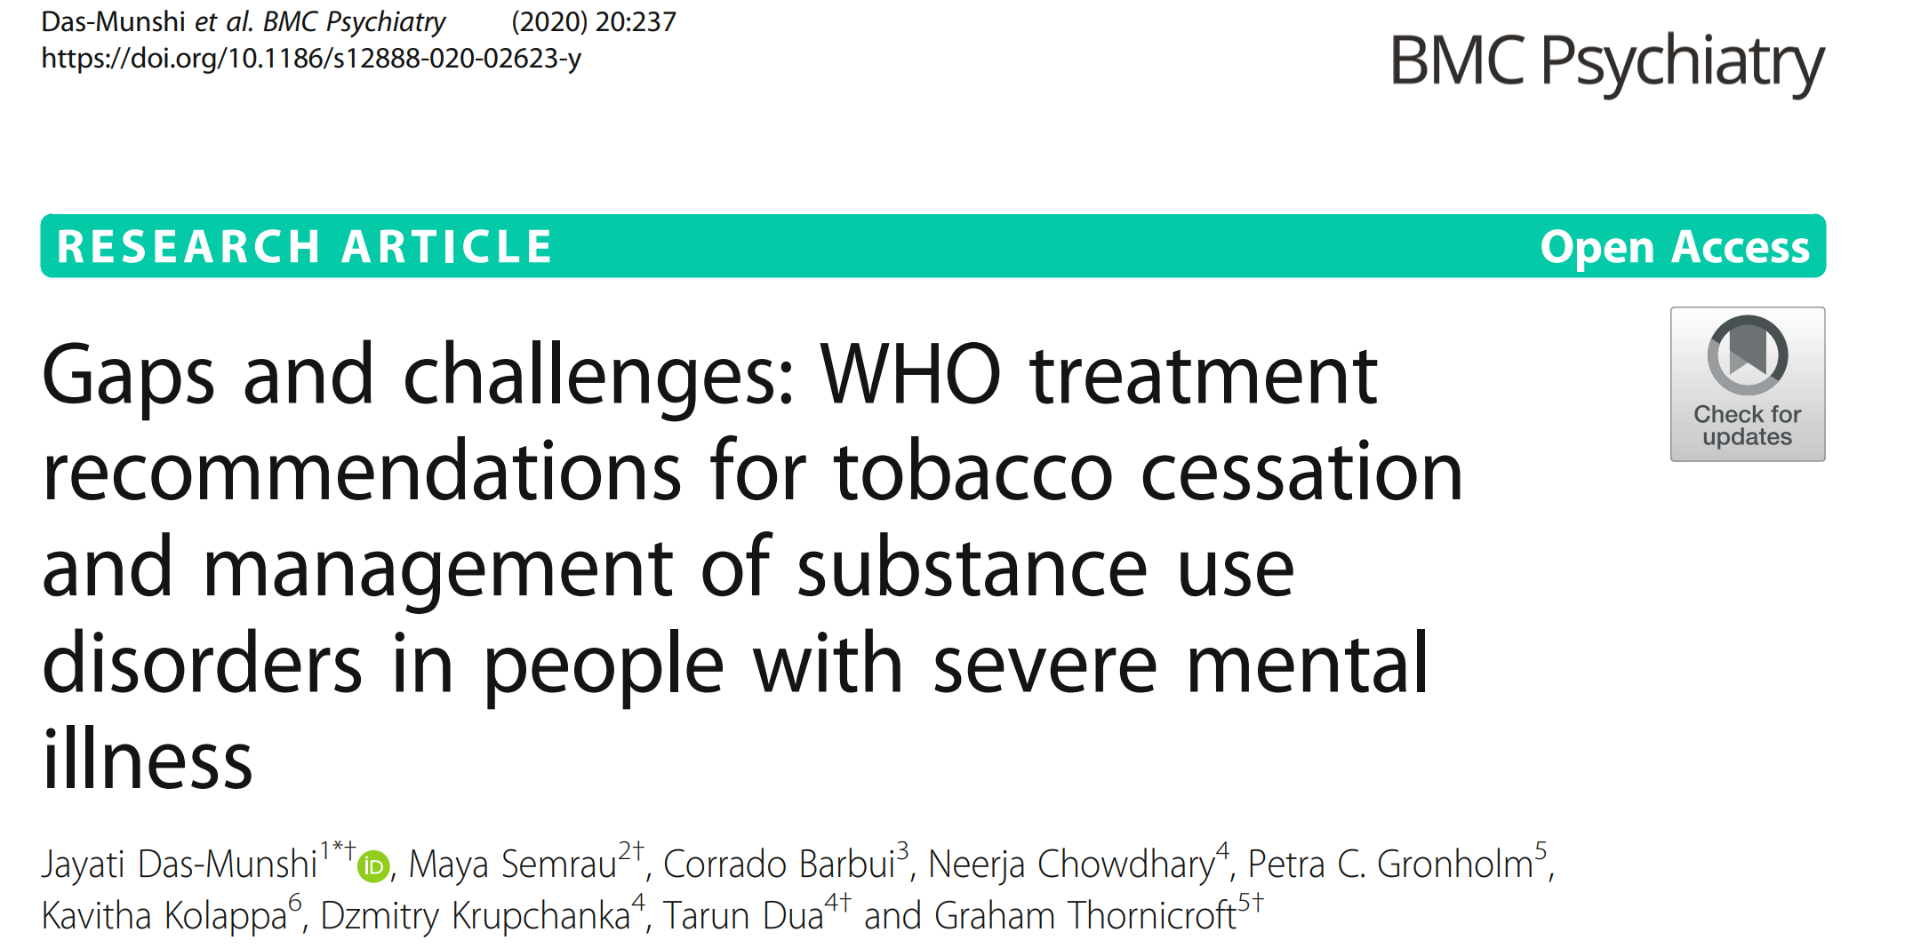
evidence based recommendations for practitioners
Challenges- evidence base mostly from well-resourced settings, therefore may not reflect local contexts, globally
Particularly for dual diagnoses- “Scientific neglect”- inequities are further perpetuated

Slide 7
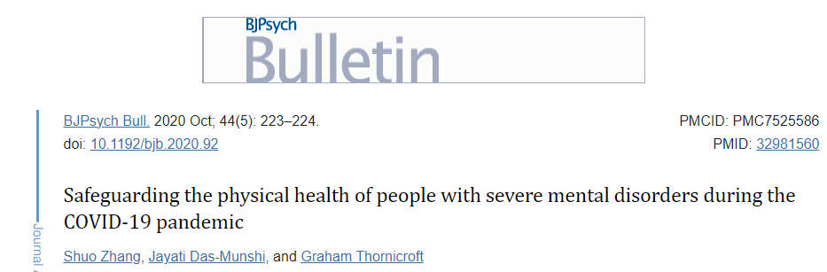
COVID-19
On 30th January 2020, following the identification of novel SARS-COV-2 coronavirus, the World Health Organization (WHO) declared a public health emergency of international concern
How did COVID-19 further impact inequities?

Slide 8
impact of COVID-19
age and gender standardised mortality ratios (SMRs) by psychiatric diagnosis; 2019 to 2020
Key: Q1: quarter 1; Q2: quarter 2; Q3: quarter 3; Q4: quarter 4; a: 2019; b: 2020.
Das-Munshi et al, The Lancet Regional Health-Europe 2021

Slide 9
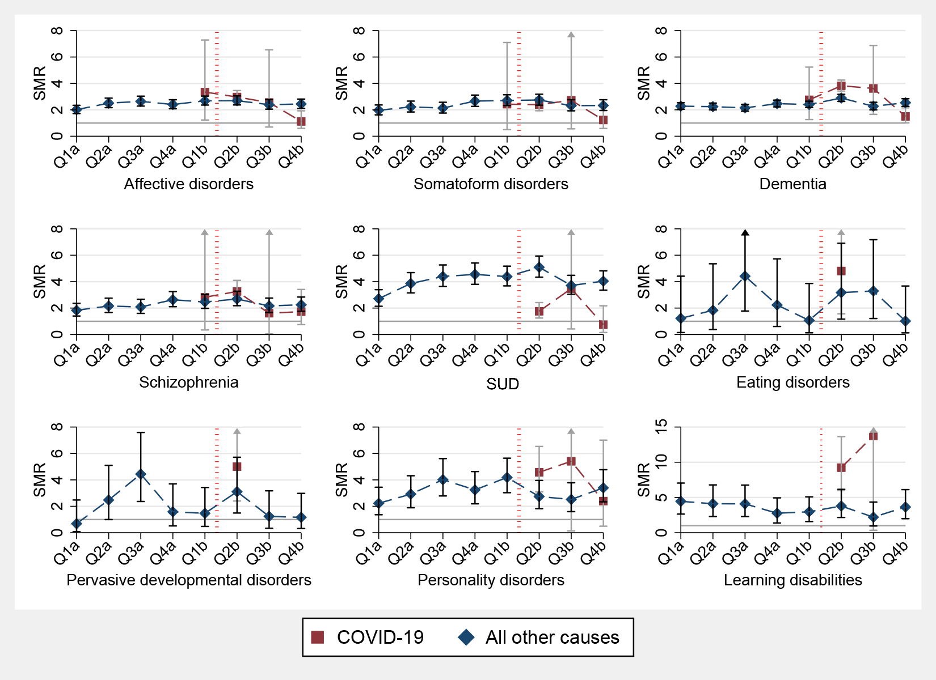
COVID-19 magnified pre-existing inequities
age and gender standardised mortality ratios (SMRs) by cause across diagnoses; 2019 to 2020
Key: Q1: quarter 1; Q2: quarter 2; Q3: quarter 3; Q4: quarter 4; a: 2019; b: 2020.
Das-Munshi et al, The Lancet Regional Health-Europe 2021

Slide 10
Overall
1
First wave
1
Second wave
1
Survival
probability
No SMI
9
SMI
.
9
9
0
140
280
420
.
.
Analysis time
0
90
180
270
0
60
120
180
Number at risk
Analysis time
Analysis time
No SMI
653024
648900
643904
623405
653024
652712
647503
644353
644156
639765
629680
620483
SMI
7493
7306
7077
6511
7493
7481
7242
7092
7086
6972
6654
6445
Key: SMI- severe mental illness.
Survival probability following COVID-19 infection;
first year of the COVID-19 pandemic in the UK
Das-Munshi et al, The British Journal of Psychiatry, 2023

Slide 11
sadly predictable?
“individual vulnerabilities are exacerbated by health system factors…”
“diversion of resources from mental health settings..”

Slide 12
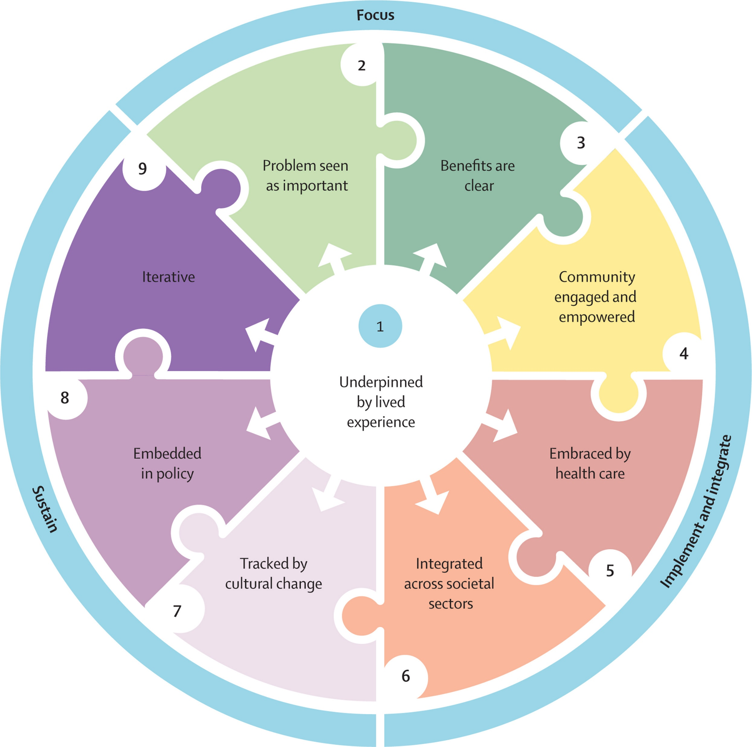
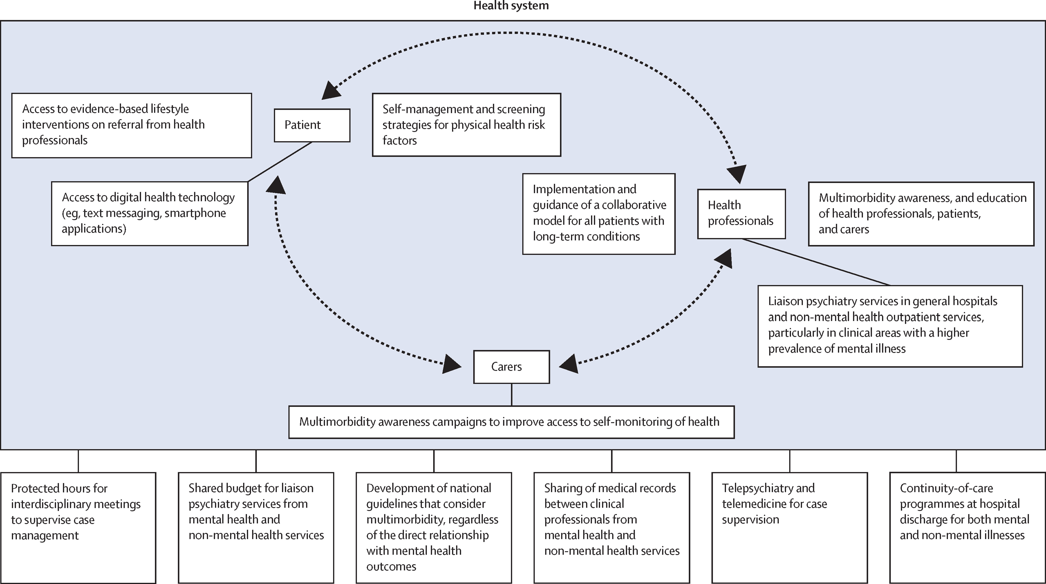
Collaborative care and implementation
The Lancet Psychiatry Commission: a blueprint for protecting physical health in people with mental illness, 2019
O’Connor et al, “Gone too soon”
Lancet Psychiatry 2023

Slide 13
Conclusions
15-20 year reduction in life expectancy in people with SMI. This is on par with the mortality gap frequently discussed for ‘inclusion health’ (socially excluded) groups.
COVID-19 laid bare these deep-seated inequities further.
To tackle this, we need to recognise that inequities are structurally mediated and embedded and not just ‘located’ in individuals
‘Joined-up’ approaches, in partnership with all actors across the system, are needed
More work to do!
Notes:
Inclusion health- homelessness, drug and alcohol dependence groups, vulnerable migrants, traveller communities, sex workers, people in contact with criminal justice system and victims of modern slavery

Slide 14


