Slide 1



Rehabilitation and palliative care for people with advanced disease
Professor Matthew Maddocks
BSc MCSP PhD FHEA
Professor of Health Services Research & Rehabilitation
12th March 2024
Notes:
Searching for titles
No idea
Roman riding – atop a pair of horse, foot on each – straddling two camps
Places I have eaten with friends
Settled on horizons – non-descript but relevance clear in a couple of places

Slide 2
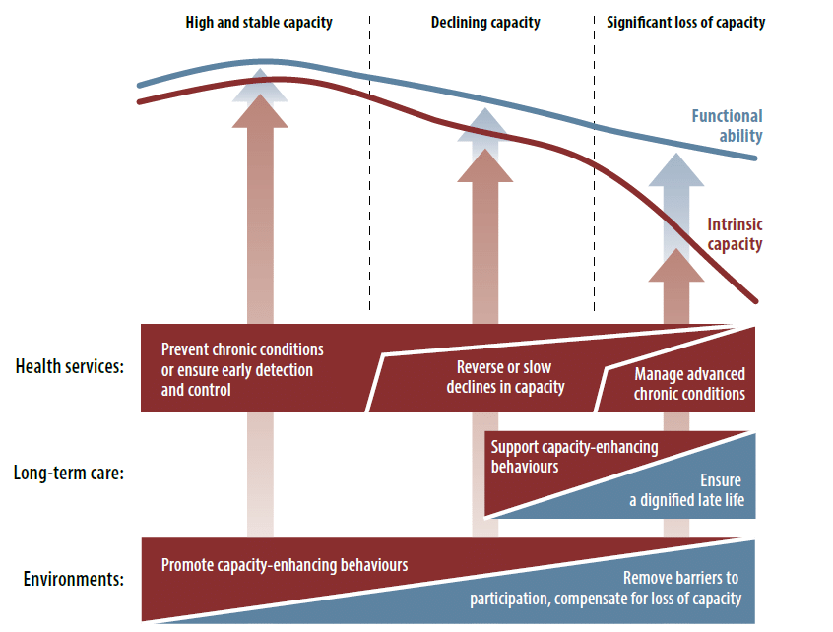
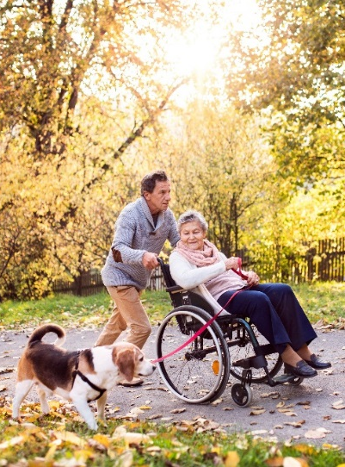
Optimising function in advanced illness
Longstanding effort on prevention to ‘compress’ morbidity, yet loss of function with advanced disease remains a major societal challenge.
Affects almost every person with serious illness(es) and those close to them.
Aims to support independence and optimise function for best quality of life.
This will require:
  better integration of rehabilitation and palliative care;
  interdisciplinary working and service delivery models;
  therapies and interventions that consider the person in their environment.
Beard et al Lancet 2016
Notes:
To set the scene for my research, you can see here the WHO policy framework for healthy ageing, and the decline in function (the blue line) that increasingly occurs as people age and experience the impacts of chronic conditions and multimorbidity.
Much of the effort towards the ‘healthy ageing’ agenda is focused here, with the aim to prevent conditions from occurring, maintain this state of high capacity, and influence this ‘tipping point’
Yet event with some success, the fact remains that a large and growing number of people are living with, and dying from, advanced disease and face distressing symptoms, disability and dependence on others, and related suffering around the loss of roles, self-identity and purpose.
To address this major societal challenge will require research which, like mine, integrates rehabilitation into care (including palliative and end of life care), exemplifies interdisciplinary and collaborative working, and (you can see from the growing gap better the blue and the red line – representing the bodies capacity) considers the person in the context of their environment to achieve optimal function and quality of life.

Slide 3
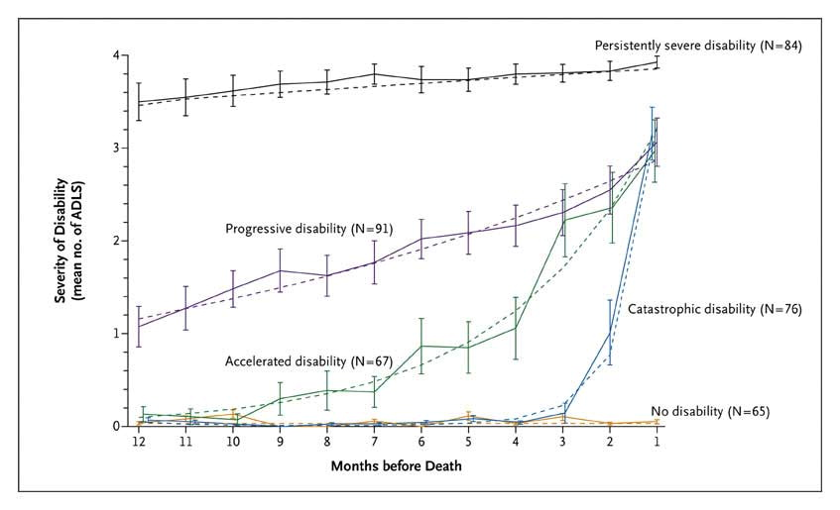

Trajectories of physical function in advanced illness
Gill et al NEJM 2010
Notes:
To set the scene for my research, you can see here the WHO policy framework for healthy ageing, and the decline in function (the blue line) that increasingly occurs as people age and experience the impacts of chronic conditions and multimorbidity.
Much of the effort towards the ‘healthy ageing’ agenda is focused here, with the aim to prevent conditions from occurring, maintain this state of high capacity, and influence this ‘tipping point’
Yet event with some success, the fact remains that a large and growing number of people are living with, and dying from, advanced disease and face distressing symptoms, disability and dependence on others, and related suffering around the loss of roles, self-identity and purpose.
To address this major societal challenge will require research which, like mine, integrates rehabilitation into care (including palliative and end of life care), exemplifies interdisciplinary and collaborative working, and (you can see from the growing gap better the blue and the red line – representing the bodies capacity) considers the person in the context of their environment to achieve optimal function and quality of life.

Slide 4

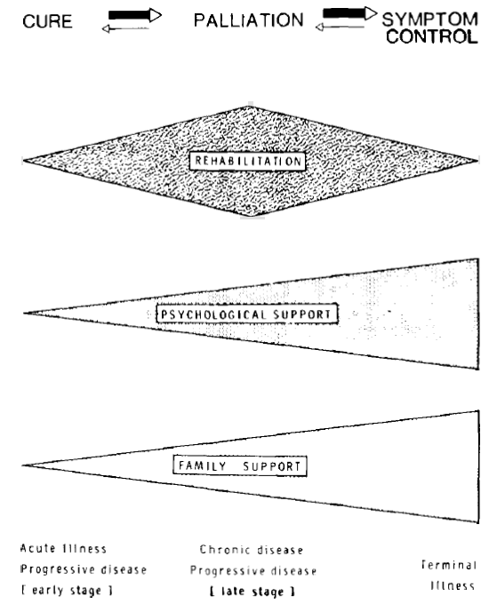
What is important towards the end of life?
Being able to perform daily activities
Keeping
up usual
routines
No longer feeling ‘who I once was’
Adequate symptom control
A sense of control
Not feel
like a burden to others
Sharing time with friends and family
Strengthen relationships with loved ones
Maintaining dignity
Singer et al. JAMA 1999;Chochinov et al JPSM 2009; Steinhausse et al JAMA 2000
Notes:
Rehabilitation is a process aimed at enabling people to reach and maintain their optimal levels of physical, emotional, psychological and social function
Rehabilitation provides people with the tools they need to attain independence and self-determination
Good terminal care may be described as rehabilitation of the dying, exemplified in the modern hospice.
The aim is to help each patient do their best, given their illness and symptoms.
Rehab: treatment of individuals who are handicapped by a disability to achieve their maximum potential.
A focus on the patient and their experience, with relatively less attention paid to the disease
Use of a holistic model of illness, which places the patients in their full context
Given low priority by government, funders, and the general public, and less money – so need to join forces
My contribution towards this agenda…

Slide 5
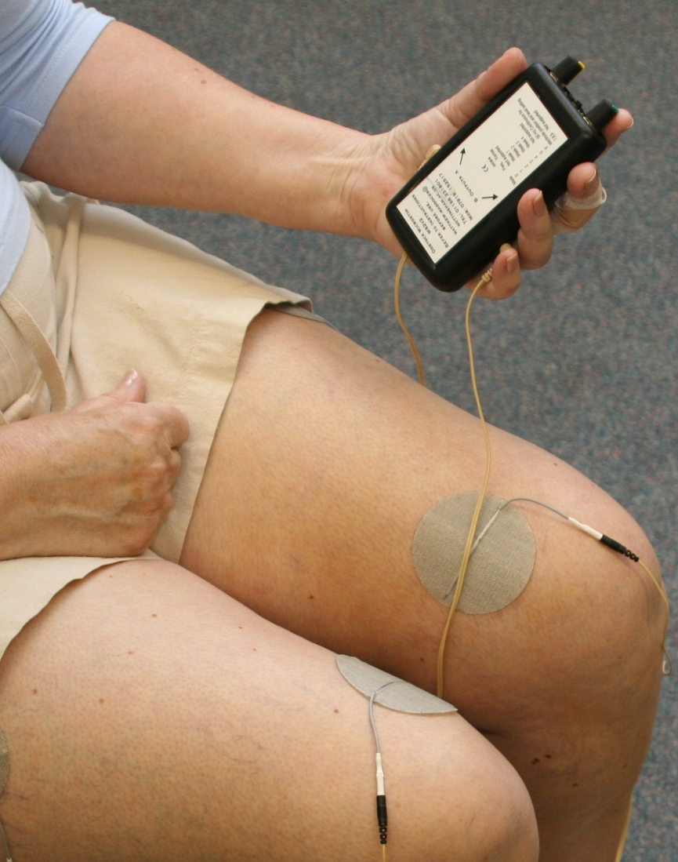
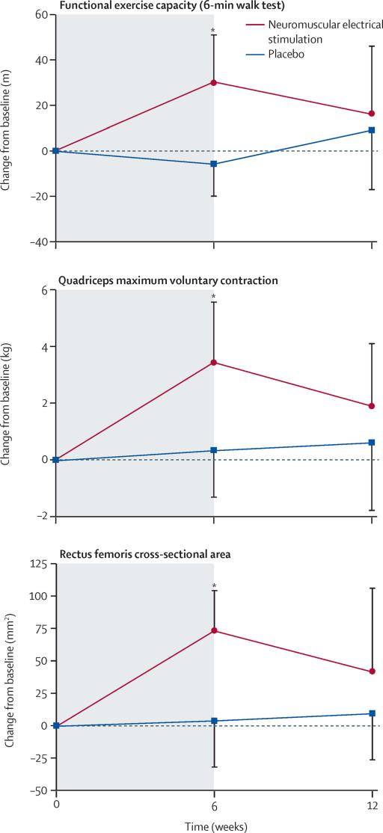
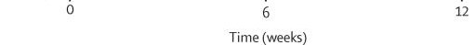
Muscle stimulation in severe lung disease
N=52
Maddocks et al Lancet Respir Med 2016
Notes:
To set the scene for my research, you can see here the WHO policy framework for healthy ageing, and the decline in function (the blue line) that increasingly occurs as people age and experience the impacts of chronic conditions and multimorbidity.
Much of the effort towards the ‘healthy ageing’ agenda is focused here, with the aim to prevent conditions from occurring, maintain this state of high capacity, and influence this ‘tipping point’
Yet event with some success, the fact remains that a large and growing number of people are living with, and dying from, advanced disease and face distressing symptoms, disability and dependence on others, and related suffering around the loss of roles, self-identity and purpose.
To address this major societal challenge will require research which, like mine, integrates rehabilitation into care (including palliative and end of life care), exemplifies interdisciplinary and collaborative working, and (you can see from the growing gap better the blue and the red line – representing the bodies capacity) considers the person in the context of their environment to achieve optimal function and quality of life.

Slide 6
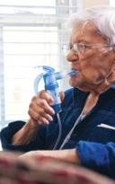
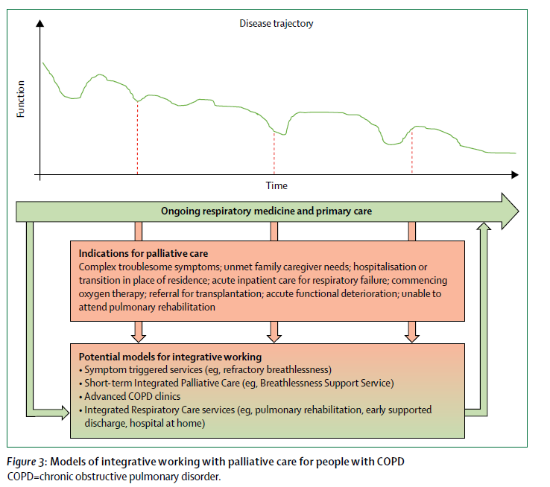
Breathlessness support services
Maddocks et al Lancet 2017; Brighton et al Thorax 2019
Notes:
Gain knowledge (staff and each other)
Reduce isolation and break cycle of ‘invisibility’
Gain confidence
Paced exercise and physical activity
Tools to help with exertional breathlessness and/or crisis: fan, walking aids, ‘poem’, plan, positions
Caregivers learn and accept patients doing things

Slide 7
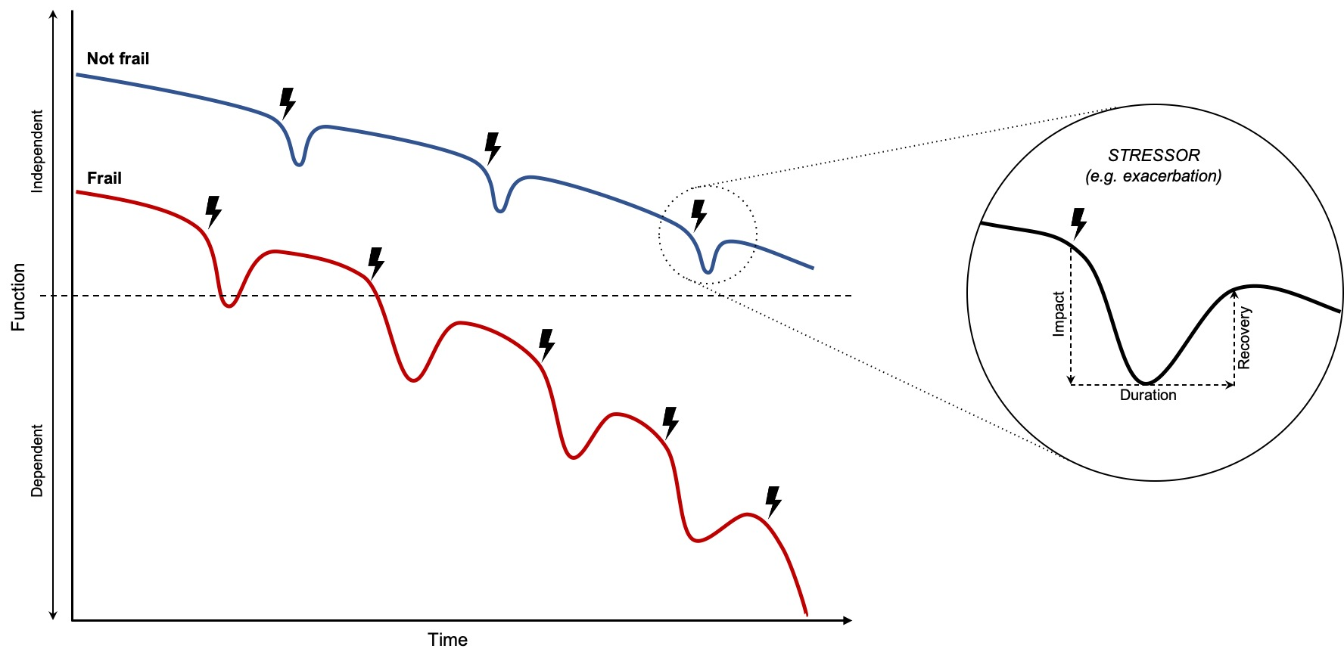
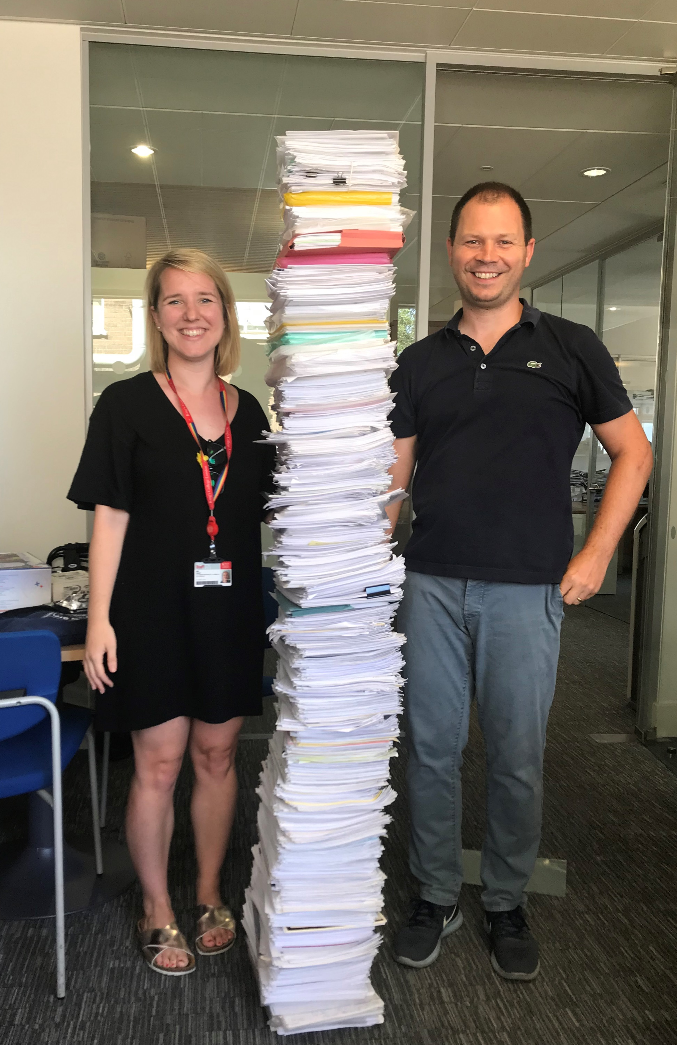
Frailty in chronic lung disease
Trajectory of health in people with chronic respiratory disease with (red) and without (blue) frailty
Osadnik et al ERJ 2023, Maddocks et al Annals ATS 2023
Notes:
A clinical state in which there is increased vulnerability for dependency and/or mortality when exposed to a minor stressor
More common among people with lung disease than the general population^{1–4}
Prevalence estimates: COPD 19% (95% CI 14, 24%),¹ lung transplant up to 58%,² ILD 12–55%,³ asthma 13%⁴
Increases risk of adverse outcomes including hospitalisation, exacerbations and mortality^{6,7}
People describe multidimensional loss, unpredictable disruption and social isolation⁸

Slide 8
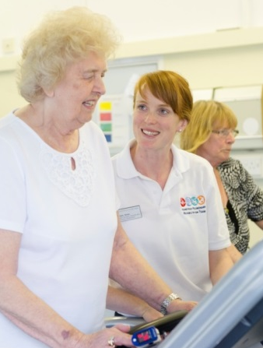
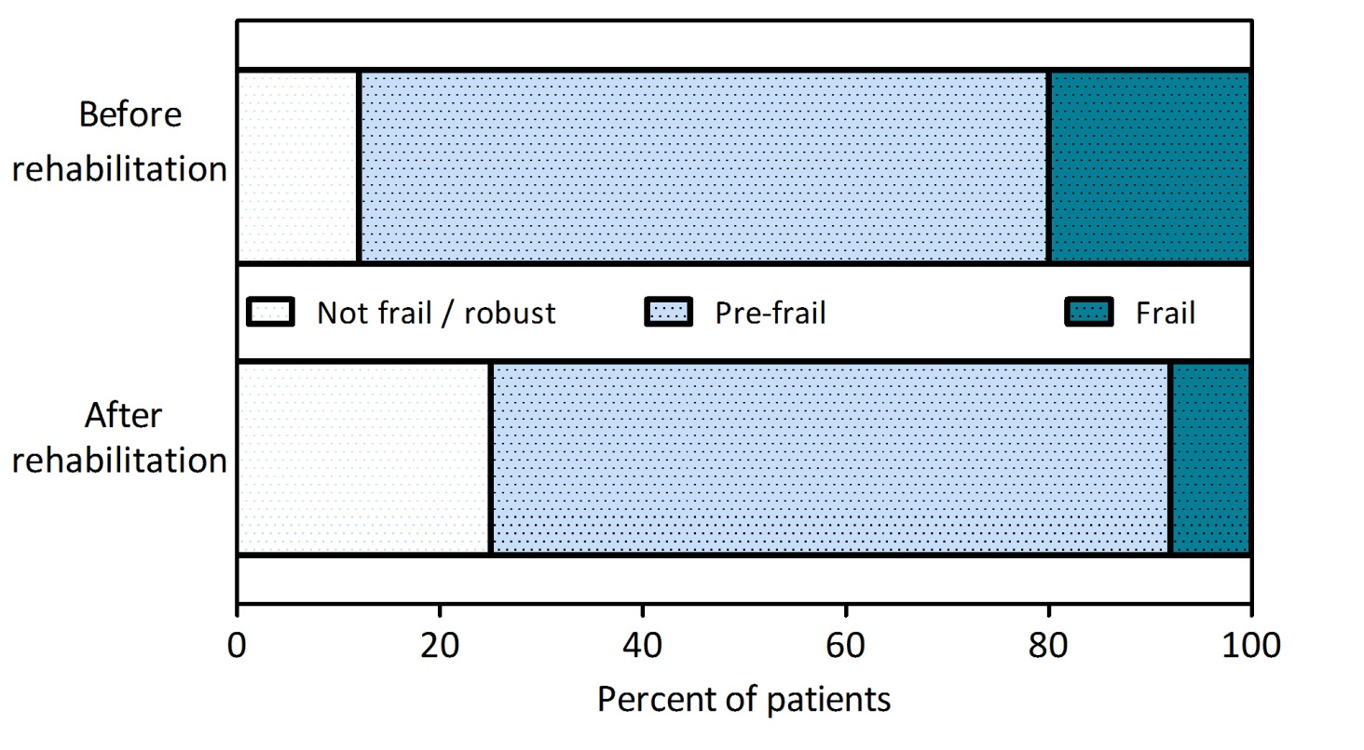
Frailty ‘rehabilitation paradox’
Maddocks et al Thorax 2016
Notes:
Pulmonary rehabilitation can improve breathlessness, exercise performance, muscle strength and quality of life in chronic respiratory diseases¹
There is a ‘frailty rehabilitation paradox’ whereby pulmonary rehabilitation can effectively reduce frailty, but programmes are challenging for individuals with frailty to complete²
The ‘fit’ of exercise may be improved by: building trusting relationships; creating a shared understanding of priorities; individualising content to match priorities; having capacity to address multidimensional losses and having flexibility in service delivery^{3,4}

Slide 9
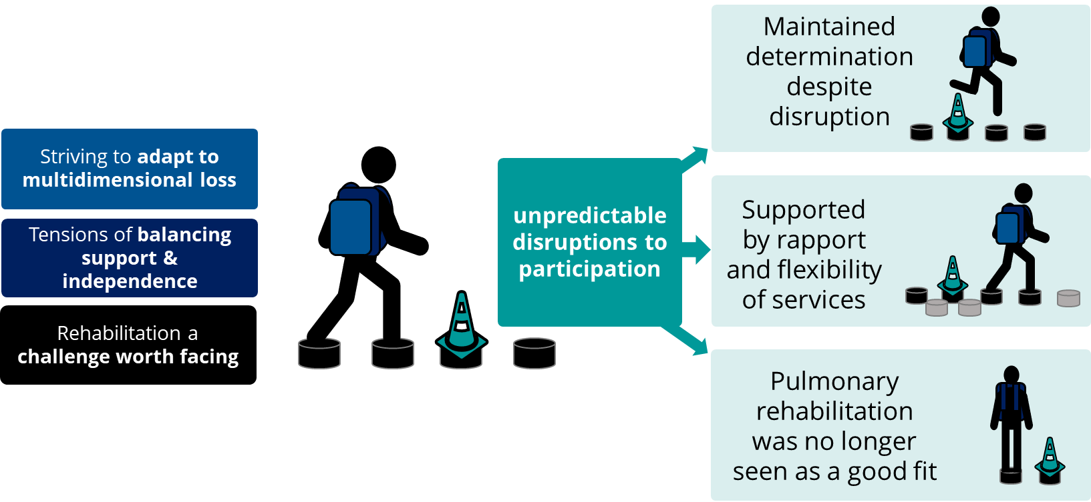
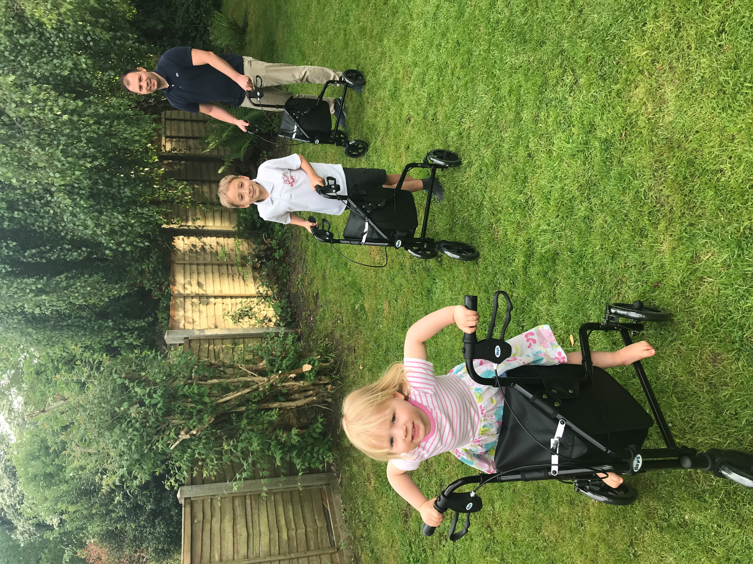
Improving services for people with lung disease & frailty
Brighton et al Annal ATS 2020

Slide 10

Care recommendations following comprehensive assessment
Brighton et al In press

Slide 11
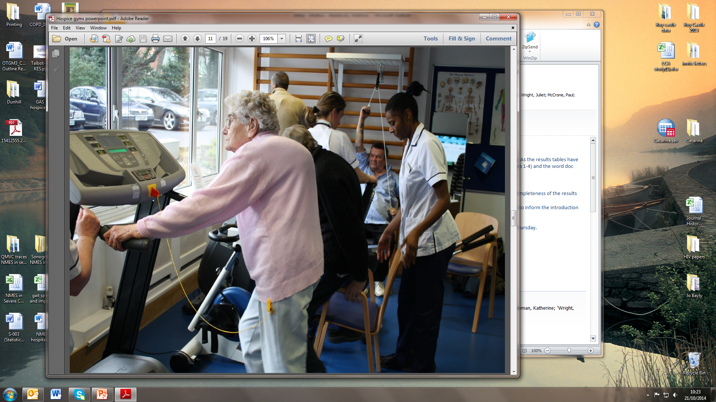
Optimising function in advanced illness
Trauma
rehabilitation
Stroke rehabilitation
Cardiac & pulmonary rehabilitation
Cancer
rehabilitation?
Palliative rehabilitation ?
Notes:
INSPIRE is a culmination of work - peoples effort
St Christopher’s / ARC - local change - gym evaluation, rehab volunteers
Access to palliative care services has increased
Rehabilitation remains under-resourced and variable within palliative care
Drivers for improvement include World Health Organisation Policy on Universal Health Coverage
Rehabilitation and Palliative care both seen as essential quality heath services
Both should be integrated within primary, secondary, and tertiary health systems using a multi-professional workforce
Working with St Christophers especially valued
Changes built on robust evidence:
positive shift in societal understanding and public perceptions around the value of rehabilitation in serious illness;
increased number of allied health professionals within and available to palliative care teams;
better skilled professionals equipped to recognise, assess and respond to rehabilitation needs;
relevant implementation of best practices from voluntary sector into publicly funded services;
improved equity of access to rehabilitation;
strong policy, guidance and commissioning of rehabilitation across specialities and settings;
improved function, independence and quality of life for people with advanced disease and their families.

Slide 12
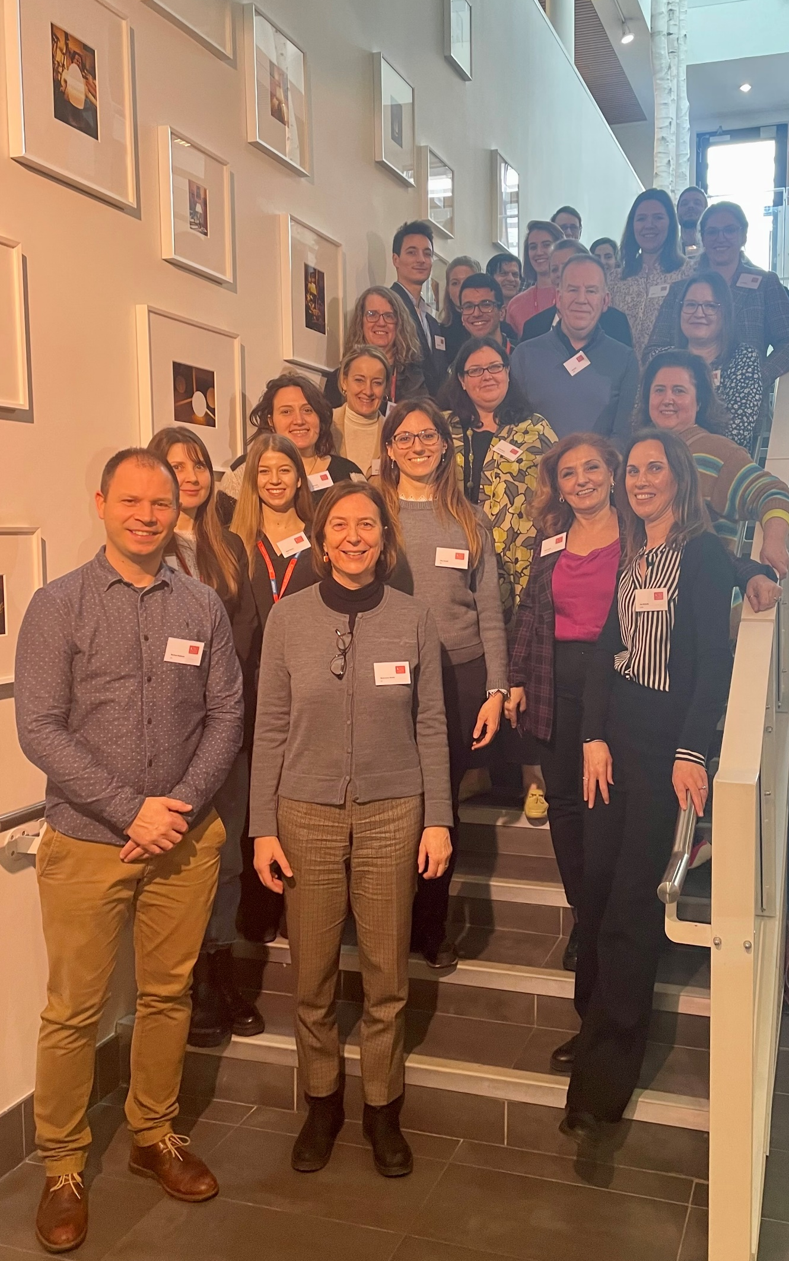

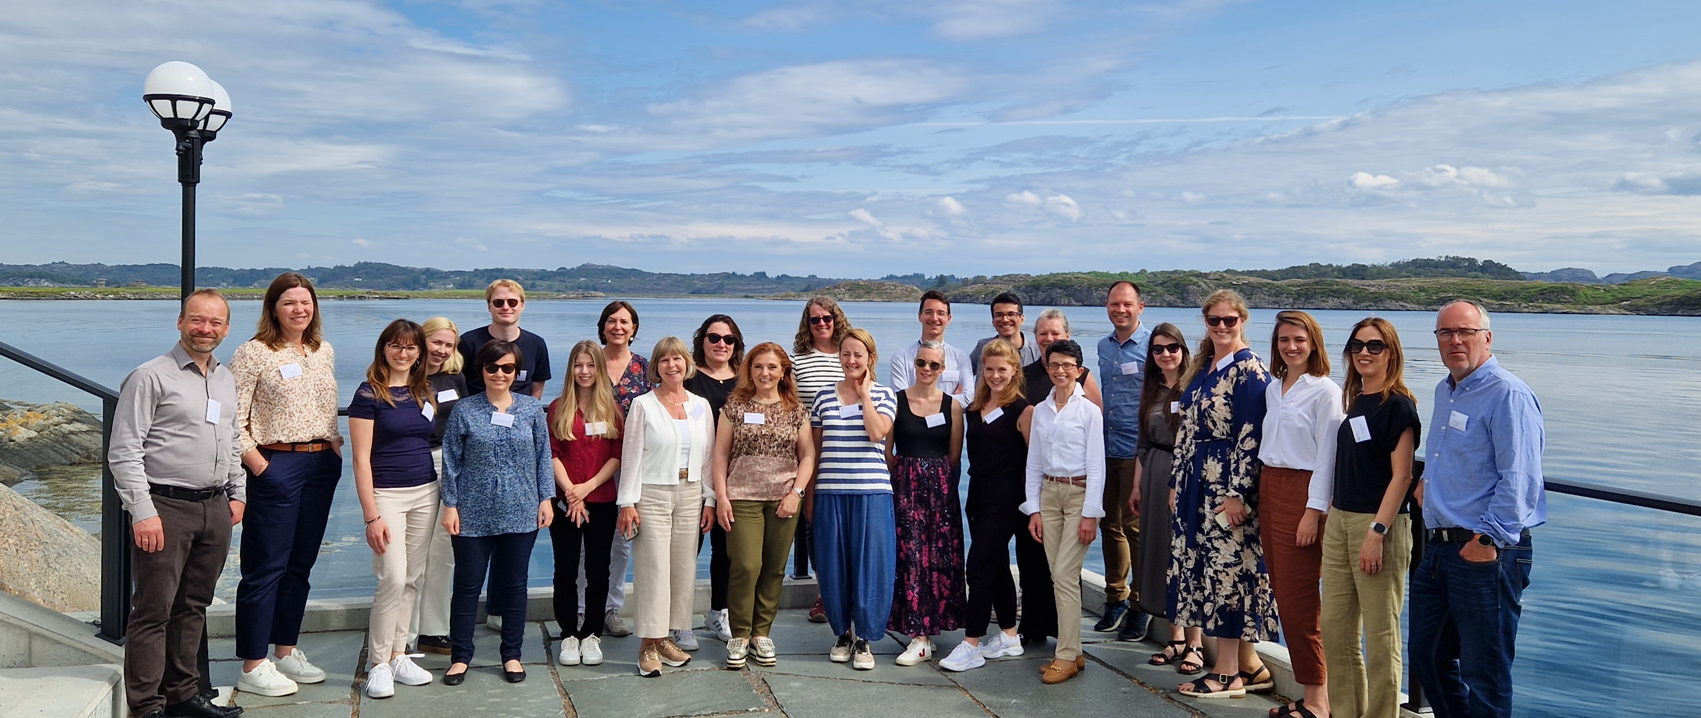
The European INSPIRE project
https://palliativeprojects.eu/inspire/
Notes:
Cancer is a main cause of illness burden, disability (loss of function) and death
Disability is rated as one of most common unmet needs – people want to live as normally as possible
Incorporates:
Multinational randomised controlled trial across five European countries (Denmark, France, Italy, Norway, United Kingdom).
Comparative analysis of health services to understand integration of rehabilitation across oncology and palliative care services.
Mixed-method evaluations of equity and inclusivity, processes and implementation, at the level of the patient, health service and health system.
Evidence synthesis and Delphi consensus study on indicators, core interventions, outcomes, and integration methods for palliative rehabilitation.

Slide 13


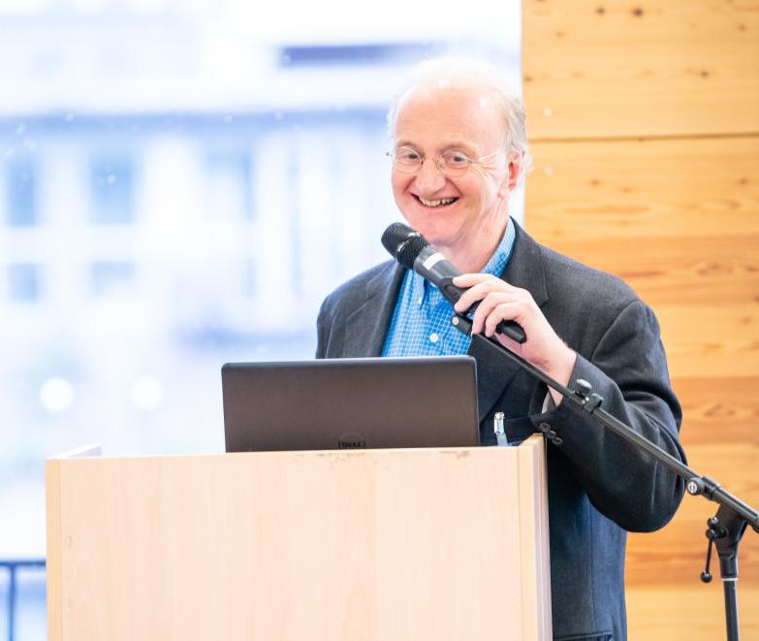









A huge thank you to funders and supporters

