Slide 1

The Festschrift Conference for Professor Sir Graham Thornicroft Local and Global Mental Health: So Near and So Far
Nino Makhashvili MD PhD
Ilia State University
GIP-Tbilisi, Georgia

Slide 2
Presentation Overview
My areas of work
Why was I asked to contribute? Case of Georgia
Prospects for the work that needs to be done in the coming years

Slide 3
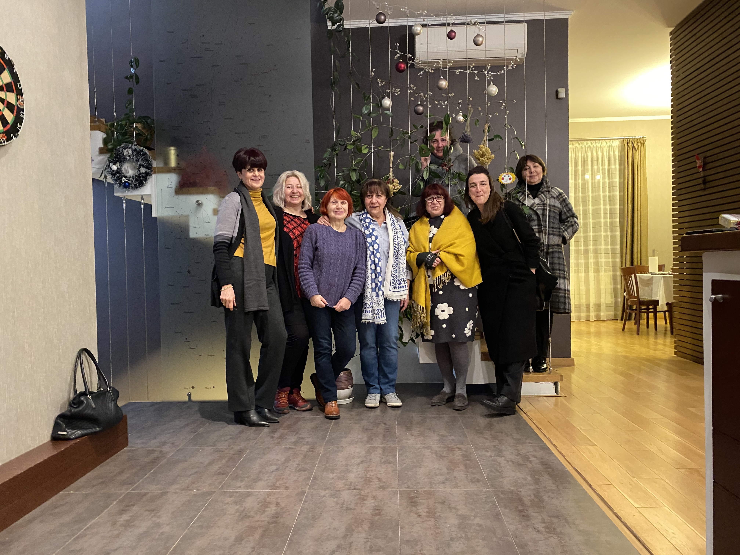
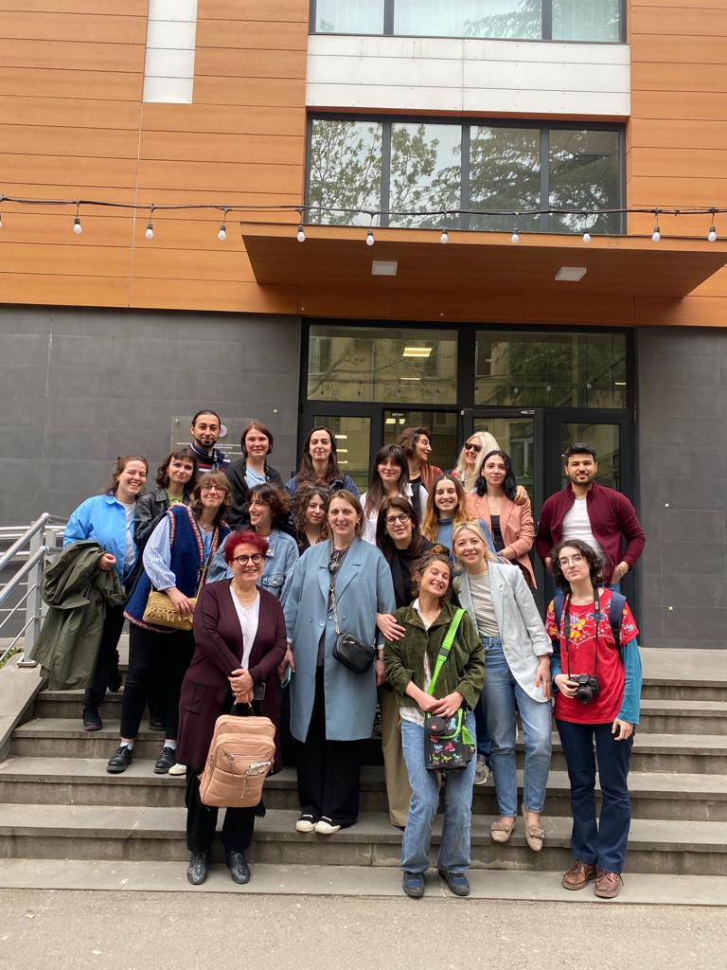
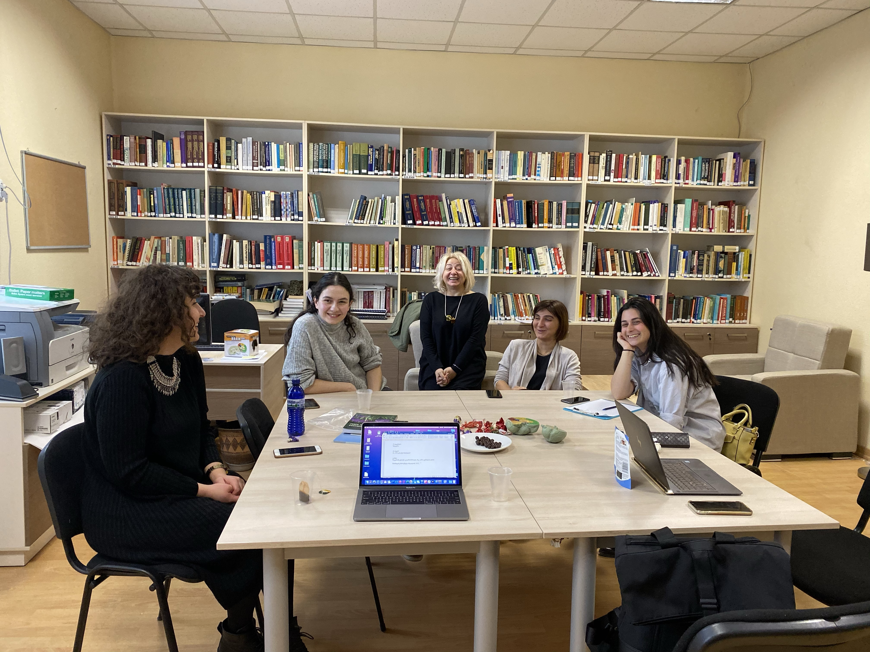
My areas of work
GIP-Tbilisi
Part of the Federation GIP
Caucasus & CA countries
Supporting Mental Health(MH) Reform
Ilia State University, Tbilisi
Leading MH Resource Centre and MA program on MH

Slide 4
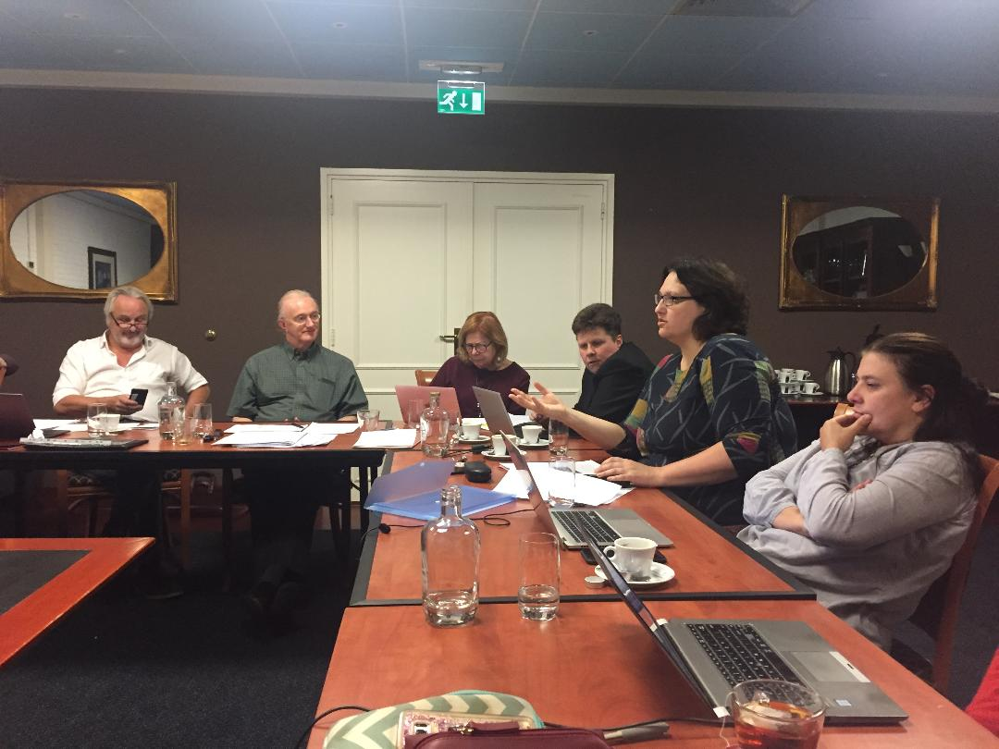
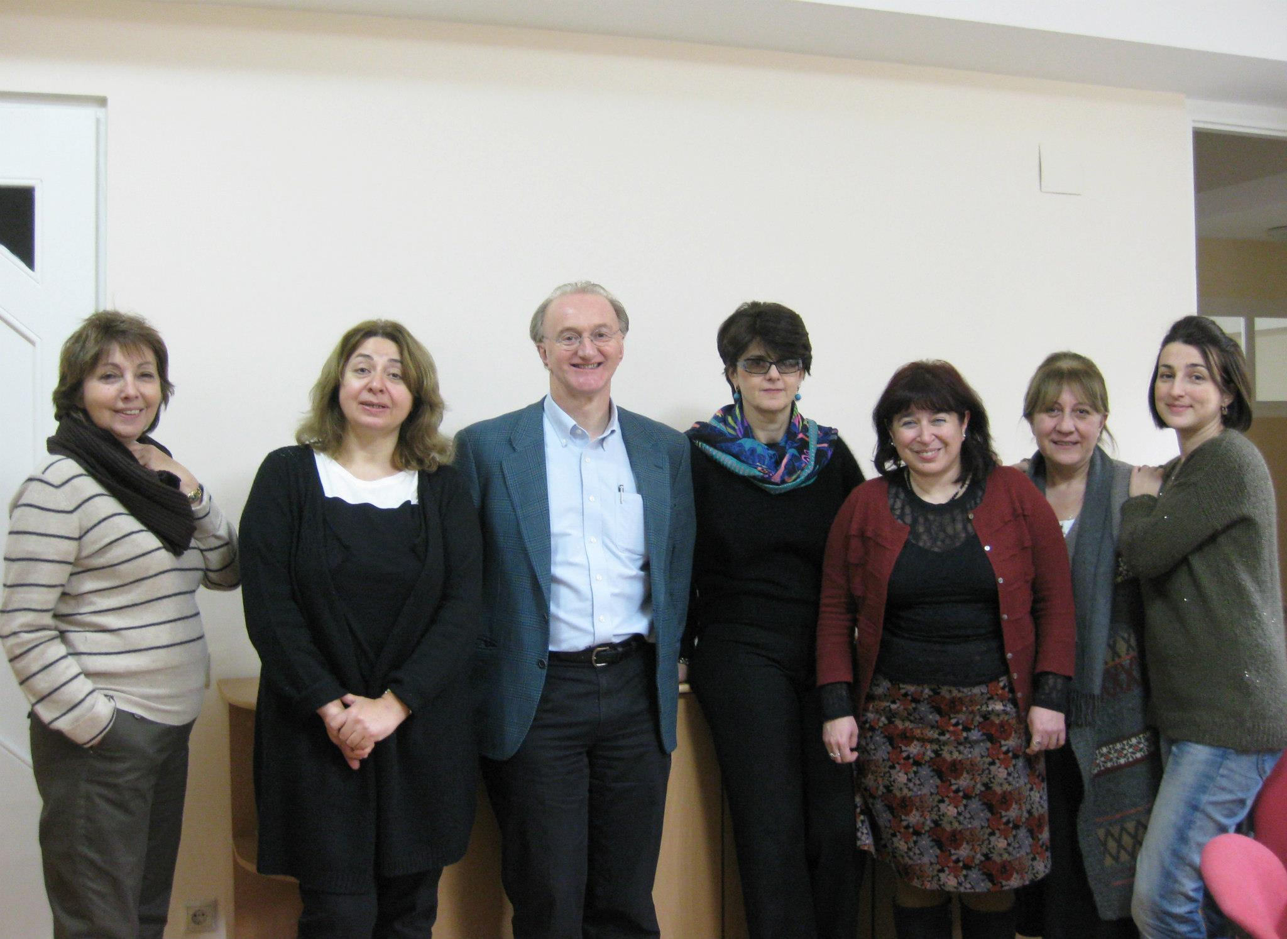
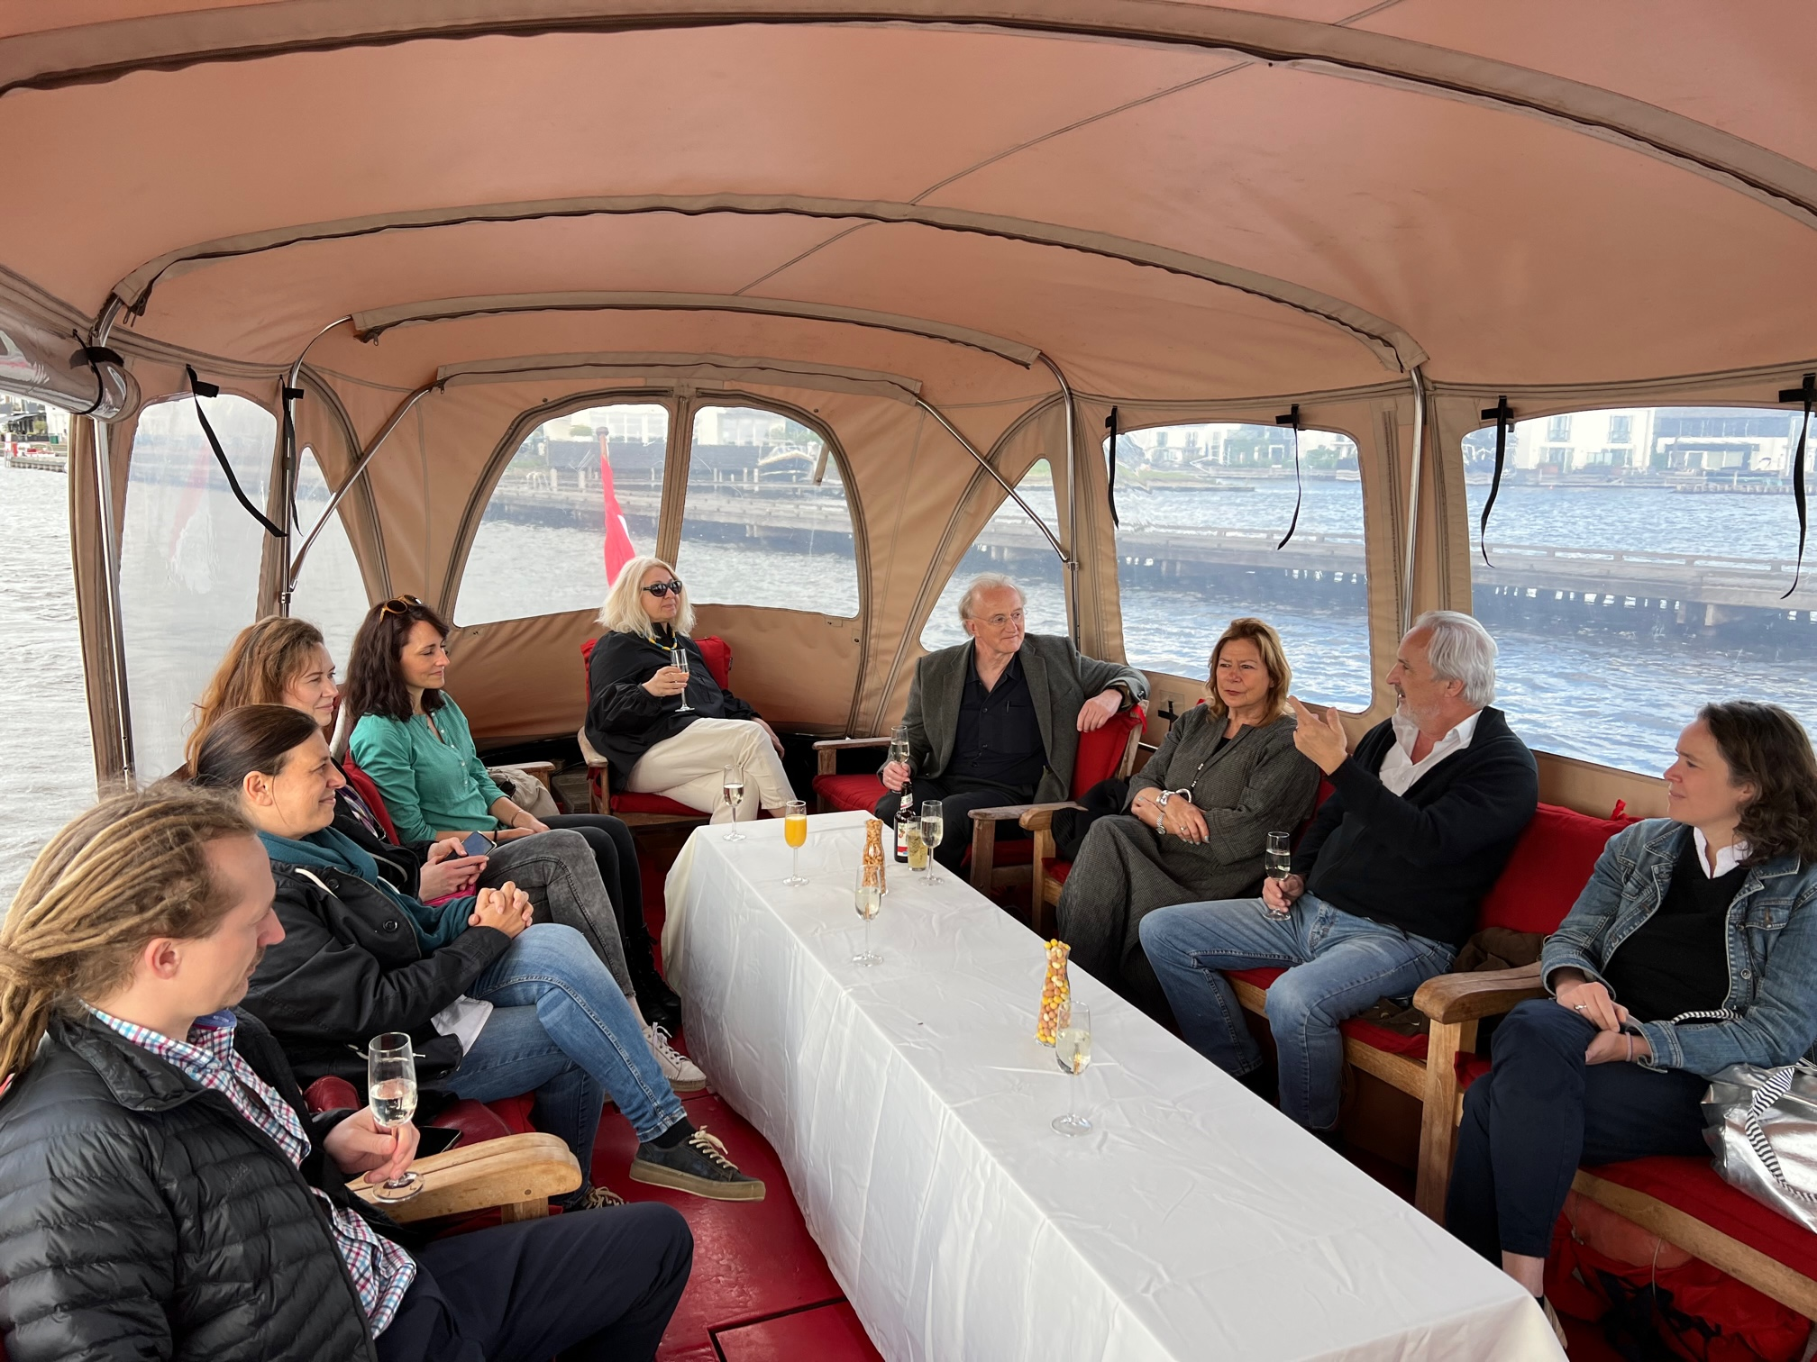
How is my work related to professor Sir Graham Thornicroft’s?
Federation GIP
Strategic directions, advice , and recommendations

Slide 5
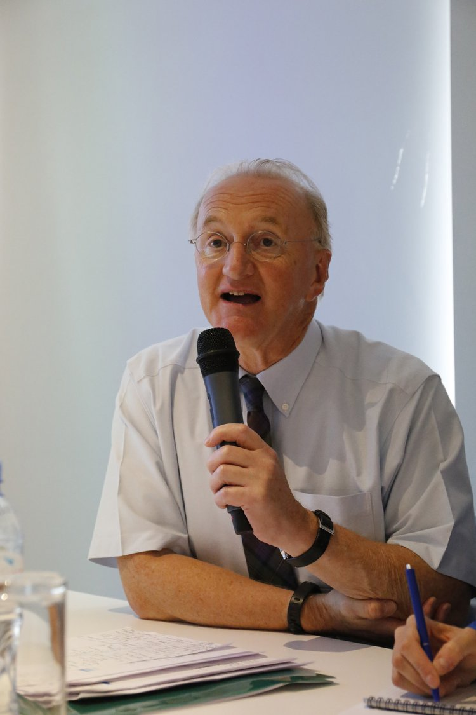
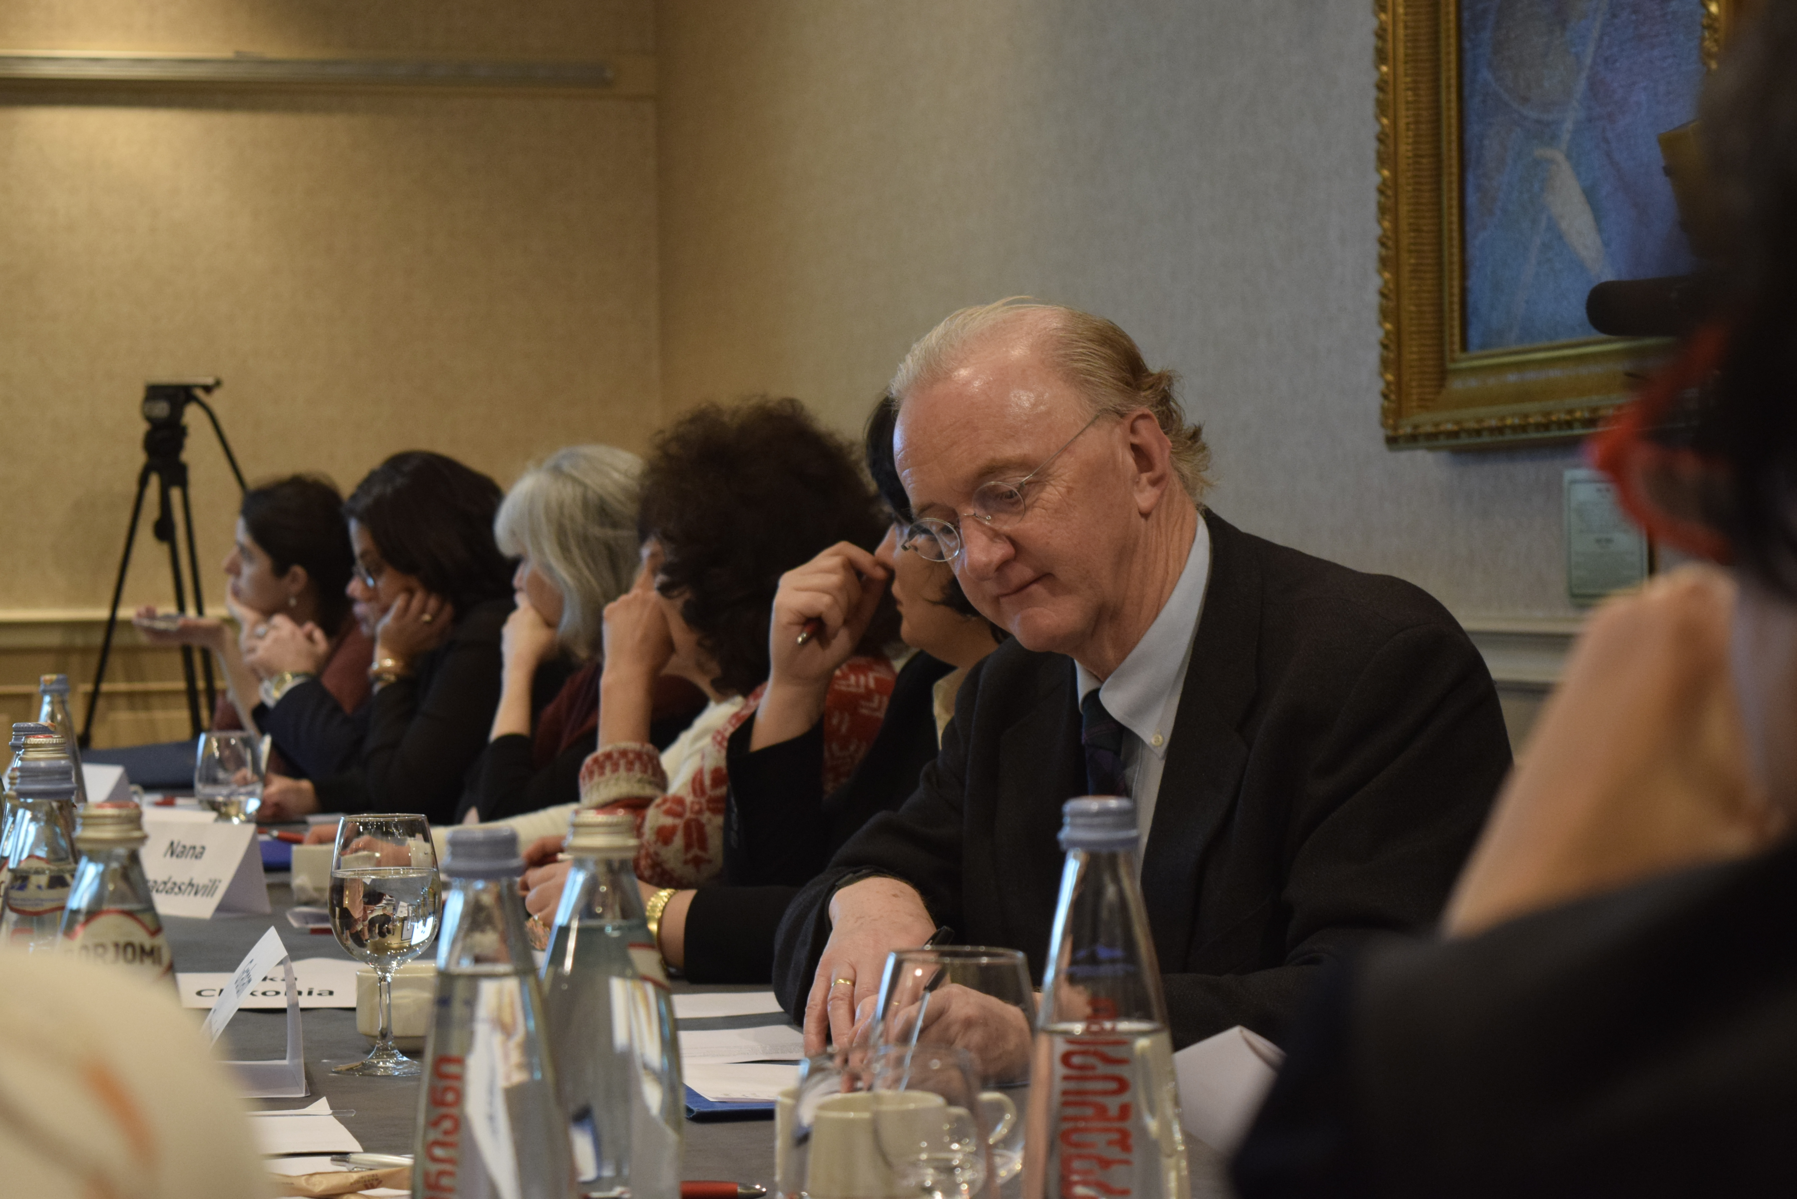
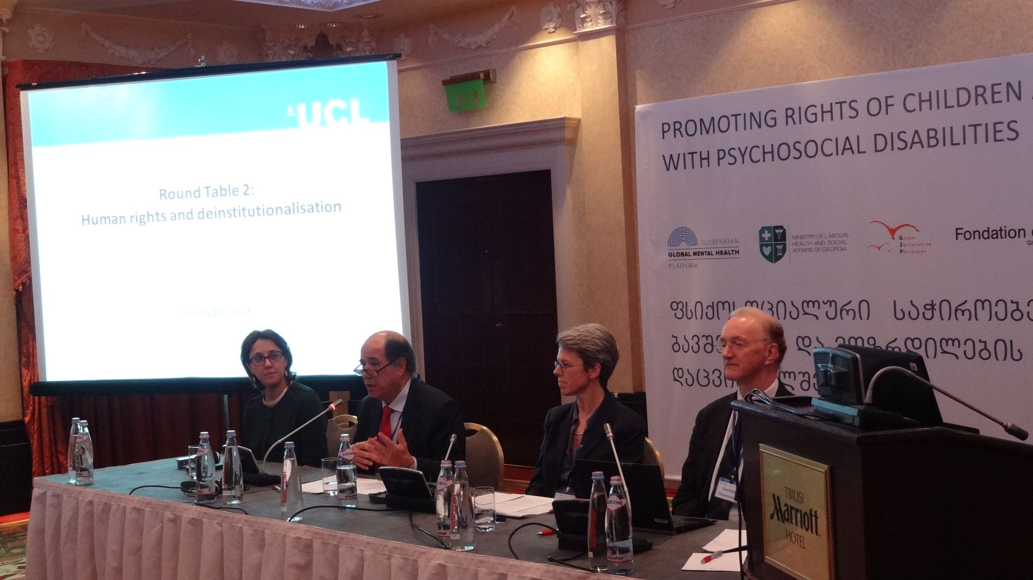
Graham’s involvement with Georgia
Policy dialogues with the Ministry of Health and Social Affairs;
State Policy on Mental Healthcare (2013), declaring the balanced care model;
Two strategy documents - National Action Plan 2015-2020 and National Strategy 2022-2030.

Slide 6
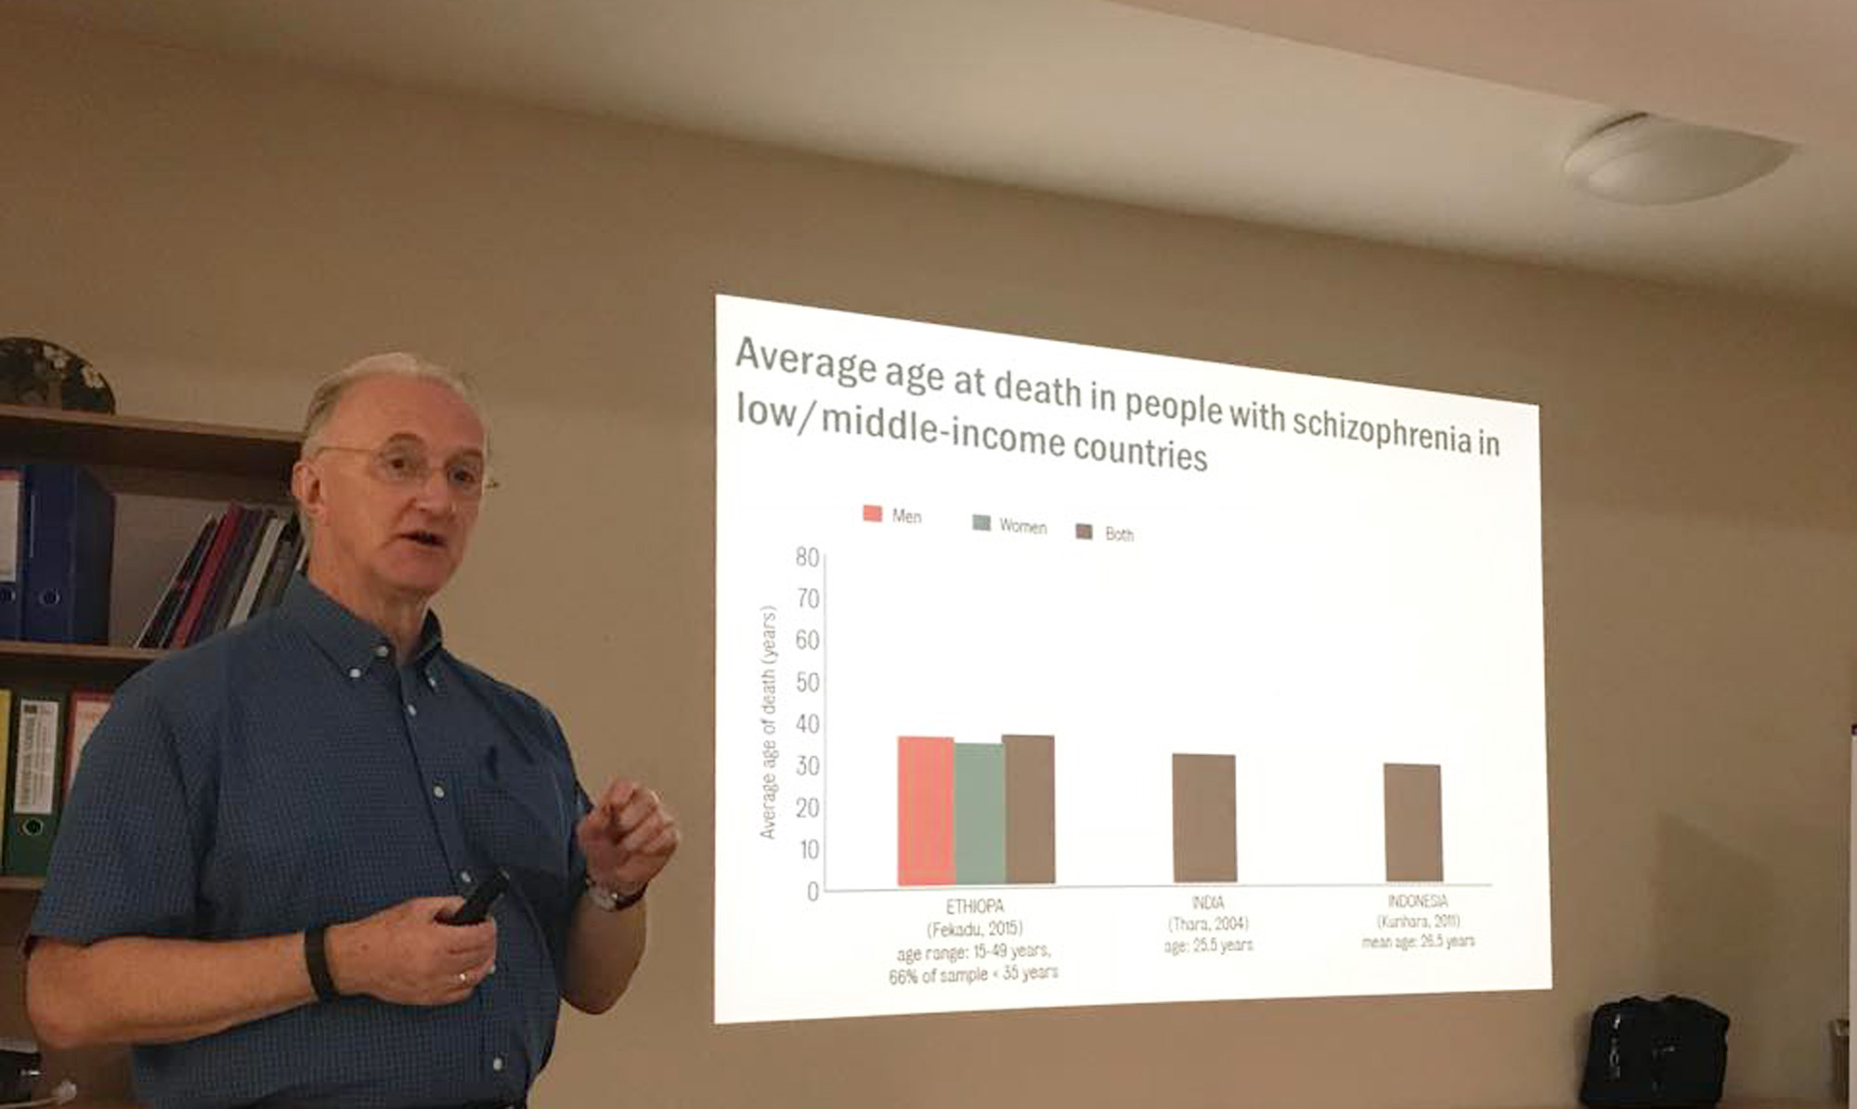

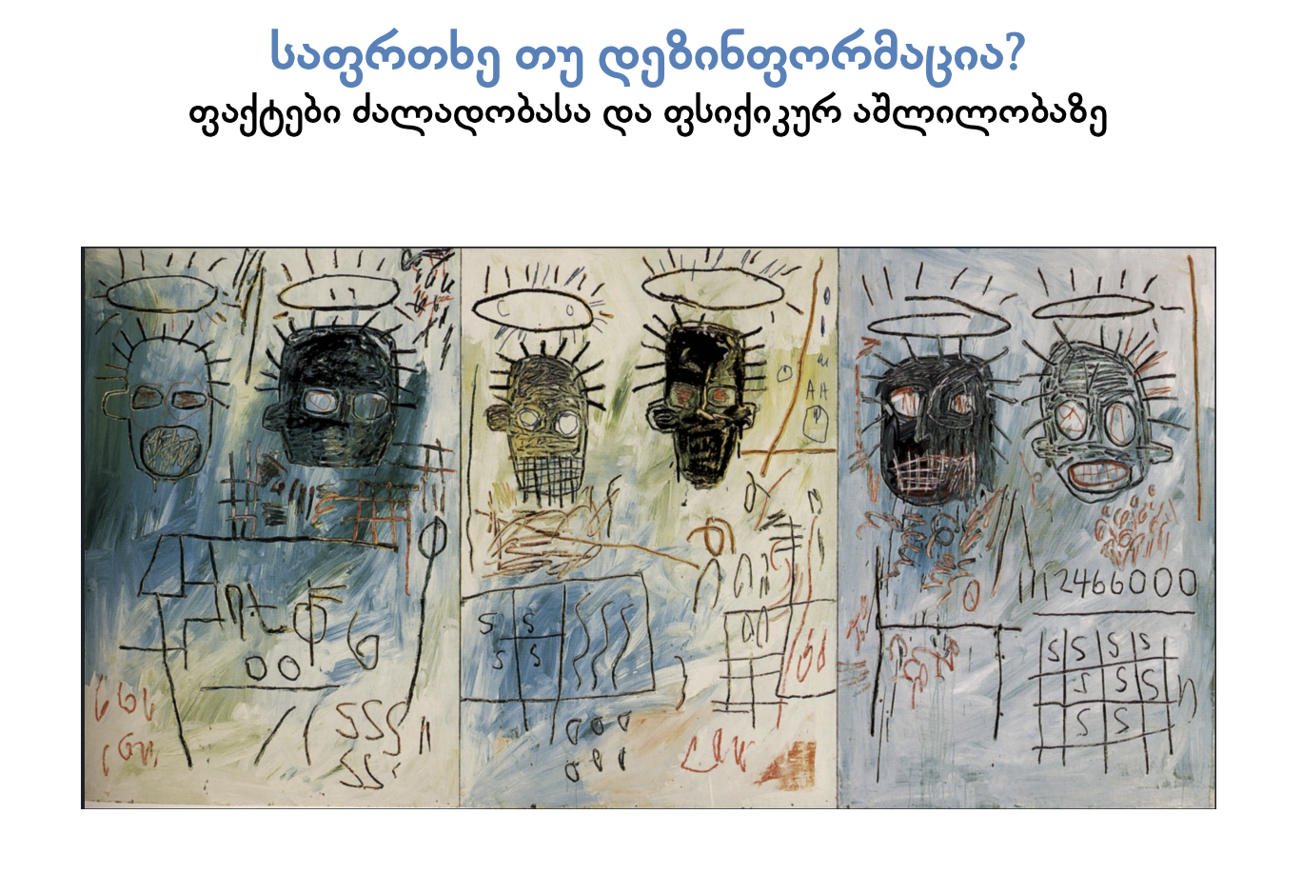
- Lectures and workshops at Iliauni; - Working with young members of the Georgian Society of Psychiatrists; - Translation of some of his work; - Involving in studies and projects.

Slide 7
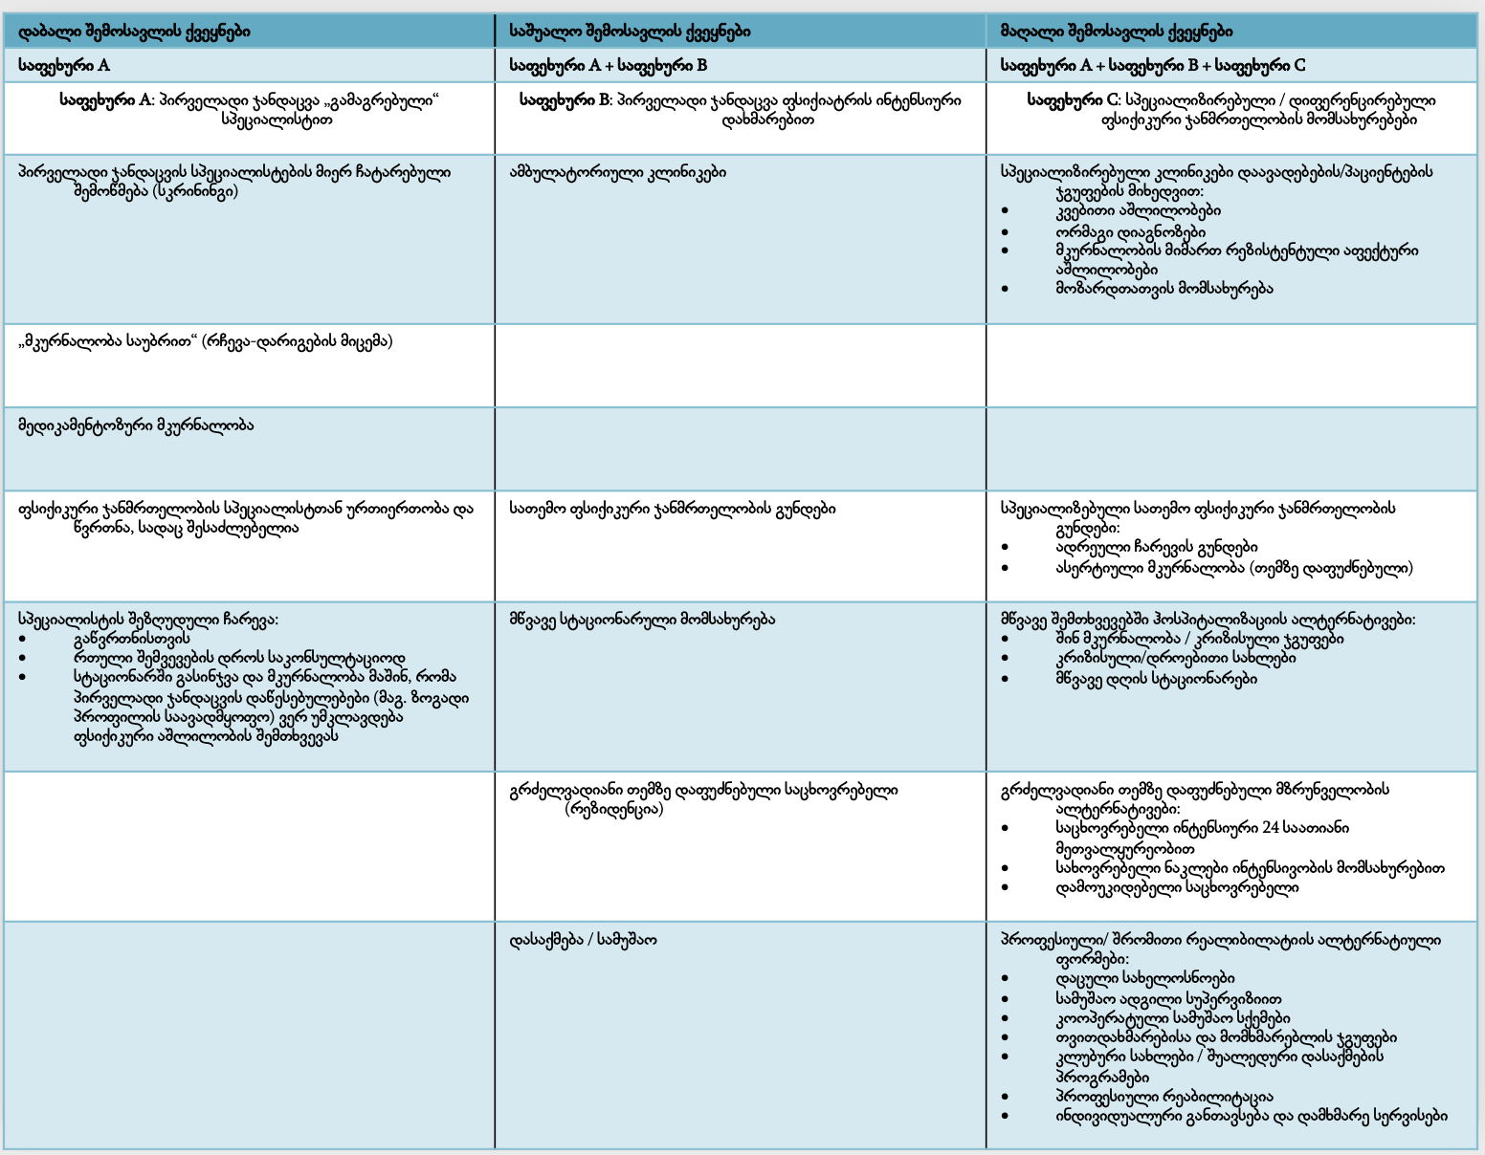
Some important achievements 1
More balance between hospital and out-of-hospital care:
- In the 2024 state budget for mental health, funding for inpatient services represents 49,57%, while the budget for community services is 50,43 %;
- A positive change: 10 years ago hospital-based services were funded by 70% of the budget.

Slide 8
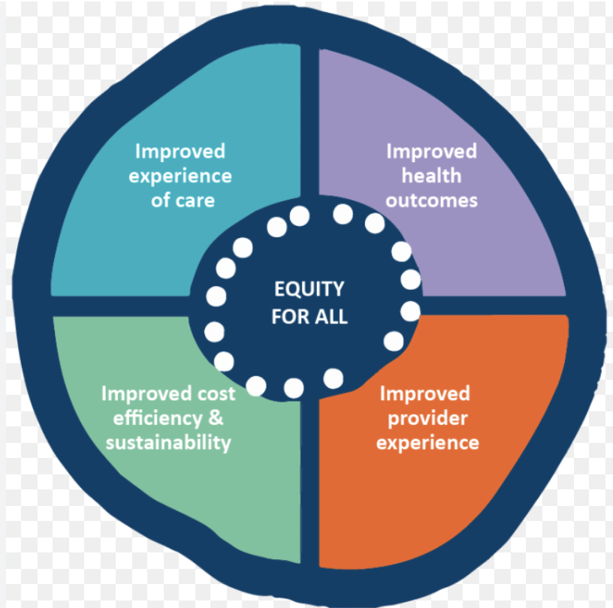
Some important achievements 2
During the reform of the MH system, several community-based services have been piloted and established:
- Outpatient Ambulatory centers, using the bio-psycho-social model and a multidisciplinary approach;
- Community-based mobile teams for people with severe mental disorders who are frequently hospitalized for a long time;
- Psychiatric Crisis Intervention Services for Adults (16-65 years) ;
- Psychosocial rehabilitation centers.

Slide 9
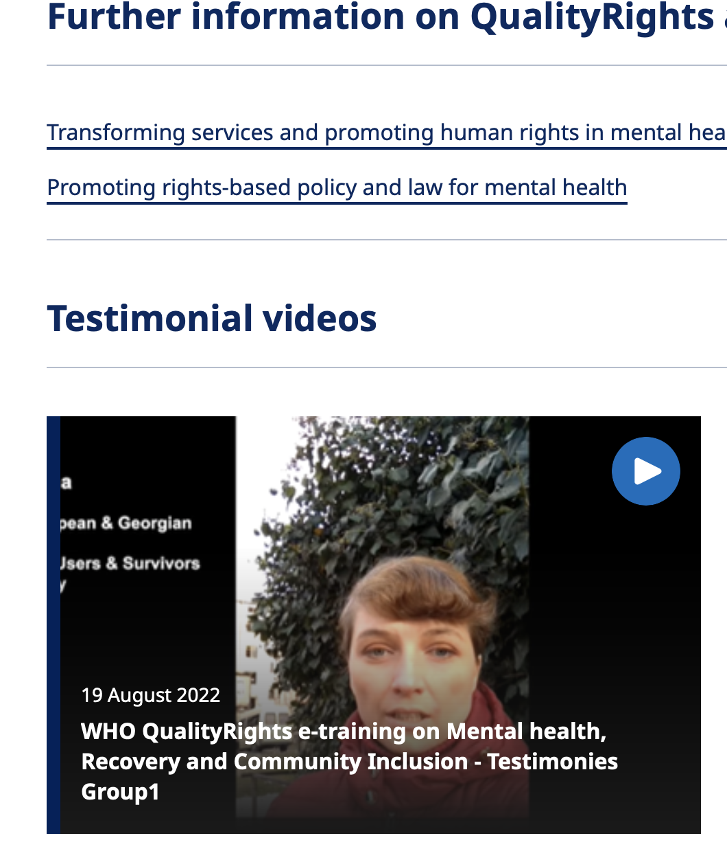
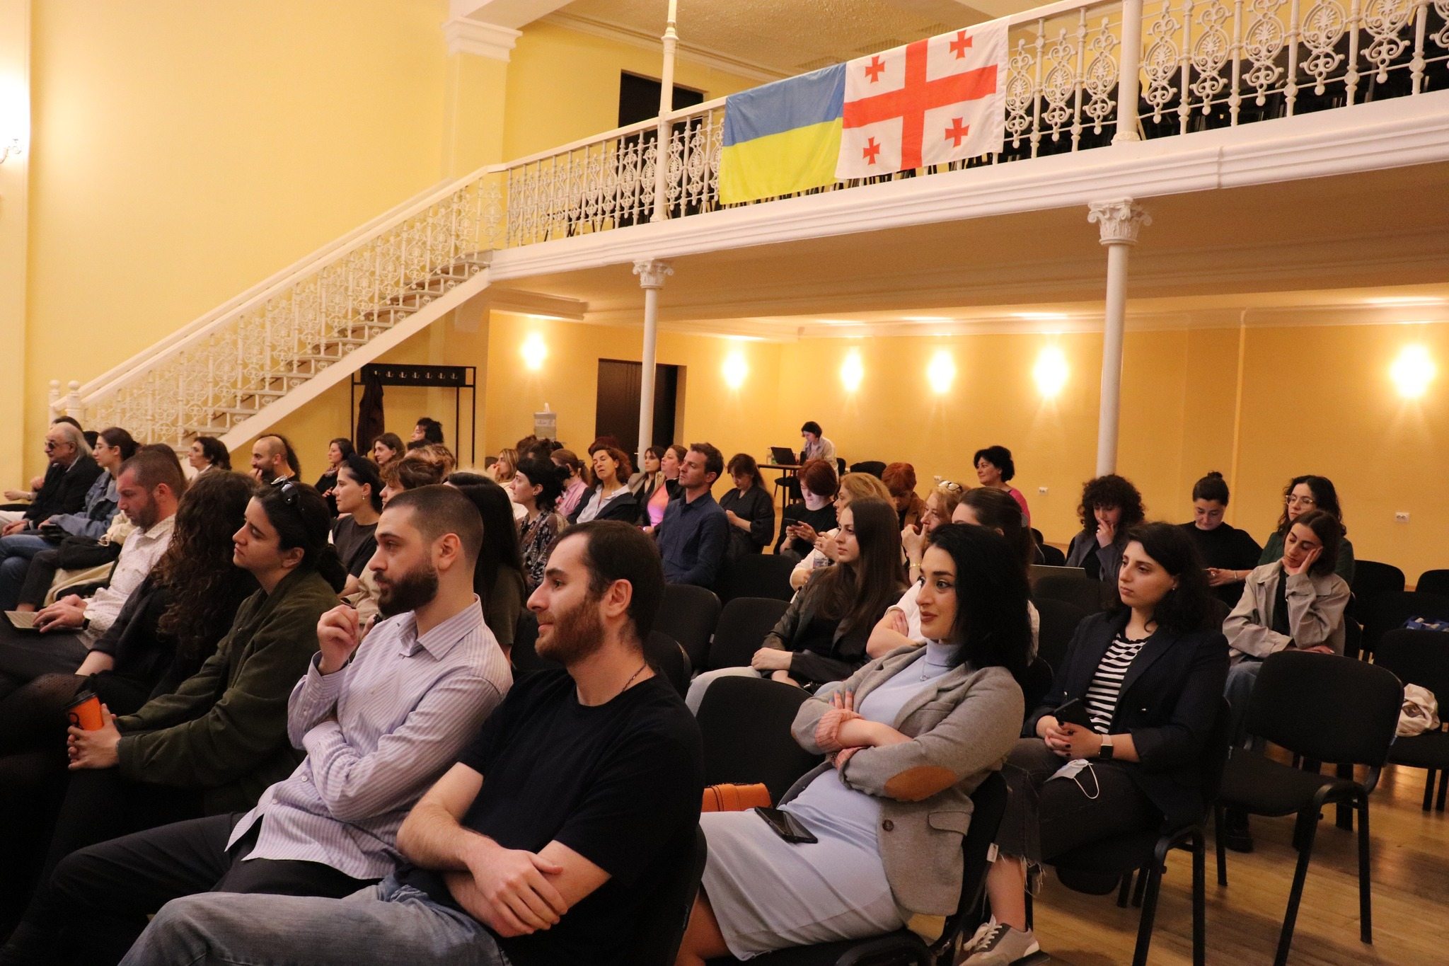
Some important achievements 3
- Strengthened movement of persons with lived experience, co-producing strategy documents and active in advocacy;
- Pilot initiatives, supported by the non-profit sector to deal with the treatment gap (80%);
- New competent multidisciplinary workforce, educated in modern MH approaches;
- Much more attention to evidence and research.

Slide 10
Barriers and challenges 1
Slow and painful De-institutionalization process with sluggish development of supported living facilities/residential care;
Lacking child and adolescent services - the funding for CAMH outpatient care is 0,302% and for inpatient – 2,11% of the whole budget;
Continual harsh human rights violations in MH institutions;
“Unregulated” Privatization and state-supported Centralization processes;

Slide 11

Barriers and challenges 2
New services - not safeguarded and properly regulated: example of acute departments in general clinics;
Also ‘How’ besides ‘What’ – re-naming services does not work; examples of Outpatient Ambulatory centers and Crisis Intervention Services.

Slide 12
Barriers and challenges 3
Low MH literacy of the Georgian population and high stigma: i.e. extremely low help-seeking rates – only 6.45 % of the people in the national-wide survey (2000) have looked for help for a mental, drug, or alcohol problem at least once in their life ;
No promotion and prevention programs;
Lack of recovery-oriented approach: the rehabilitation component reaches only 0,26% of total MH funding;
Still no involvement of primary care in mental health delivery.

Slide 13


Slide 14
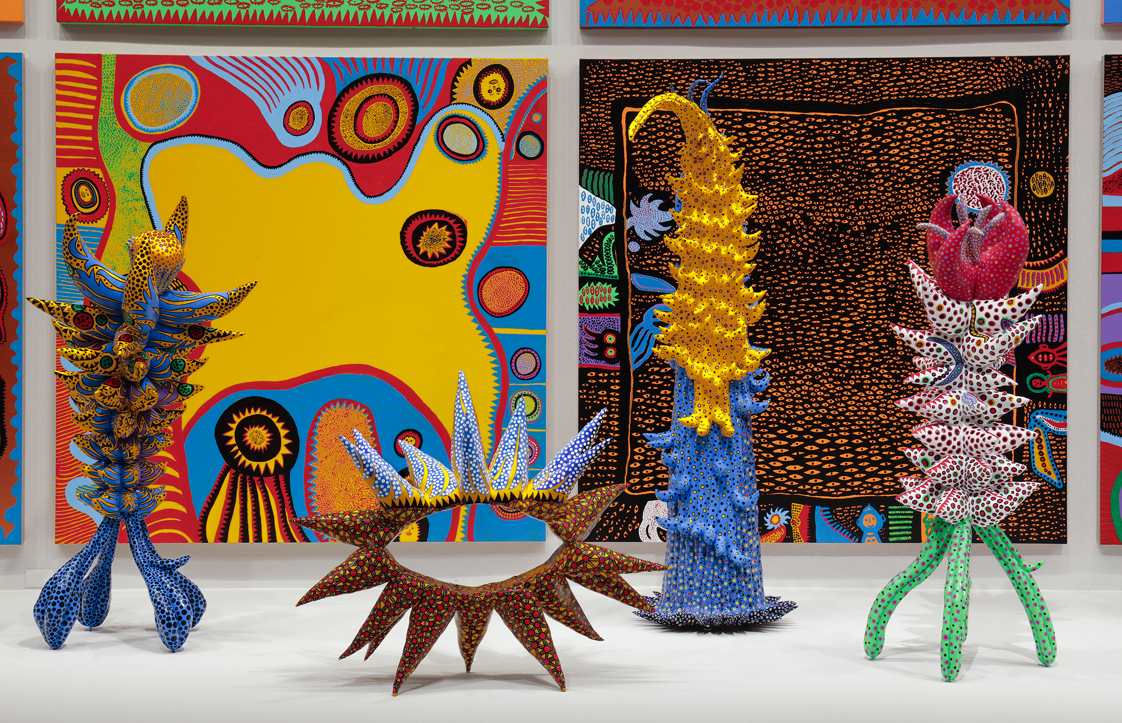
THANK YOU! nino.makhashvili.1@iliauni.edu.ge

