Slide 1
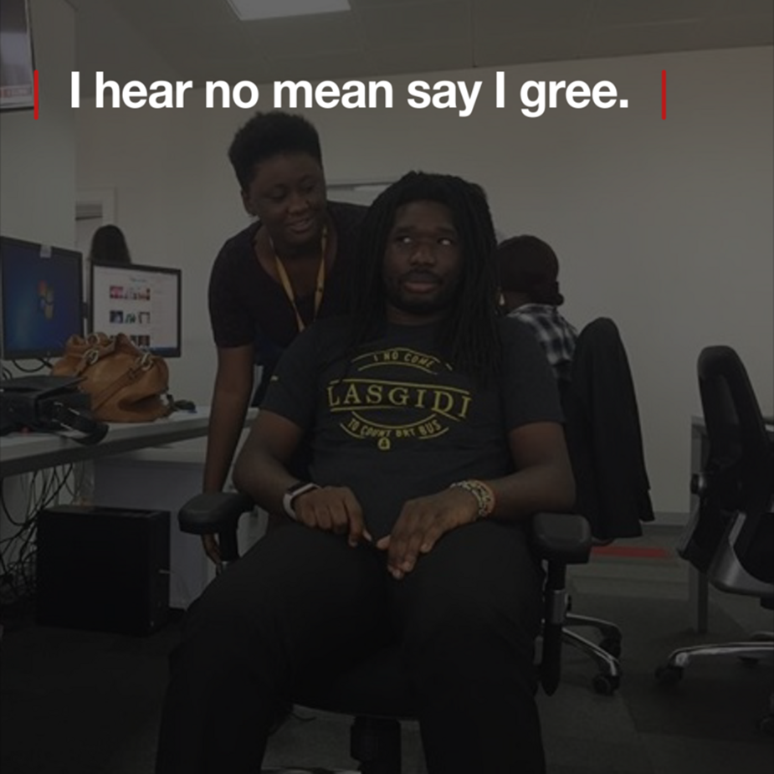



Co-production in Global Mental Health intervention development and evaluation
Julian Eaton
Centre for Global Mental Health, LSHTM
julian.eaton@lshtm.ac.uk
Notes:
I am going to use Nigerian proverbs written in pidgin. So shine your eyes

Slide 2

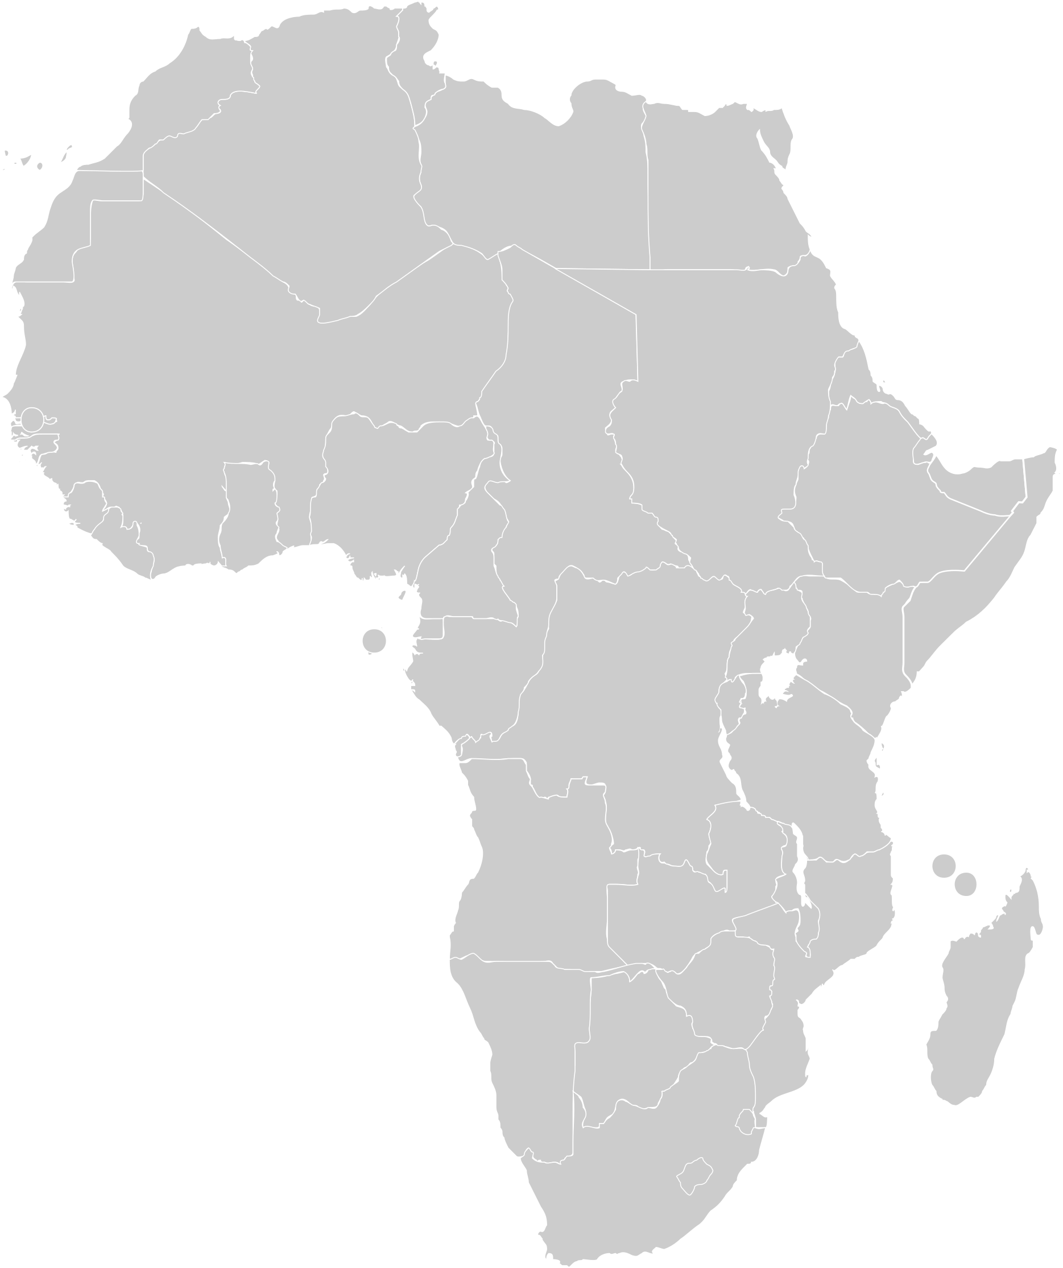
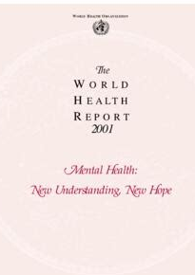

Significant refinement of ideas in GMH from a strong foundational base
Notes:
Ideas develop gradually and need to refine with time.
2001 World Health Report New understanding, new hope. Lancet series. Basically sound, but need refinement.
Largely led by ‘experts’ Mainly psychiatrists and psychologists
Important addition of wider variety of actors, like experts in communication (will come to embedding and realist evaluation later), traditional healers, more social science, local implementers etc

Slide 3
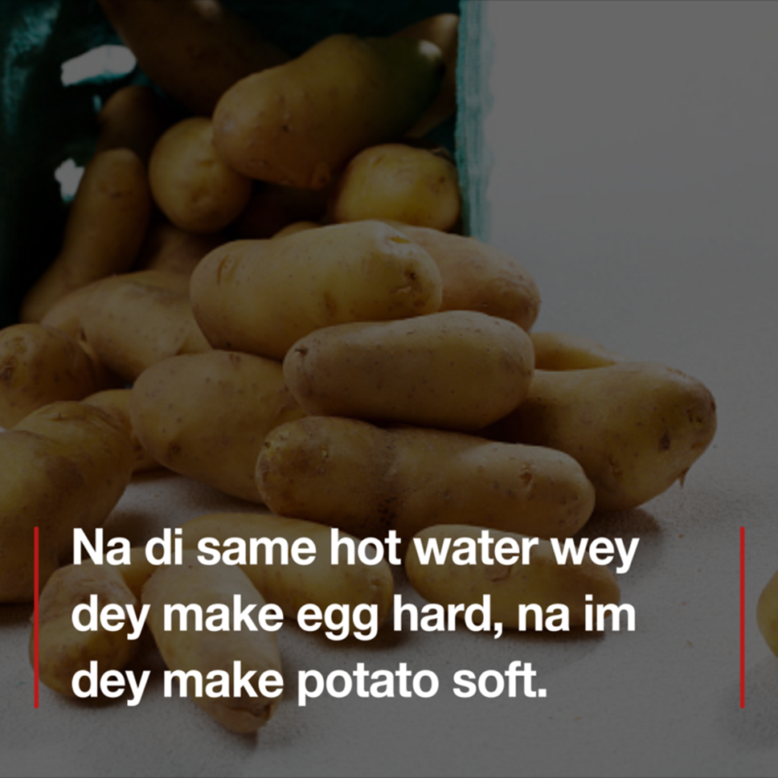
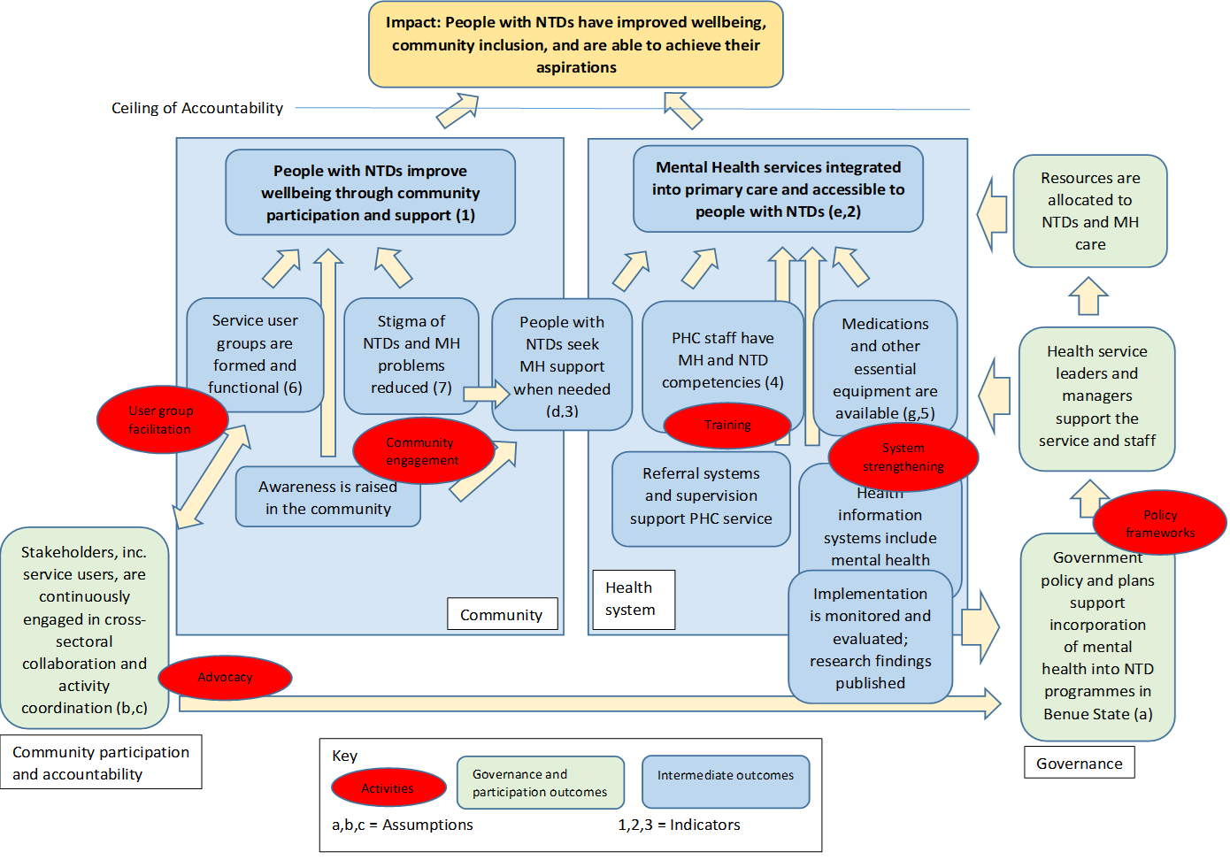
ToC from the MindSkinLink project, Nigeria

Slide 4
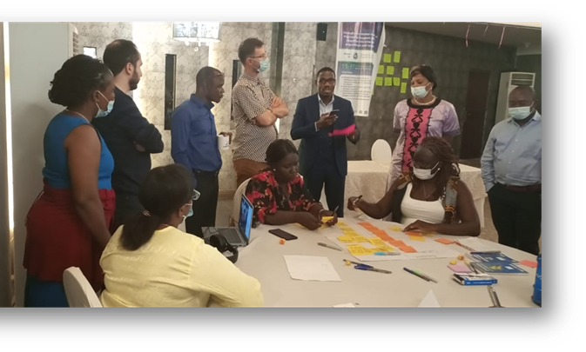
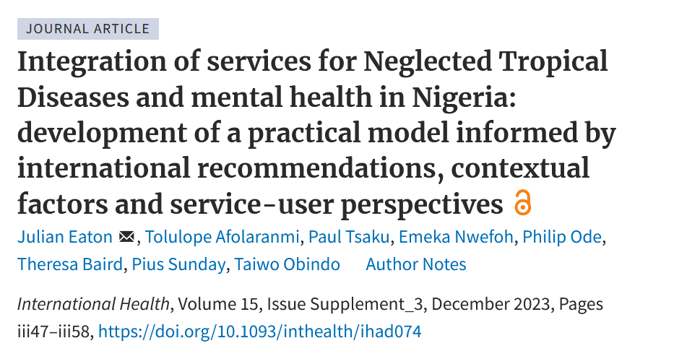
Systematising collaborative approaches to knowledge generation
Experts from local communities and health system leaders involved at all stages
People with lived experience (later) acknowledged as part of this process
Theory of Change incorporating local expertise, evidence and theory
Incorporated into evaluation and research, instrument development, governance, accountability

Slide 5
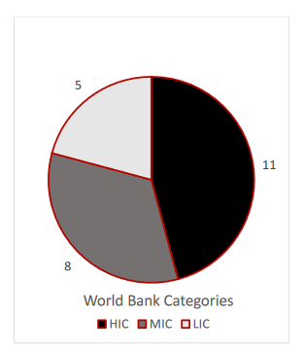
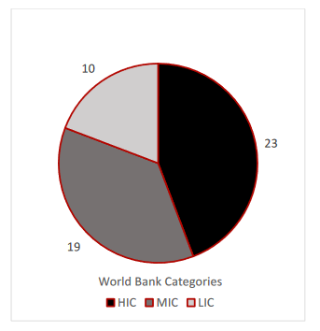
A global balance of perspectives
Significant commitment to global balance, but all clinicians were trained in western psychiatric tradition
Little representation of traditional approaches, but increasingly seen in more community-orientated practice
mhGAP Guidelines Development Group, 2010
Lancet Commission on GMH and sustainable development, 2018
Eaton J. Rebalancing power in global mental health. International Journal of Mental Health. 2019 ; 48(4):288-98.
Notes:
Reflected in thinking at CGMH about international collaborations

Slide 6
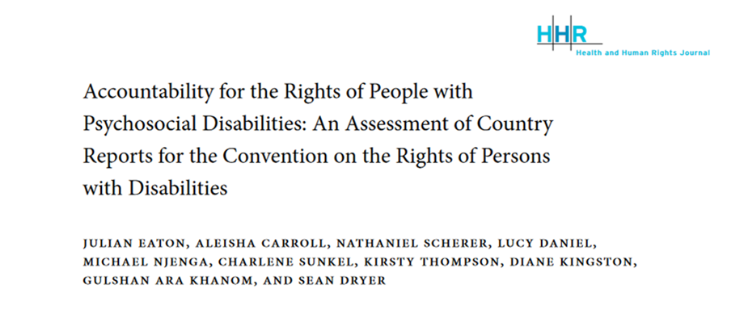
A global balance of perspectives
Ongoing differences in views around models of disability
Improvement in language, eg ‘committed suicide’, ‘disorder’ etc, but a long way to go
Challenges to traditional perspectives around capacity (legal vs mental capacity)
Diagnosis and dimensions addressed in GMH Commission
Notes:
Reflected in thinking at CGMH about international collaborations

Slide 7
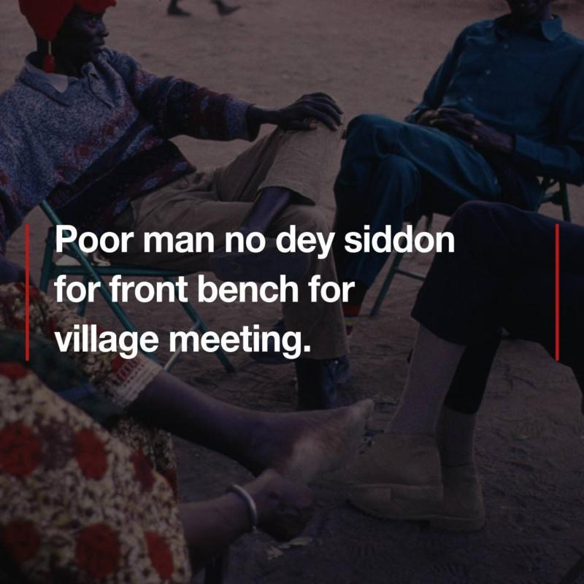
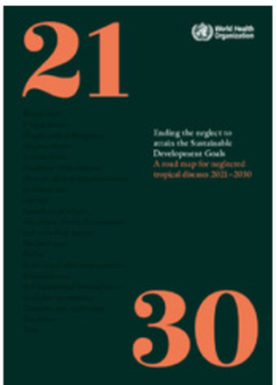


Recognising power imbalances despite formal recognition of co-production as a principle
Semrau M, Lempp H, Keynejad R, et al. Service user and caregiver involvement in mental health system strengthening in low- and middle-income countries: systematic review. BMC health services research 2016; 16: 79. journal article. DOI: 10.1186/s12913-016-1323-8.
Notes:
MH Action Plan, mhGAP, Wellcome Trust all have as central principle
Power dynamics and real problems of tokenism in research, and a situation that has hardly changed in some places
Graham demonstrated how to do it well in his co-leadership of Lancet Stigma Commission with Charlene
New Wellcome Trust programme at Africa CDC includes at all levels

Slide 8


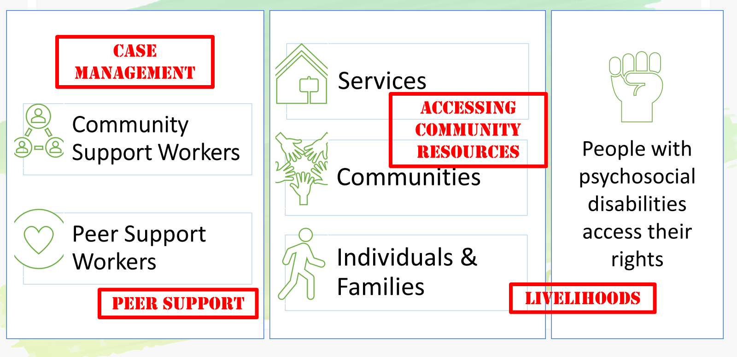


Support, Comprehensive Care and Empowerment for People with Psychosocial Disabilities (SUCCEED Africa)

Slide 9
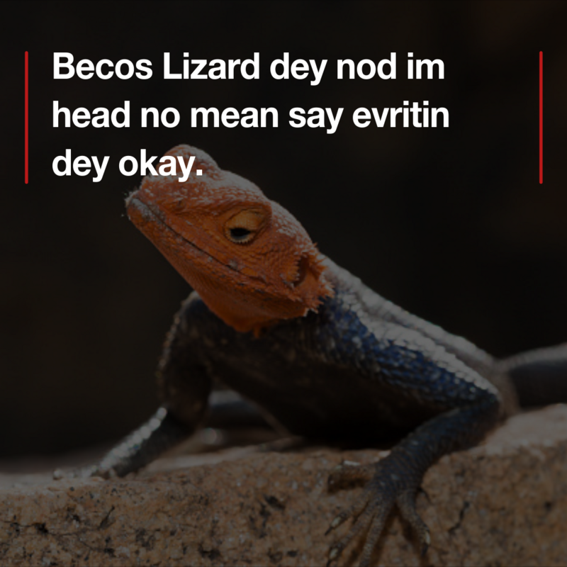
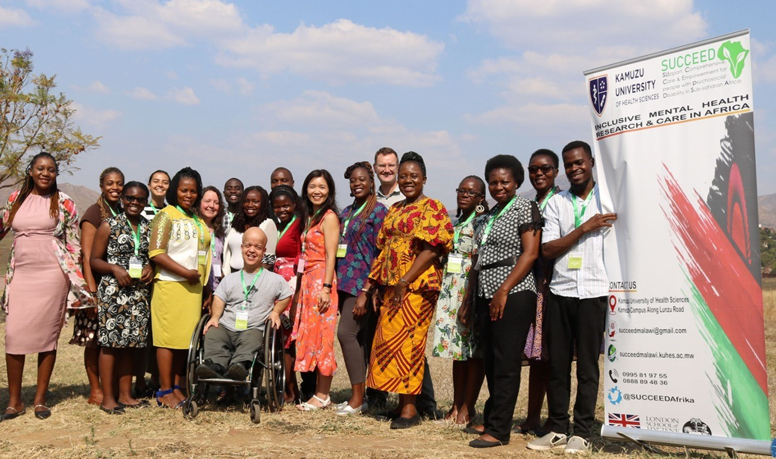
Experiences of co-production in SUCCEED
This material has been funded by UK aid from the UK government; however the views expressed do not necessarily reflect the UK government’s official policies.
Notes:
Hired Peer Researchers, learned together.
Generally positive experience with all team members expressing appreciation and joint learning.
Need to move beyond thanking SUCCEED
Need to balance opps with junior researchers also, fairness in authorship, positive discrimination
Main thing is practical courtesy of being given time to prepare, to have space to speak, occasional reasonable accommodation.
Look out for the MOOC!
Great work of GMHPN in guiding reearchers

Slide 10
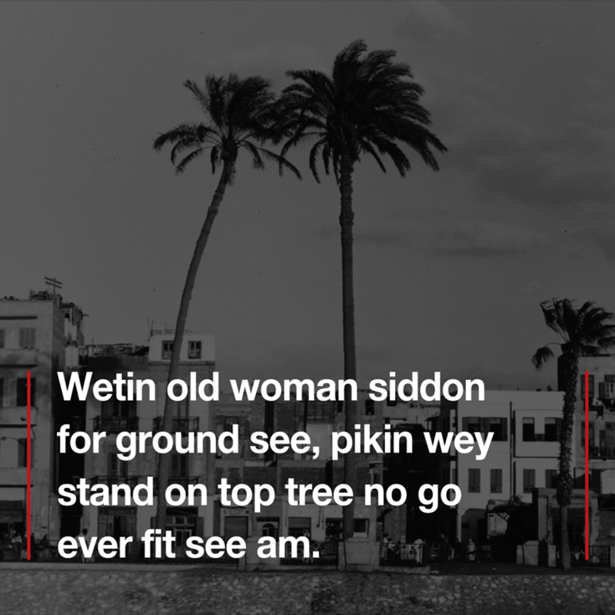
Standing on the shoulders of giants
Notes:
Recognising all that Graham has taught so many of us
Clear demonstration of how we can work collaboratively towards common ends.
Pleasure of working with Graham on mhGAP, Lancet Commission, and many other projects.

Slide 11



Proverbs:
julian.eaton@lshtm.ac.uk
@MHInnovation
www.lshtm.ac.uk/research/centres-projects-groups/succeed

