Slide 1
Integration of Mental Health into Primary Health Care in Nepal
Prof Mark Jordans
Festschrift Conference for Professor Sir Graham Thornicroft Local and Global Mental Health: So Near and So Far
March 2024

Slide 2
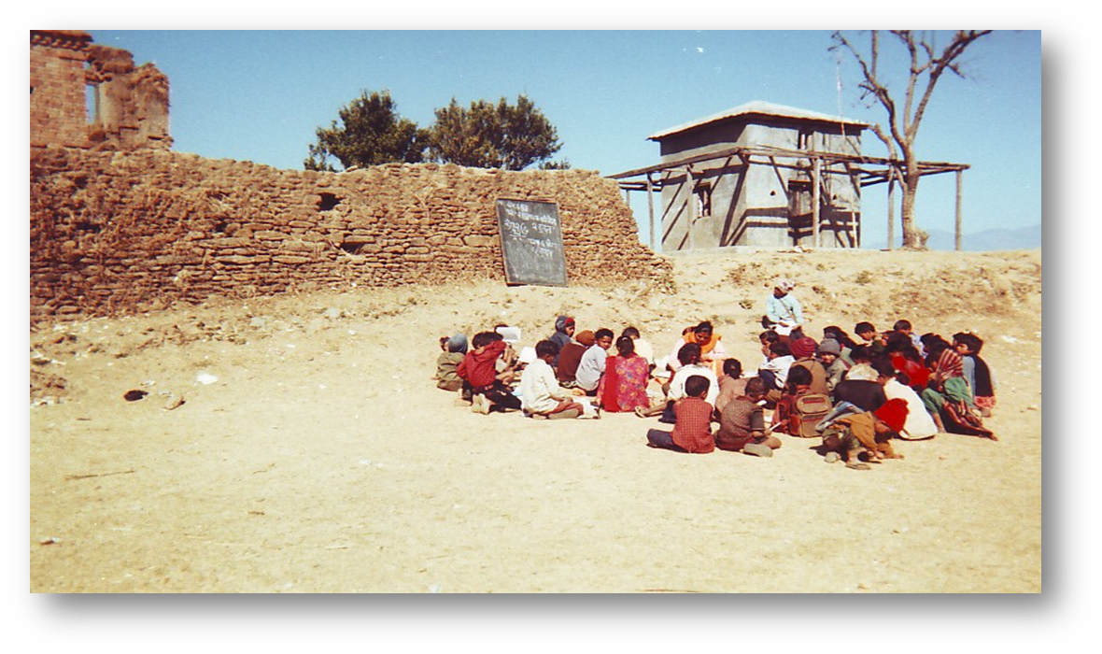
Call for action: reducing the treatment gap by scaling up the coverage of mental health services

Slide 3
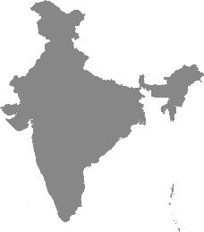
Develop
Implement
Scale Up
ETHIOPIA
SOUTH AFRICA
INDIA
NEPAL
UGANDA

Slide 4
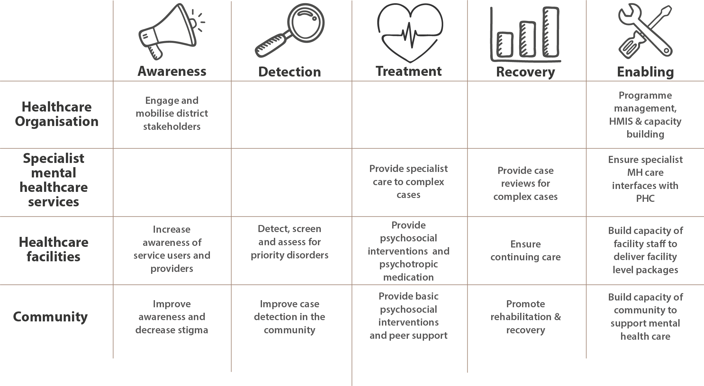
Mental Healthcare Plans
ETHIOPIA
SOUTH AFRICA
INDIA
NEPAL
UGANDA

Slide 5
Guidelines for the integration of mental health into PHC
Detect
Diagnose
Treat
Notes:
Watch video

Slide 6
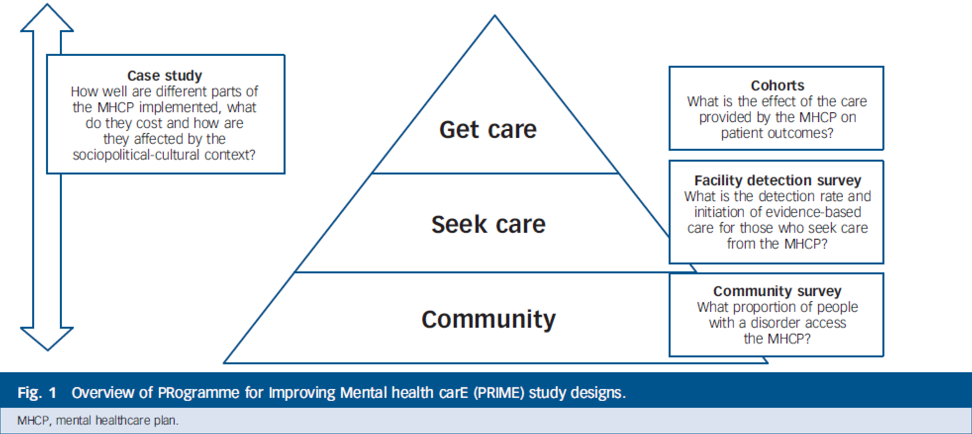
PRIME Evaluation Designs

Slide 7
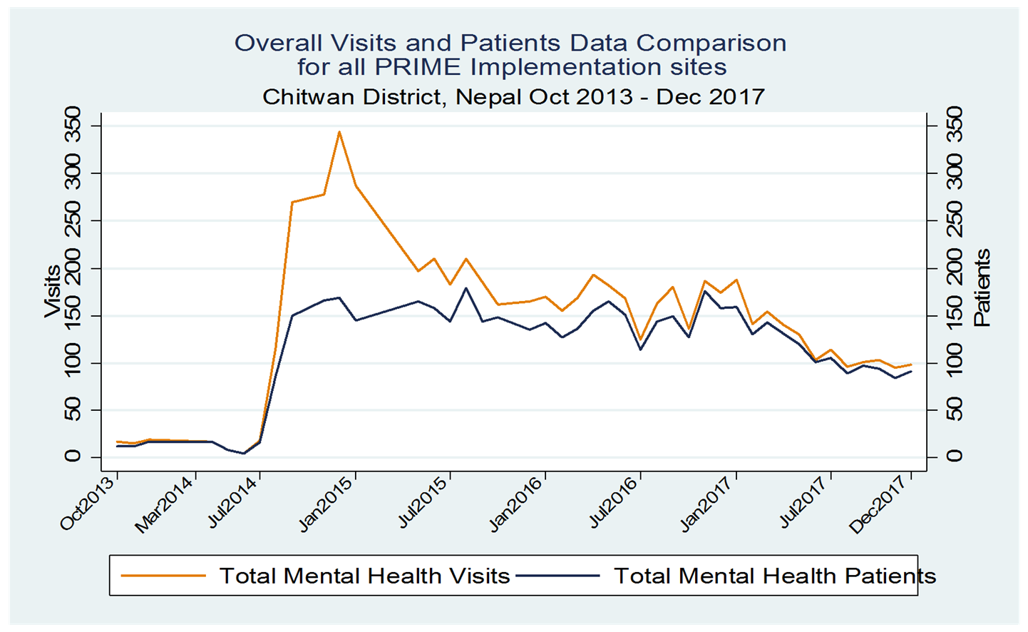
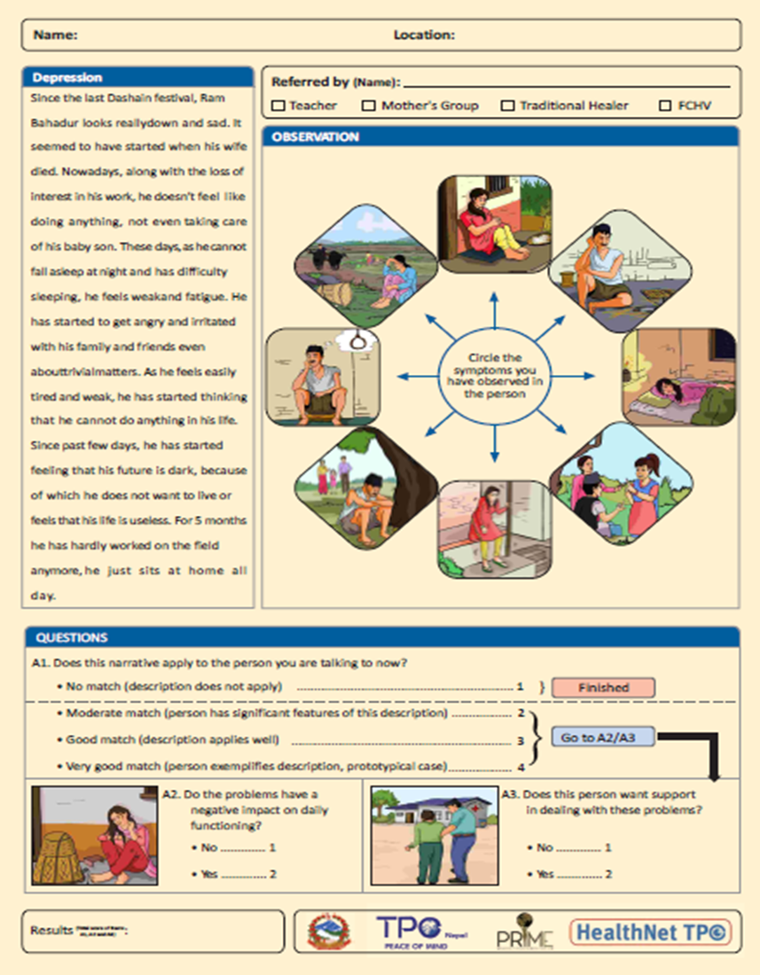
People seeking care

Slide 8
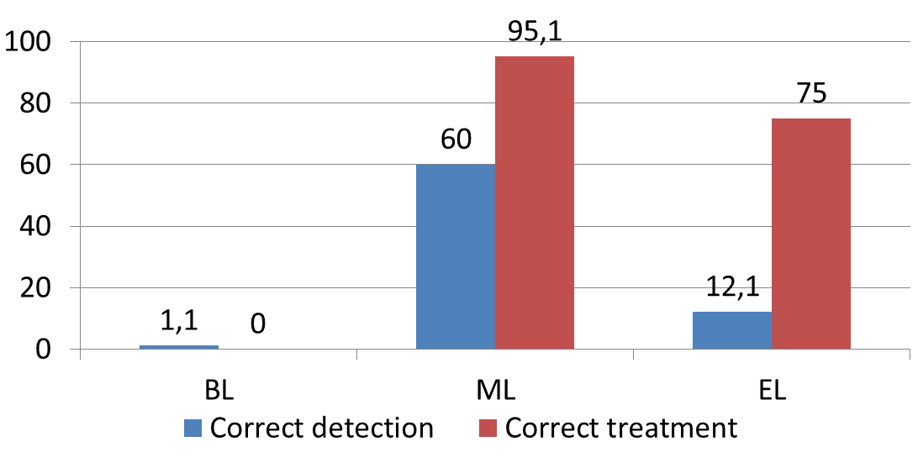
Accuracy of detection and treatment initiation
Sample size
Baseline = 1252
Midline = 1395
End line = 979
Depression
AUD

Slide 9
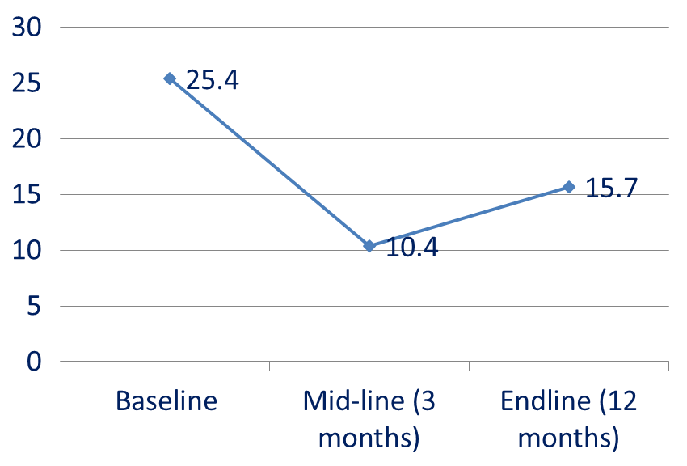
- Depression cohort N= 137 - Psychosis cohort N=95 - AUD cohort N= 175 - Epilepsy cohort N= 42
People benefiting from treatment
Depression symptom severity
AUD symptom severity
Notes:
NOTE: all statistically significant compared to BL.
Similar trends for reduction in impairment in functioning, just not included

Slide 10
Conclusion 1
Promising research results in terms of
Feasibility of implementing the district-level Mental Health Care Plan
Increased uptake of mental health care in PHC clinics
PHC workers show high levels of accurate treatment initiation
Service users show clear benefits after receiving mhGAP-based treatment
Now what?

Slide 11
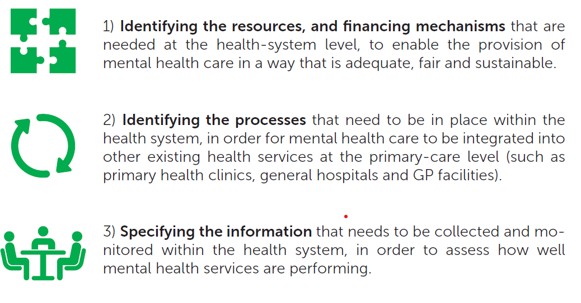
Research to policy
RESEARCH
POLICY

Slide 12
Policy development
Separate mental health unit (under NCD) has been established
Six psychotropic medicines that were used in PRIME has been included in the essential drugs list
Standard treatment protocol (STP) has been developed based on mhGAP intervention guides
Separate budget has been allocated for community mental health

Slide 13
Conclusion 2
Promising research results in terms of
Feasibility of implementing the district-level Mental Health Care Plan
Increased uptake of mental health care in PHC clinics
PHC workers show high levels of accurate treatment initiation
Service users show clear benefits after receiving mhGAP-based treatment
Not so promising results
Low levels of accurate detection of depression and AUD

Slide 14
Reducing stigma amongst health workers
Mental Health Service Users
are trained on stigma-reduction messaging and PhotoVoice
Day 1 Pre-tests Introductions | Day 2 Introduction to psychosocial skills | Day 3 Service user recovery stories, communication skills and role plays | Day 4 Communication skills, Psychoeducation, Stigma didactic session | Day 5 Case management, intro to mhGAP
Day 6 Psychiatric history taking; Service user recovery story | Day 7 Depression; Service user recovery story | Day 8 Psychosis; Service user recovery story; | Day 9 Alcohol use disorder; Service user recovery story; Challenges and Barriers | Day 10 Supervision and post-test
Notes:
This is the curriculum highlighting the areas where service users and aspirational figures are added to an existing mhGAP training curriculum in Nepal.

Slide 15
Standardized mhGAP Training
RESHAPE Training
3 patients per health worker
patients
4 patients per health worker
health facilities
47%
correct
diagnoses
73%
false positives
depression
psychosis
depression
psychosis
Notes:
Then we looked at correct diagnosis by health workers. Compared to 47% of correct diagnosis in the mhGAP arm, there was 73% correct diagnosis in the RESHAPE arm.

Slide 16
Conclusion 3
Integrating mental health into primary health care using mhGAP shows promising results, but for real impact:
Policy change and adoption
Addressing barriers such as stigma, detection
Study of methods and strategies that facilitate the uptake and improve the quality of evidence-based practice

