Slide 1
Metro Charity Talk
Why the Black Lives Matter Campaign is so important now

Slide 2
JO Background:
Long-standing interest in anti-racist and E&D work going back to work in the community/NVS sector as a black activist – local and national work
Social work – AOP, understanding of social movement in driving E&D & Involvement

Slide 3
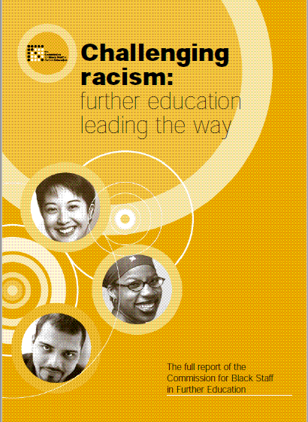

Slide 4
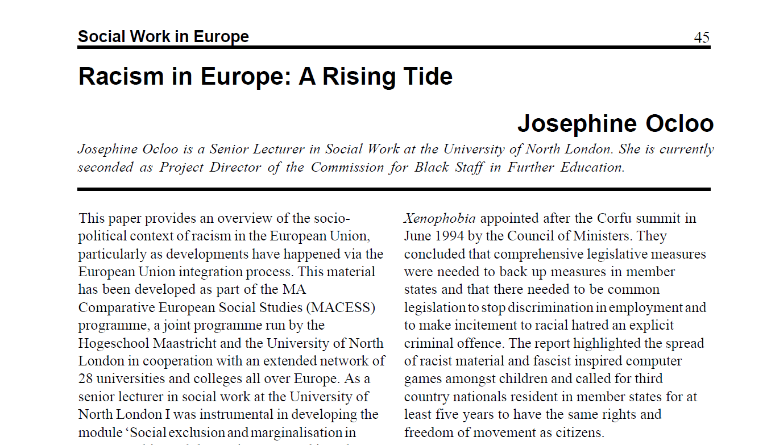
Full article at:

Slide 5
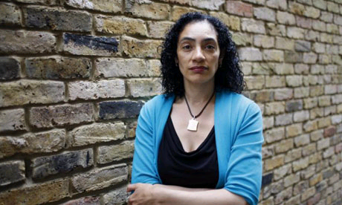
Patient champion- Driven by a personal tragedy, Josephine Ocloo campaigns to give a voice to those who feel they have been wronged by the medical profession and to make healthcare in Britain safer.
Mark Gould reports.
The Guardian
Wednesday June 25, 2008
Josephine Ocloo: "I have lost my child in horrendous circumstances under an organisation that was supposed to be caring for her." Photograph: Teri Pengilley
Notes:
Insider/outsider experiences as a patient champion – but always standing at the back of the bus
I am an harmed patient
activist/researcher (insider/outsider in this area), as I came to this area having experienced a SUI through the death of my child and subsequent cover-up. I went on to do a PhD in patient safety and I am a safety champion at various senior levels
More recently after 21 year campaigning for justice, I stood up at a conference after I decided I was no longer prepared to stand at the back of the bus of the patient safety movement culminating in Jeremy Hunt asking his civil servants to review the evidence in my case. This analogy of standing at the back of the bus has led to me applying this thinking more recently to the experiences of wider groups of BAME people in patient safety

Slide 6
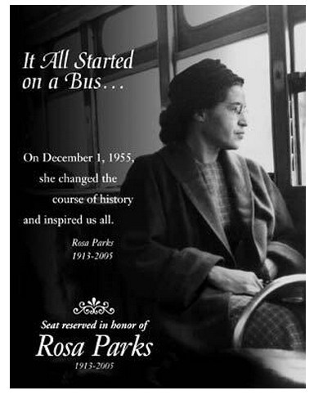

Slide 7
Published Papers on PPI in Patient Safety & Quality:
Ocloo, J, Goodrich, J, Tanaka, H, Birchall-Searle, J, Dawson, D, Farr, M. The importance of power, context and agency in improving patient experience through a patient and family centred care approach. Health Research Policy and Systems. 2020.18:10.
Ocloo, J & Matthews, R. From tokenism to empowerment: progressing patient and public involvement in healthcare improvement. BMJ Qual Saf 2016 0:1–7.
Ocloo, J (2013) How FT governors can improve patient safety. London Health Service Journal.
Ocloo, J.; O’Shea, A.; Fulop, N. (2013) Empowerment or Rhetoric?: Investigating the role of NHS Foundation Trust Governors in the governance of patient safety Health Policy: Vol 111(3):301-310
Ocloo, J. & Fulop, N. (2011) Developing a 'Critical' Approach to Patient and Public Involvement in Patient Safety in the NHS: Learning Lessons from other parts of the Public Sector? Health Expectations June 2011.
Ocloo, J. (2011) 'Broadening the Patient Safety Movement: Listening, Involving & Learning from Patients & the Public'. In Rowley, C.A. & Waring, J. (eds) Socio-Cultural Perspectives on Patient Safety. Surrey: Ashgate publishing
Ocloo, J. (2010) Harmed patients gaining voice: Challenging dominant perspectives in the construction of medical harm and patient safety reform. Social Science & Medicine. 71, 510-516.
Notes:
All of my work has focussed on using action research or participatory approaches

Slide 8
ARC South London
We are a research organisation that brings together researchers, health and social care practitioners, and local people to improve health and social care in south London

Slide 9
The core members of the NIHR ARC South London collaboration are:
NHS Foundation Trusts:
King’s College Hospital NHS Foundation Trust (host trust)
Guy’s and St Thomas' NHS Foundation Trust
South London and Maudsley NHS Foundation Trust
St George's University Hospitals NHS Foundation Trust
Academic networks:
Health Innovation Network (Academic Health Science Network for south London)
King’s Health Partners (Academic Health Science Centre for south London)
Universities:
King’s College London
Kingston University
St George's, University of London
We also work with a range of local and national charities, health commissioners, local authorities, and community organisations in south London.

Slide 10
ARC South London has seven core areas of research. They are:
alcohol – tackling the impact on public health from harmful drinking
children and young people – improving care for children with complex needs and disabilities
maternity and perinatal mental health – addressing health inequities among women from vulnerable groups
palliative and end of life care – improving the quality, availability and cost-effectiveness of palliative care
patient and public involvement (PPI) research – understanding and strengthening PPI practice in health and social care
public health and multimorbidity – understanding and developing interventions to address multimorbidity
social care – understanding the value of day services for people with multiple complex conditions.

Slide 11
ARC South London has seven core areas of research. They are:
alcohol – tackling the impact on public health from harmful drinking
children and young people – improving care for children with complex needs and disabilities
maternity and perinatal mental health – addressing health inequities among women from vulnerable groups
palliative and end of life care – improving the quality, availability and cost-effectiveness of palliative care
patient and public involvement (PPI) research – understanding and strengthening PPI practice in health and social care
public health and multimorbidity – understanding and developing interventions to address multimorbidity
social care – understanding the value of day services for people with multiple complex conditions.

Slide 12
Current Research Involvement:
Current sit on the MH Equalities Taskforce/PCREF at NHS England & NHS Improvement
Mental Health – loneliness/isolation in the pandemic
Needs/Services for those with Complex Emotional needs linked to PD
Developing a broader patient harm definition in patient safety
Grant – Ethnic inequalities in mortality and service use in people with mental disorders and multimorbidities during the COVID-19 pandemic: Mixed methods study
Notes:
Participatory methods

Slide 13
Covid-19 Mortality in the UK
Stark disparities in mortality rates/health inequalities for particular groups: e.g. BAME communities, disabled people, those on lower incomes, those living in the most deprived areas, care home residents, and those in the poorest health etc. These groups already face considerable inequalities in health which may now get much worse.
People from a black ethnic background are at the greatest risk of death involving Covid-19 than all other ethnic groups. black men 3 times more likely than white men to die & black women more than twice as likely to die as white women (ONS June 2020).
Adjusting for socio-economic factors/geographical location, partially explains the increased risk, but there still remains twice the risk for black males after this & around one & half times more risk for black females (ONS June 2020).
South Asian people were the most likely group to die from Covid-19 after being admitted to hospital across the UK – with diabetes a significant factor.
Notes:
More generally, patterns of Covid-19 related death concerning geography and social deprivation also show some striking inequalities. For the week ending 18th April in England and Wales, when adjusting for size and age structure of the population, there were 36.2 deaths involving COVID-19 per 100,000 people. However, the age-standardised mortality rate of deaths involving COVID-19 in the most deprived areas of England was 55.1 deaths per 100,000 population compared with 25.3 deaths per 100,000 of the population in the least deprived areas. In Wales, the most deprived areas had a mortality rate for deaths involving COVID-19 of 44.6 deaths per 100,000 population, almost twice as high as the least deprived area of 23.2 deaths per 100,000 population[ONS 1st May 2020]..

Slide 14
Institutional Racism
Black people have long been more likely to enter mental health services through emergency/criminal justice systems, more likely to be in psychiatric intensive/medium secure units, more likely to be secluded/physically restrained.
Racially based social/economic disadvantages are at the root of ethnic differences
Forensic psychiatry is seen as the area racial injustices are most acutely felt. ‘complex, coercive & adverse pathways, into, through & out of mental healthcare faced by black people, with poorer access to effective interventions/poorer outcomes’.
In considering the implications of psychiatric diagnosis & (often aggressive) treatment for the life-course of the patient, Nazroo asks does the maxim of ‘Do no harm’ actually hold?”
[Nazroo 2015 & 17]

Slide 15
BAME Women & Maternity
Black women have more than five times the risk of dying in pregnancy or up to six weeks postpartum compared to white women, women of mixed ethnicity three times the risk and Asian women almost twice the risk (MBRRACE-UK 2019).
Mortality rates also remain high for Black or Black British and Asian or Asian British babies. Whilst stillbirth rates for these groups have reduced over the period 2015 to 2017, conversely neonatal mortality rates have increased over the same period (MBRRACE Perinatal Mortality Report 2019).

Slide 16
Community Zoom event:
Pregnant women facing fear/isolation: Concerns raised by Doulas, about verbal/ emotional abuse of some BAME women perceived to be driven by racist attitudes*
BAME groups with higher risks from the virus, fearful of attending outpatients/hospital with other symptoms/going to get medication/blood tests/high levels of distrust in health system
People with disabilities/learning difficulties worried about discrimination/whether they would be treated fairly in terms of access to resources/ventilators
Digital exclusion preventing many vulnerable people accessing primary care/benefits
Loss of face-to-face services/detrimental impact on MHSU’s: e.g. /BAME/LGBT+ groups have higher rates of poor MH/worse access, closure of services have a particular impact
Notes:
We held a zoom event at very short notice for groups across the protected characteristics: [age, disability, gender reassignment, race, religion or belief, sex, sexual orientation, marriage and civil partnership and pregnancy and maternity], as covered under the Equality Act 2010. This showed that diverse groups want to be involved and the issue to address is about structural barriers to inclusions
2. Black women are currently 5 times more likely than White women to die in childbirth

Slide 17
Being heard, not, “seldom heard”: democratising research with diverse communities during the Covid-19 pandemic.
Opening up a broader debate about democratising the whole research process, rather than just D&I in PPI, which is much narrower.
Debates in GHR talk about moving away from semi-colonial approaches which serve the interests of populations in high income countries/the need to have more equitable research partnership addressing high mortality/morbidity rates in poor/ middle income countries.
These debates raise questions about democratising research in the UK, particularly in the pandemic & about who benefits from research/how it addresses the needs of groups facing the worst health inequalities.

Slide 18
Key Points from BMJ Piece
Groups facing the worst inequalities often the least likely to be involved in the design/implementation of research. This reflects wider patterns of public sector involvement which show that those most likely to be involved are older, from white ethnic groups, and higher socio-economic backgrounds.
This context exists despite long-standing calls for more equal partnership models to involve diverse groups in research and healthcare practice.
Need for more participatory/co-produced and action research types methodologies in research

Slide 19
Developing D&I in ARC South London Work:
Making D&I a standing item on all boards and committees.
Adding D&I to the terms of reference of boards/committees.
Exploring how broader community representation of individuals/groups can be achieved on ARC boards/committees.
Ensuring all projects include considerations of D&I.
Ensure all themes (main/cross-cutting) complete D&I Achievement Logs (to identify good practice/areas of improvement/monitor progress].
Further thought should be given to addressing issues of under-representation of research participants in research themes, especially from BAME, disability and LGBTQ+ groups.
Exploring how staff from under-represented groups are able to input at a strategic level into the work of the ARC.
Notes:
How can we democratise research spaces so a wider group of the public/researchers can co-produce research?
How can local diverse communities be represented/EDI addressed in research institutions/structures?
What are the best ways for research groups to be inclusive in recruit diverse participants in research?

