Slide 1
Contingency management to incentivise treatment in alcohol-related liver disease
Reducing the harm caused by alcohol – ARC South London research symposium
Sofia Hemrage
Prof Colin Drummond
Dr Paolo Deluca
Dr Stephen Parkin
This PhD is supported by the National Institute for Health Research (NIHR) Applied Research Collaboration South London (NIHR ARC South London) at King's College Hospital NHS Foundation Trust. The views expressed are those of the author[s] and not necessarily those of the NIHR.

Slide 2
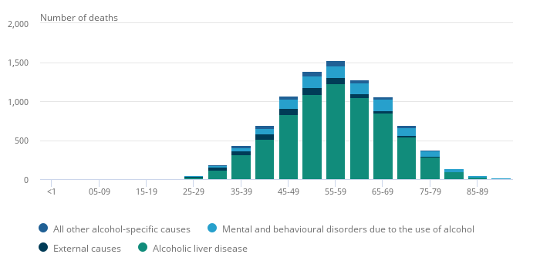
Alcohol-related liver disease (ARLD)
78% of deaths due to ARLD (2021)
Health inequalities

Slide 3
ARLD and treatment
Few ARLD patients attend treatment and community alcohol services
Mostly leading to re-admission or death
Discharge and referral to community alcohol treatment services
Patient admitted to hospital with liver episode
Does not attend treatment
Relapse and re-admission

Slide 4
Which therapies help reduce alcohol harm in patients diagnosed with ARLD?

Slide 5
Contingency management to incentivise treatment
Behavioural technique to motivate a positive behaviour change
Rewards include shopping vouchers
Ethically approved by the Department of Health and Social Care
Successful in studies including opioid use and alcohol dependence
Cost-effective

Slide 6
Research design
Planned with Patient and Public Involvement (PPI)
In collaboration with the Alcohol Care Team, King’s College Hospital
Patient admitted after liver episode
Study enrolment
Integrated care offered over 3 months (standard treatment)
Addiction care | Liver care | Talking therapies
Contingency management for attending services
+
Follow-up

Slide 7
Aims
Acceptability
Treatment experience
Views, perceptions
Feasibility
Reasons for engagement/non-engagement
Inform implementation into standard treatment
Plan a future, larger study

